Slide 1
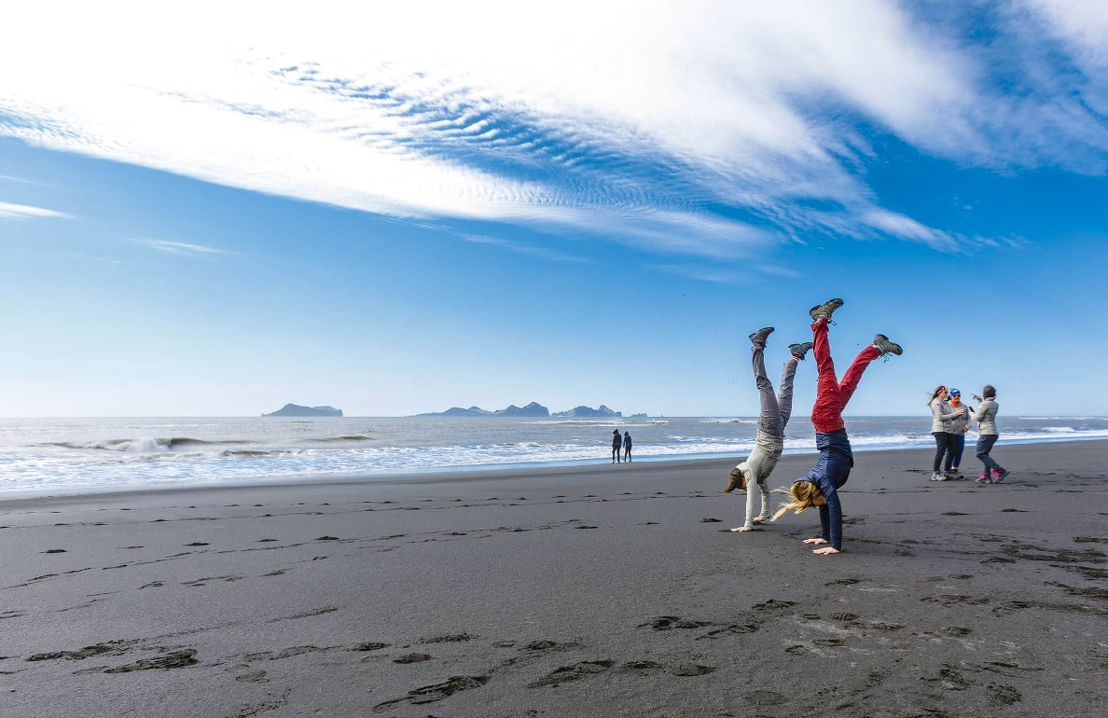

Photo Credit: https://midgardbasecamp.is/
Module 2 (Part 1)
Market Research & Business Planning (Your Alternative Accommodation Business) ​
www.epicstays.eu

Slide 2

Module 2 (Part 1)
Photo Credit:
Section 1:
Tools for Market Research. Understanding the Market - Your Guest & What They Want?
Section 2:
Defining Your Concept & Value Proposition
2

Slide 3



02
Photo Credit: Cave People, Iceland
Page 5
Photo Credit: Natur Air Suite, Italy
Module 2
Overview
CONTENTS
01
03
Page 0
Page 6
Introduction to Market Research & Business Planning
Learning Objective for all three sections of this module
Photo Credit:
A-Frame in Soča, Gorizia, Slovenia

Slide 4
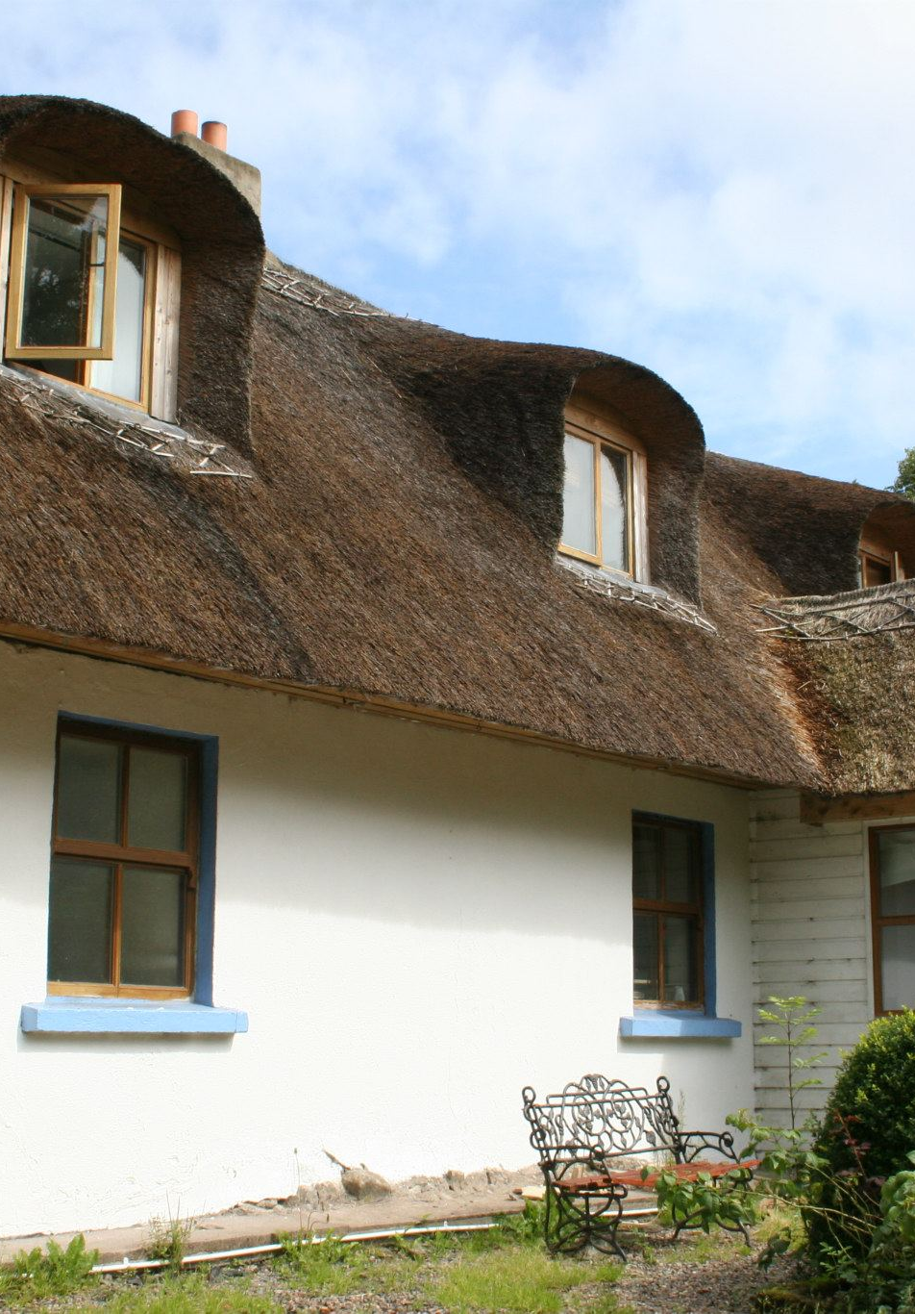

04
Page 8
Photo Credit: Teapot Lane, Leitrim, Ireland
Section 1
Tools for Market Research – Understanding
the Market
CONTENTS
05
Page 31
Section 2
Defining Your Concept & Value Proposition
Photo Credit: Church Blönduós, Iceland

Slide 5
Module 2 Overview
Learning Outcomes
01
Tools for Market Research – Understanding the Market
This module explores how to turn your unique accommodation idea into a real business opportunity. Learners will gain practical skills to understand their guests better, research the market, develop a strong concept, and present it with confidence.
The journey begins with market research, introducing simple and effective tools to gather reliable insights about who your guests are, what they want, and what is already available in the local area.
Apply practical methods to gather reliable insights into their local tourism market.
Use simple and effective research techniques to collect and interpret guest-related data.
Conduct market research to identify target guests and their needs.
Utilise guest-centred tools to analyse who is (or could be) visiting the area, what motivates them, and where accommodation supply gaps exist.

Slide 6
Module 2 Overview
Learning Outcomes
Defining Your Concept &
Value Proposition
02
From Section 1, learners will then begin to focus on Section 2 which covers concept development, using research findings to shape a distinct idea and define a strong value proposition — clarifying why guests should choose their accommodation.
Through the Pitch Deck method, participants will also learn how to communicate their idea professionally and test it for funding or collaboration.
Translate market research findings into a clear and compelling business idea using the Pitch Deck method.
Identify the qualities of a strong concept and define a value proposition that highlights why guests would choose their accommodation.
Develop a distinct concept and value proposition for their business.
Create a short pitch deck to test the idea for funding or collaboration opportunities.
Communicate your value proposition clearly to both guests and partners.

Slide 7
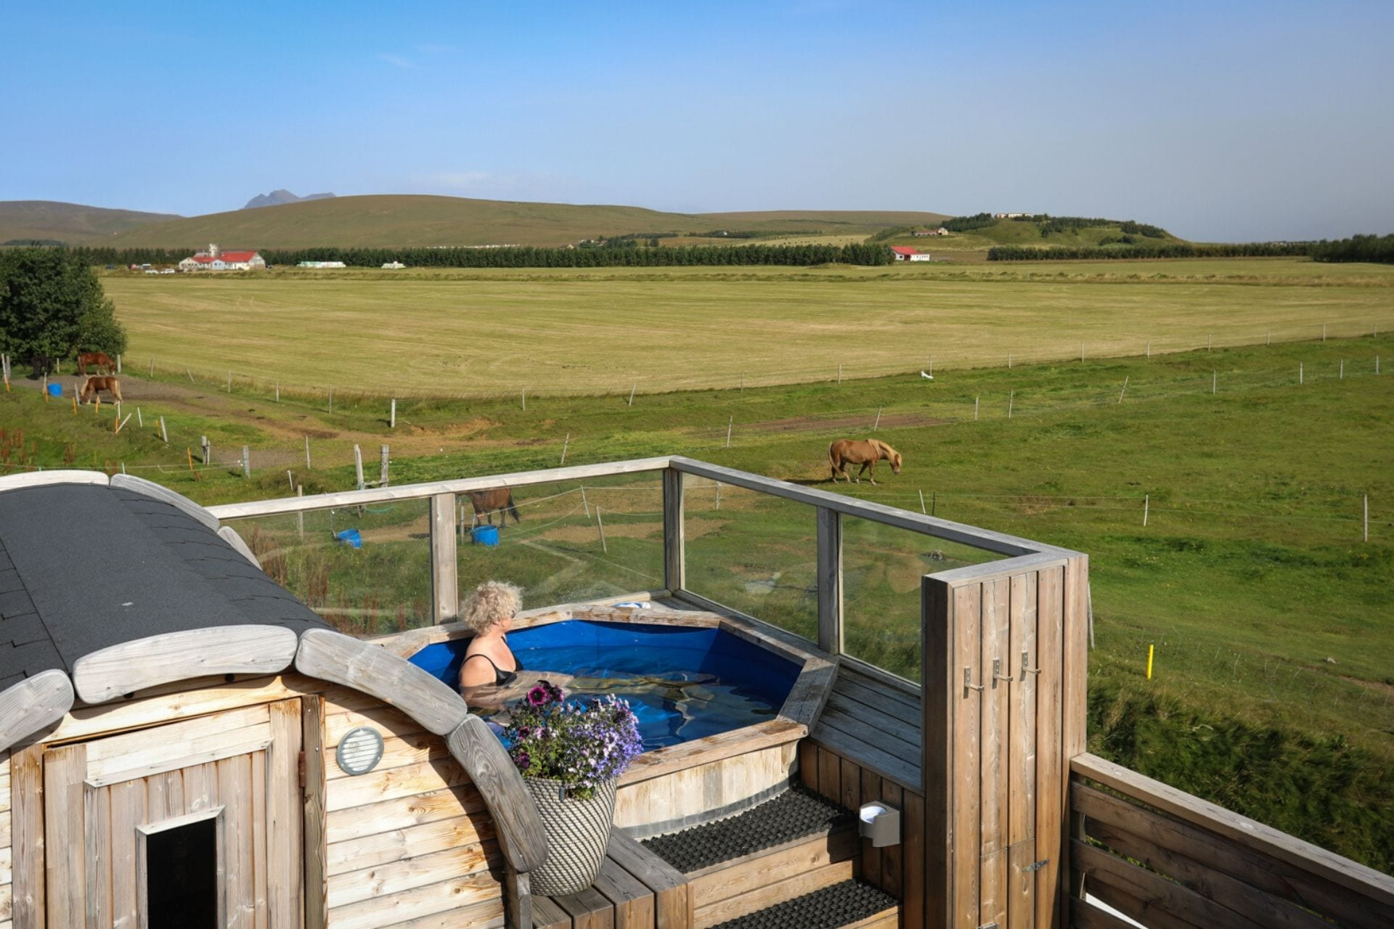
Section 1
Photo Credit: Midgard, Iceland
Tools for Market Research – Understanding
the Market
“You can’t design the perfect stay if you don't know who is knocking on the door “

Slide 8

Section 1
Tools for Market Research
– Understanding
the Market
Overview:
To achieve this, you need to understand the importance of market research. This section introduces you to practical methods for gathering reliable insights about your local tourism market. It covers key research techniques that help you create a viable business. It encourages you to undertake market research for your tourism product and in that process learn how to document findings and look for patterns, such as: What kinds of guests visit (or could visit)? About customer feedback: How to find out what your guests like and what the do not like?
Understanding Who Your Guests Are and What They Want Is Essential For Long-term Success.
8

Slide 9
Section 1: 3 Key Learning Areas
01
Understanding What Kind of Guests Visit (or Could Visit)
02
Customer Feedback:
How to find out what your guests like and what the do not like? Learn to collect customer feedback in a simple way and use that to improve your accommodation business.

Slide 10
Section 1: 3 Key Learning Areas
03
Practical Methods for Gathering Reliable Insights
Understand how to gather insights into your local tourism market and learn from other tourism businesses.

Slide 11
Understanding What Kind Of Guests Visit
(or could visit)
01
Key Learning Area
Your guests are the key ingredient in your business, without guests there is no business. Therefore it is vital to be able to understand what kind of guests visit you. What are the looking for? What are their likes and dislikes? This section equips you to understand the guests need and how your business can fulfill those.
You’ll explore different methods that give you the insights and the knowledge needed to start document your guest´s profile. By doing that you will start to gain valuable insights into what kind of guests could visit you and thus strengthen your alternative accommodation business.
11

Slide 12
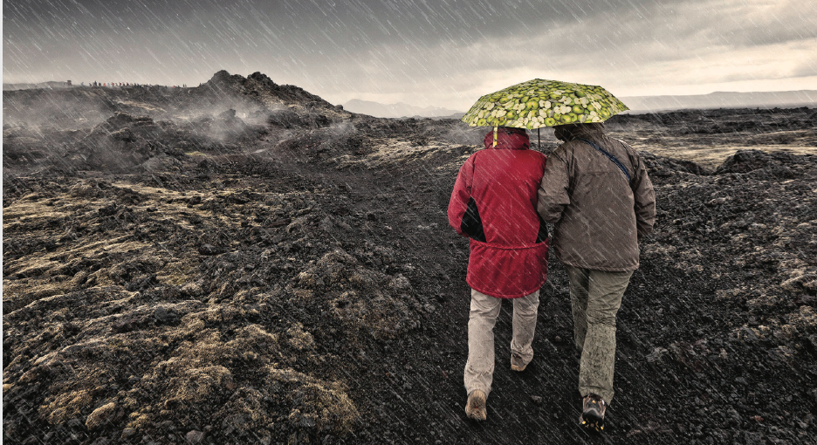
Understanding What Kind of Guests Visit (or could visit)
Photo credit:
Einstök íslensk upplifun: Vegur til vaxtar. Nýsköpunarmiðstöð Íslands /
Unique Icelandic Experience: Road to Growth. Iceland´s Innovation Centre
Asking the Right Questions
Who is our guest?
Can you describe them?
What kind of guest to I get?
What kind do I prefer to get?
What stories can I tell to catch„ my type“ of guest?
12

Slide 13
Understanding What Kind of Guests Visit (Or Could Visit)
Target Groups and Your Story
Regional or national tourism agencies regularly create target group analysis and presented what they feel are the most appropriate guest for that specific region or country.
It can give your business a valuable insight into the kind of guest you are hosting and the type you might host. The pictures give an example from Business Iceland of the type of guests Iceland could be looking for.
Photo credit:
https://www.islandsstofa.is/afangastadurinn/markhopar-afangastadarins

Slide 14
Understanding What Kind of Guests Visit (Or Could Visit)
Target Groups and Your Story
If you describe your guest, the target group that buys your tourism product, what would that description look like?
The more you know your guest the better you are going to be able to create a tourism product your guest wants to buy. The picture give an example from Business Iceland of the type of guests Iceland could be looking for.
Photo credit:
https://www.islandsstofa.is/afangastadurinn/markhopar-afangastadarins

Slide 15
Customer Feedback: How to Find Out What Your Guests Like and What They Do Not Like?
02
Key Learning Area
To be able to know how to collect customer feedback you need to understand the basics of what customer feedback is. Customer feedback is the information or opinions your customers provide about your product or service. These can be positive, highlighting what you're doing well, or negative, pointing out areas for improvement.
Why is this important? Customer feedback is the key to business success. It gives insight into what customers need, prefer, and want to avoid. When taken seriously, it can help you make the right decisions to improve your business and give your customers exactly what they want.
Source: https://miro.com/research-and-design/collecting-customer-feedback-methods/
15

Slide 16
Customer Feedback – Various Forms
How to Find Out What Your Guests Like and What They Do Not Like?
What is customer feedback? It can come in various forms, direct, indirect and inferred:
Direct feedback is when customers directly communicate with you about their experiences. This can be through emails, phone calls, or even face-to-face interactions.
Indirect feedback is a little more subtle. It's not communicated directly to you, but you may find it on social media, review websites, or in conversation with others.
Inferred feedback is the most subtle of all. It's derived from analysing customer behaviour data, like website browsing patterns, purchase habits, or usage statistics.
16

Slide 17
Customer Feedback - How To Gather Feedback
How to Find Out What Your Guests Like and What They Do Not Like?
Methods for collecting customer feedback:
Surveys
Interviews
Focus groups
Usability tests
Feedback boxes, suggestion forms, and contact forms on website
Social media listening
Analyzing customer support tickes
Review platforms
Key areas where you might gather feedback include your product's functionality, the quality of your service, or the overall customer experience. Understanding these components can make a huge difference in your business.
How to collecting this important feedback? There are several methods available, each with its benefits and ideal applications. Here are some of the most popular ones:
17

Slide 18
Customer Feedback - How To Gather Feedback
How to Find Out What Your Guests Like and What They Do Not Like?
Surveys
Surveys are an excellent method for collecting customer feedback. They're easy to distribute, scale, and analyse. You can use different types of surveys depending on your needs, such as Customer Satisfaction (CSAT), Net Promoter Score (NPS), and Customer Effort Score (CES). Designing effective surveys requires clear, concise questions that are easy to understand and answer.
Interviews
One-on-one interviews allow for a more in-depth understanding of your customer's experiences. You can ask follow-up questions, delve deeper into responses, and observe non-verbal cues. The key to a good customer interview is preparation and active listening.
18

Slide 19
Customer Feedback - How To Gather Feedback
How to Find Out What Your Guests Like and What They Do Not Like?
Focus Groups
Focus groups involve customers discussing their experiences, perceptions, and opinions about your product or service. Moderating focus groups effectively requires careful planning, creating a comfortable environment, and guiding the conversation productively.
Usability Tests
Usability tests involve observing customers
using your product to understand how easy and intuitive it is to use. Remember to clearly define tasks, encourage participants to think out loud, and observe quietly.
Feedback Boxes, Suggestion Forms, and Contact Forms on the Website
These methods allow customers to provide feedback at their own convenience. Ensure these are easy to find on your website, simple to use, and promote open-ended feedback.
19

Slide 20
Customer Feedback - How To Gather Feedback
How to Find Out What Your Guests Like and What They Do Not Like?
Social Media Listening
Customers often share opinions on social media. Using social media listening tools can help you find and track these conversations, allowing you to respond to feedback and observe common trends.
Analyzing Customer
Support Tickets
Support tickets can provide valuable feedback about the problems customers are experiencing. Regularly review and analyze these tickets to identify common issues or trends.
Review Platforms
Online review platforms are a goldmine of customer feedback. Responding professionally and appreciatively to both positive and negative reviews shows your commitment to customer satisfaction.
20

Slide 21
Practical Methods for Gathering Reliable Insights
03
Key Learning Area
Understand how to gather insights into your local tourism
market and learn from other tourism businesses. Networking plays a vital role here. Networking refers to learning through groups of people. It can be local businesses who are in the same sector as you or simply run a business and also need to learn about their customers. Therefore, sharing experiences and stories with like-minded people can be a simple but powerful
way of gaining reliable insights
Networking can mean joining a local business association and learn through in-person meetings, field trips to like-minded businesses, attending meetings, conferences or incubators. It can also mean being a member of a regional or national association where knowledge and practical methods is widely shared.
21

Slide 22
Practical Methods for Gathering Reliable Insights
Type Of Networking - Business to Business (B2B) and Business to Consumer (B2C)
Networking:
Through different methods, you can share experiences and stories with like-minded people and gain insights (B2B).
Learning from other tourism businesses (B2B) – in your region, through your travels, through your guests’ experiences (B2C) at other tourism businesses.
Learning from businesses in other sectors – picking up best practices (B2B).
Join a local business association and learn through in-person meetings, field trips with and to like-minded businesses, attend meetings, conferences or be a part of business incubators (B2B).
Be a member of a regional and/or national tourism/accommodation association where knowledge and practical methods are widely shared (B2B).
22

Slide 23
Practical Methods for Gathering Reliable Insights
Example Of A Local Network - Business To Business (B2B)
An example for a small alternative accommodation business that provides breakfast and dinner alongside the accommodation. This is a list of different stakeholders your companies can benefit from reaching out to:
Local Food Association, Tourism Clusters (can be both regional and national), Representatives from tourism within the local municipality.
Destination Marketing Organisations (DMO´s), Local Food Brand (e.g. Seafood Trail including restaurants and producers), managers and staff at the major attractions in your area (exhibitions, museums, restaurants etc.)
Main domestic sale organisations (Travel Agencies, Bus companies, Cruise ship agents, Tour guides that regularly visit the area)
Foreign sale organisations that focus on your region (Travel Agencies that e.g. participate in nationwide or Europe wide sales conferences, e.g. ITB Berlin)
23

Slide 24
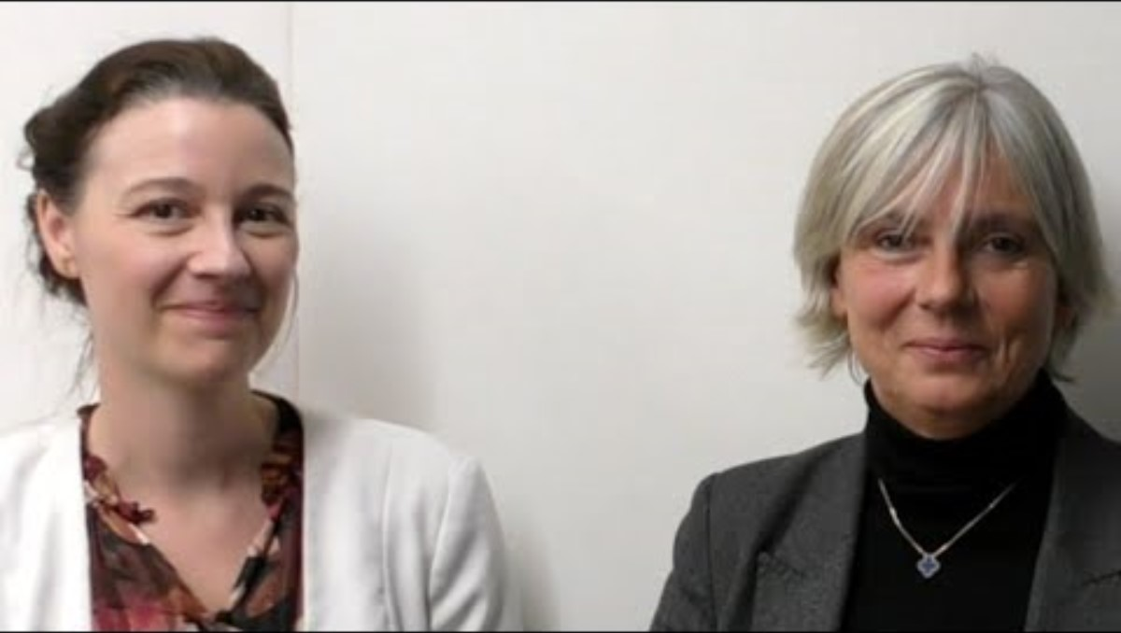
Experience the
New Glamping - Interview with Huttopia
Click to Watch Video
Name:
Come and be Inspired by Iceland
Description:
6-min sit-down with Huttopia co-founder Céline Bossanne and global sales & marketing chief Amélia Brouhard. They explain how they segment guests (urban families vs. digital nomads), the storytelling they use to activate each persona, and why every site’s marketing starts with “listen to local needs first.”
Apply to Topic Market Research:
Applies to the “Target group and your story”.
The duo spell out their research loop:
guest surveys
persona boards
test campaigns
and how that shapes product tweaks.
Link: https://www.youtube.com/watch?v=lq5Y5Ca0HYo
Photo Credit: Insider Travel Report / Huttopia
24

Slide 25

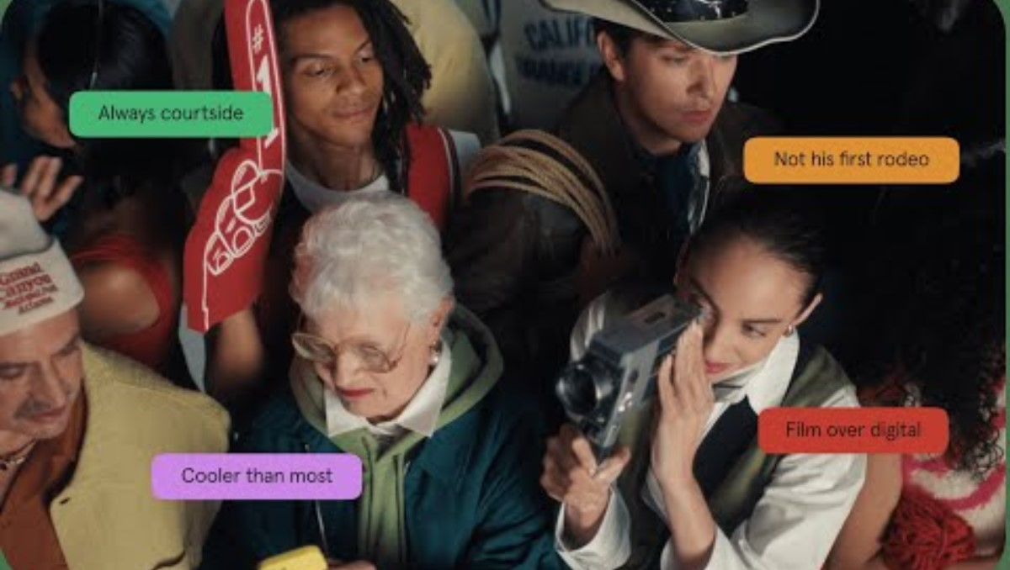
Digital Tool: Typeform
“Gather Fresh Insights Direct from Guests”
https://destinationinsights.withgoogle.com/
Build Insightful Surveys
FastDrag-and-drop a 5-question Travel Persona form and publish in under 10 minutes.
Embed During Booking Flow
Show the first question inside your confirmation email so guests share their motives before arrival.
Visualize Results Instantly
Live bar-/pie-charts auto-update; export PNGs or push to Google Sheets for your Business Model Canvas. Tip: keep it to ≤ 6 questions to maintain >50 % completion.
Click to Watch Video

Slide 26

Practical Exercise: Guest Profiling 101
This exercise helps you identify your ideal guest by mapping who they are, what drives them, and how they travel.
Work through the three data buckets below and record insights you can test later against your business ideas.
1. Demographics
Age ranges (e.g., 25–34, 35–54)
Country/region of origin (e.g., Germany, USA, UK, Nordics)
Travel party (e.g. solo, couples, families, small groups)
26

Slide 27
Practical Exercise: Guest Profiling 101
3. Trip Patterns
Season (e.g. peak summer vs. winter Northern Lights)
Length of stay: e.g. 1 night, 2–5 nights, week or more?)
Spend per night: €80–120 (budget), €150–250 (mid), ≥€300 (premium)
2. Psychographics
Motivations (e.g. adventure, culture, wellness, slow travel)
Values (e.g. sustainability, authenticity, digital detox)
27

Slide 28


Digital Tool: Canva Mood-Board
Click to Watch Video
Visualize Your Story
https://www.youtube.com/watch?v=aWiwlqsnSX
Curate Visual DNA Fast - Search “Mood Board” templates, then drag brand images, fonts & colour swatches onto one canvas in minutes.
Lock-in Brand Consistency - Use the board as a reference for cabins, signage, website and socials. Brands that present visuals consistently can lift revenue by ≈23 %. Tip: limit yourself to ≤ 3 core colours and 2 fonts for a coherent look.
Collaborate in Real Time - Share the edit-link with your architect or designer; comments and tweaks sync instantly with version-history built in.
Example: send the edit-link to your architect; they can pin wood-sample photos or comment on texture choices right on the board.

Slide 29
Grant and Fund Support Organisations
Name | Country | Description
Icelandic Regional Development Institute (Byggðastofnun) | Iceland | Offers grants & low-interest loans to rural SMEs - Gives small accommodation providers in remote areas affordable capital to renovate, expand or green their operations - helping spread visitor spend and jobs across Iceland.
Tourist Site Protection Fund (Framkvæmdasjóður ferðamannastaða) | Iceland | Offers grants for infrastructure, safety & nature‐protection projects at visitor sites - Ideal for paths, signage, viewpoints around your accommodation.
NATA – North Atlantic Tourism Association | West Nordic region – Iceland, Greenland & the Faroe Islands | Offers development & marketing grants for West Nordic collaborations, up to DKK 100 000 (≤50 % of costs) for cross-border tourism product, marketing or travel projects that involve at least two West Nordic countries and advance sustainability or innovation.
29

Slide 30

Section 2
Photo Credit: The Bubble Hotel, Iceland
Defining Your Concept & Value Proposition

Slide 31
Section 2
Defining Your Concept
& Value Proposition
Overview:
In this section, you'll learn how to use the Pitch Deck method to develop and communicate your concept for a unique, experience-based accommodation business. The method breaks your idea into ten simple but powerful elements, helping you define what makes your offer special, who it is for, and how it fits within your personal goals and local context. This tool will give you confidence in your idea, support collaboration with others in your community, and help you move toward a clear, fundable, and meaningful business.
Develop a clear concept and value proposition by using the Pitch Deck method to shape your tourism business idea.
31

Slide 32
Section 2: 4 Key Learning Areas
01
Introduction to the Pitch Deck:
Get to know the Pitch Deck as a method. Understand why it's used by entrepreneurs and how it helps define and communicate business ideas clearly
02
What Makes a Good Concept?
Learn how to craft your value proposition and define what makes your accommodation experience-based, unique, and desirable to your target guest.

Slide 33
Section 2: 4 Key Learning Areas
03
Testing and Validating Your Idea
Explore ways to collect early feedback, test your assumptions, and show early "traction" to build confidence in your concept.
04
Making it Real and Relevant
Align your idea with your personal goals, the needs of your community, and potential partners. Understand your role and your support ecosystem.

Slide 34
Introduction to the Pitch Deck Methodology
-A Tool for Understanding and Communicating Your Concept
01
Key Learning Area
Why should tourism SMEs use the Pitch Deck?
The Pitch Deck is a proven tool used by start-ups, business incubators like the Icelandic Gulleggið ("the Golden Egg"), and innovation-driven tourism companies to shape and sharpen their business idea. It breaks down your concept into 10 key elements, making it easier to understand, develop, and present to others.
By using this method, you gain clarity about your goals, your guests, and what makes your offering unique. The Pitch Deck is also a powerful communication tool – useful when seeking funding, community collaboration, or even just explaining your idea to your partner or architect.
34

Slide 35
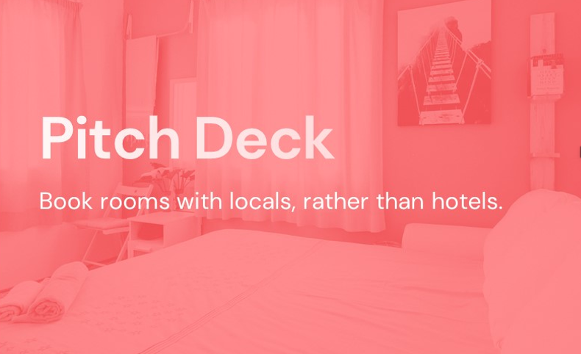

Photo Credit: vip.graphics
How Airbnb Told Their Story:
In 2008, Airbnb launched their idea with a simple pitch deck. Their core message was: “Book rooms with locals, rather than hotels.” That short phrase explained the problem, the solution, and the unique experience.
A Startup Example Using 10 Slides:
Their deck included slides on the market, their product, early traction, and the team. It was easy to understand – and easy to support.
“You'll become more confident in your product as you build your pitch.”
Case Study
Airbnb's First Pitch Deck
Explore the original pitch deck: https://www.slideshare.net/RyanGum/airbnb-pitch-deck
Further explanation of the slides:
https://www.pitchdeckhunt.com/pitch-decks/airbnb
35

Slide 36

Airbnb Co-founder Explains the Original Deck
Photo Credit: Youtube
Click to Watch Video
Name: Interview With Airbnb CEO Brian Chesky | Fortune
Description: Airbnb CEO Brian Chesky discusses how it got started,
the future of the business, and globalization.
Link: https://www.youtube.com/watch?v=GFMeuSIhIYg
Click to View
36

Slide 37
From Idea to Experience: Crafting a Strong Concept
02
Key Learning Area
What makes your accommodation meaningful to guests? A strong concept is more than just a building - it’s a story, a feeling, and a promise. This section explores how to define your value proposition and connect with your ideal guest.
You'll explore:
The 4 Realms of Experience (Pine & Gilmore)
Traditional vs. experience-based tourism
How to define your concept using Pitch Deck steps 3–5 (Solution, Value Proposition, Market)
Use this learning area to reflect on your unique offer and turn it into a compelling and memorable concept.
37

Slide 38
Pine & Gilmore – The Four Realms of Experience
Mapping Your Guest Experience - Use the Four Realms to Understand Your Offer
The Four Realms:
Entertainment Passive absorption
(e.g. watching a performance)
Education Active participation + absorption
(e.g. bread-making class)
Escapist Active + immersive
(e.g. hiking, glamping)
Esthetic Passive immersion
(e.g. soaking in a hot tub with a view)
Apply to Your Concept:
Where does your accommodation fall? Most great stays blend 2–3 realms. Epic ones touch on all of them.
38

Slide 39




Explains How to Define a Strong Value Proposition
Absorption
Entertainment
Educational
Why a Guest Would Choose Your Accommodation Over Others
Passive Absorption
Four Realms
Active Absorption
“The Sweet Spot”
An experience can consist of four different realms of an experience. It can include active or passive participation, immersive or absorptive experience.
A business has to ask itself what kind of specific experience does my business want to offer? By looking at all four realms and the needs of the quest, a business can find its ideal experience.
Esthetic
Escapist
Immersion
The Four Realms of an Experience - Source: https://hbr.org/1998/07/welcome-to-the-experience-economy
39

Slide 40
Traditional vs. Experience-Based Tourism
What Type of Experience Are You Offering?
Are You Selling a Room - Or a Story?
Traditional: "Double room in countryside“
Experience-based: "Sleep in a restored sheep barn with stories from locals“
Traditional: "Breakfast at 8 “
Experience-based: "Bake ryebread in a geothermal oven with your hosts“
Tip: Think beyond location and amenities. What emotions or stories do you create?
Reflection Prompt: Rewrite one sentence from your business description to turn it into a memory for your guest.
40

Slide 41
Explains How to Define a Strong Value Proposition
Why a guest would choose your accommodation over others. When developing an experience tourism product you should consider the following:
Traditional tourism | Experience tourism
Within what branch of tourism are we developing the product (adventure, cruise ship, leisure, travel, culture)? | What makes our community speciel? (People, places, stories, tradition and more).
What entertainment or services can our local area offer? | What memories do we want our guests to take away from us?
What can visitors do upon arrival, where should they stay, what activities or events should be the focus of attracting people (e.g. golf, festivals, theatre)? | What interests do the guest have in common with our services/activities?
Which partners and suppliers want to be part of the package tour? | Who do I need to work with to create the right experience for the guest?
 | What products already exist that are experience-based or could be developed as the basis for, or as part of, a package tour?
 | How can the experience be personalized for different guests?
 | What unique, original, and local “secrets” can be worked with, showcased, or participated in?
Source: Einstök íslensk upplifun: Vegur til vaxtar. Nýsköpunarmiðstöð Íslands / Unique Icelandic Experience: Road to Growth. Iceland´s Innovation Centre
41

Slide 42
Defining the Core of Your Concept
Problem – Solution – Value – For Whom?
Pitch Deck Focus:
#3 Solution:
What do you offer?
#4 Value Proposition:
Why is it valuable and different?
#5 Market:
Who is this for?
Activity Prompt:
Try to answer the following in 1 sentence each:
What are you offering your guest? (the solution)
What makes it emotionally or practically valuable? (the value)
Who will love this most – and why? (the market)
These sentences will help you complete your own pitch deck – and describe your concept to others clearly and persuasively.
42

Slide 43
Recap – What Makes a Good Concept?
Your Concept Should Be:
Clear – Memorable – Grounded in Place
Checklist:
Emotionally engaging: guests feel something
Easy to explain: one sentence is enough
Based in place: your story connects to the land or community
Designed with a guest in mind: not for “everyone”
Tip: Your Pitch Deck should communicate not only what you do, but why it matters to your guests
43

Slide 44
From Concept to Validation:
How Do You Know Your Idea Works?
03
Key Learning Area
You’ve Crafted a Concept
– But Does It Resonate?
In Key Learning Area 3, you’ll explore how to:
Test your idea early (before spending money)
Gather useful feedback from real people
Show small wins and early traction in your Pitch Deck (Element #8)
Hint: Even small actions (a survey, a booking, an Instagram comment) are signs your idea has potential.
44

Slide 45
Test Before You Build
Quick and Low-Cost Ways to Validate Your Idea
Tools You Can Use:
Typeform or Google Forms - Run a simple guest interest survey
Instagram/Facebook Post - Share a concept image, ask: “Would you stay here?”
Ask Past Guests - Send 3 concept ideas and get votes or comments
Small Prototype - Try out a mini version (e.g. 1-night storytelling event)
Pitch Deck Tie-In: Use the best results in Pitch Deck Element #8:
Traction to show real interest from real people.
45

Slide 46
Your Concept in Context: Aligning with You, Your Guests, and Your Place
04
Key Learning Area
Focus Questions:
Does your idea match your personal goals and lifestyle?
How does it fit within your local community or landscape?
Can you connect with other small businesses nearby?
Pitch Deck Elements:
#7 Team: Who is behind the idea and why?
#9–10 Finance & Support: Covered in more detail in Module 6, but reflect on what kind of support you may need (partners,
grants, time, training)
Tip: A good concept is not only clear – it’s also rooted and supported.
46

Slide 47
You’re Not Alone
Local Collaborators
(Cafés, Artists, Activity Providers)
Community Partners
(Municipality, Development Office)
Surround Yourself with the Right People and Places
Concept
Activity:
Draw a simple map with your concept in the center. Around it, place:
Local collaborators (cafés, artists, activity providers)
Community partners (municipality, development office)
Guest sources (DMOs, social media groups)
Support organizations (grants, training programs)
Geust Sources
(DMOs, Social Media Groups)
Support Organisations
(Grants, Training Programs)
Purpose: See how your business fits into the wider tourism system – and where you can build relationships or get support.
Tip: Use this to strengthen Pitch Deck Element #7 (Team) and prepare for networking and funding.
47

Slide 48
Crafting Your Core Message
A Simple Statement with Big Impact
Prompt:
Complete this sentence:
“We offer [type of accommodation] for [guest type] who want to [core experience/value] in [place].”
Example: “We offer off-grid cabins for nature-loving couples who want to reconnect and recharge in North Iceland.”
Why it matters:
This sentence can:
Anchor your Pitch Deck
Guide your marketing
Help others understand (and remember) your idea
Tip: Say it out loud. Would you remember it in 10 seconds?
48

Slide 49
What You’ve Learned in Section 2 (Part 1)
Pitching with Purpose
In this section, you learned how to define your concept clearly, connect it with guest needs and local opportunities, and prepare to share it with others using the Pitch Deck model.
Summary Points:
You explored what makes a strong tourism concept
You used the Pitch Deck method to shape and clarify your idea
You connected your idea to local assets and real guests
You tested and refined your concept using practical tools
49

Slide 50
What You’ve Learned in Section 2 (Part 2)
Start Simple, Learn as You Go
Now that you’ve clarified your concept, it’s time to take the first steps toward communicating it clearly and persuasively. Your Pitch Deck doesn’t need to be perfect - think of it as a living document that helps you explore, test, and explain your business idea.
Checklist for Drafting:
Slide 1: Your one-sentence concept
Slide 2: The problem your guest faces
Slide 3: Your solution and the experience you offer
Slide 4: Your guest profile
Slide 5: Any traction, feedback, or validation so far
Tip: Save visuals or quotes from your process
- they can go directly into your deck!
50

Slide 51
A Pitch Deck example Gulleggið (the Golden Egg)
The 8 Elements to Include in a Pitch Deck
Name and Short Description
Describe your solution or product briefly.
The Problem
What problem is the target group facing?
The Solution
How does your idea solve this specific problem?
The Team
Highlight the strengths of your team.
Customer / Market
Who is the target customer and how big is the market?
Why Now?
Show why now is the right time to introduce this solution.
Competition
Who are the competitors and what is your competitive advantage?
Revenue and Cost Forecast
Describe the key revenue and cost items for the next 12 months.
How will you finance your idea next year? What is your revenue model?
Source: https://gulleggid.is/masterclass/
51

Slide 52

Resources Section
Photo Credit: Images used under license from
Microsoft 365 stock library.
Additional templates for Resources, Exercises, etc

Slide 53
Additional Reading, Tools & Templates
Name | Description
Pine Joseph; Gilmore, James H. (2011), The Experience Economy, Updated Edition, Harvard Business Review Press Kindle Edition | A key business book that describes how the experience economy works, what it is about and presents many case-studies that you can learn from. This link provides an introduction to the ideas behind this concept: https://hbr.org/1998/07/welcome-to-the-experience-economy
Pitch Deck Masterclass (Gulleggið) | Short Icelandic video lessons explaining how to structure your pitch deck step-by-step. Ideal for first-time entrepreneurs in tourism or creative sectors. Visit: https://gulleggid.is/masterclass/
Canva – Free Pitch Deck Templates | Pre-designed, drag-and-drop slide decks with modern visuals. Customize easily to match your concept's tone and style. Visit: https://www.canva.com/presentations/pitch-deck/
Typeform – Create Guest Feedback Surveys | Use this to gather insights from guests and test parts of your concept. Great for validating your idea. Visit: https://www.typeform.com/
53

Slide 54
Additional Tools & Templates
Name | Description
University Lab Partners – Pitch Deck Guide | Clear explanations of each slide in a 10-step pitch deck, with business-focused examples. Visit: https://www.universitylabpartners.org/blog/the-10-slide-pitch-deck-template
Downloadable Templates: | Concept Canvas (PPT / PDF): One-page overview of your business idea. Guest Persona Sheet: Helps define your ideal guest and their needs. Pitch Deck Slide Outline: A blank outline you can fill in step-by-step. Tip: Bookmark and reuse these as you grow and improve your idea!
54

Slide 55
Well Done
Module 2 (Part 2)
Section 3: Building a simple,
viable Business Plan via a
Business Model Canvas
You have Completed… Module 2 (Part 1)
Section 1: Tools for Market Research. Understanding the Market
Section 2:Defining Your
Concept & Value Proposition
Next is…

