Slide 1
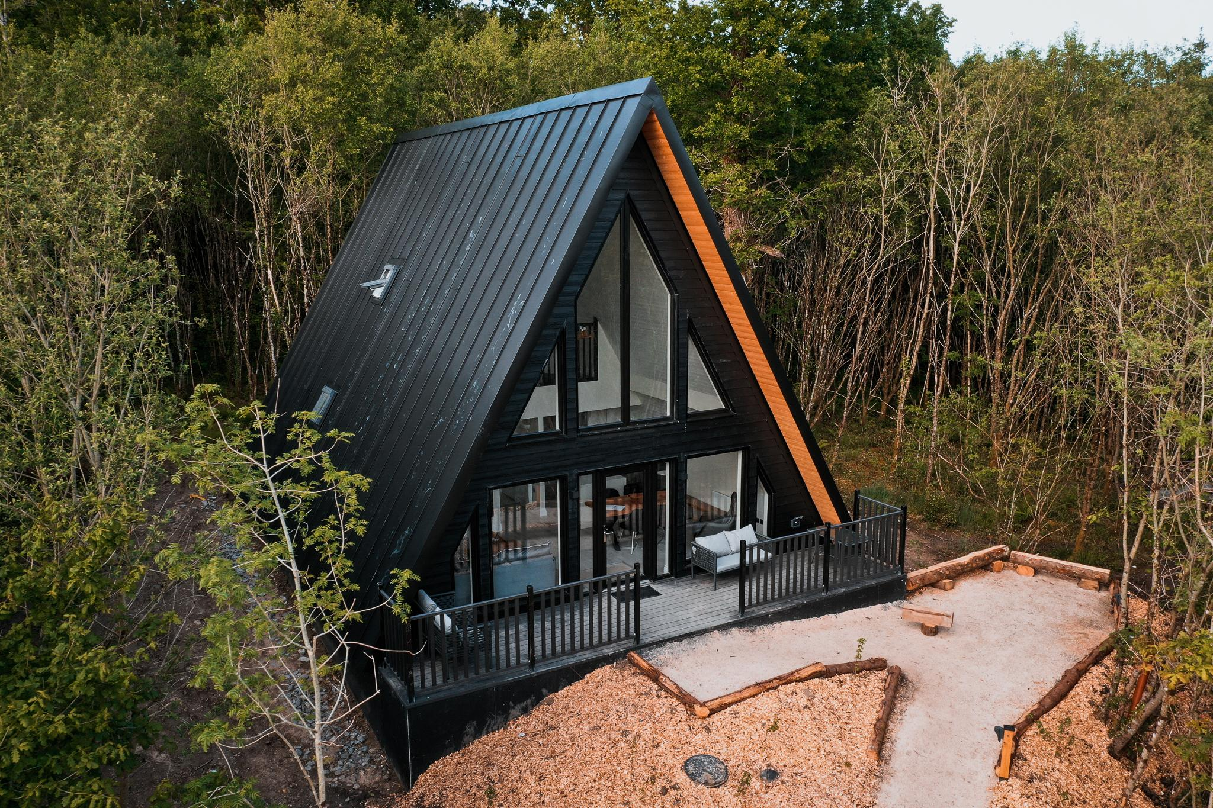
Case Study
Drumhierny Woodland, Leitrim, Ireland
Tourism Planning and ‘Commercial Tourism Use’

Slide 2
Case Study: Drumhierny Possibly Used Financial Planning Best Practices
Phased investment, starting lean and scaling after market validation.
Grants from LEADER, Failte Ireland, or SEAI for eco-tourism, energy efficiency, and rural development.
Blended financing: equity, small commercial loans, and reinvested revenue.
Yield management to optimise pricing during peak (spring to autumn) vs. low season.
Minimum Stay Policy (a 2-night stay minimum and 3 nights on weekends and bank holidays) supports their strategic yield management. This reduces operational costs (cleaning, laundry and check-in), increases Average Booking Value (ABV) per guest. Improves occupancy efficiency (fewer 1-night-onlys), Aligns well with their wellness-focused brand – slow down and immerse yourself in nature. In your cash flow model, calculate based on:
2-night minimums × 16 lodges × €250/night avg.
At 60% annual occupancy, revenue could exceed €875,000/year, before other services
Partnerships for local experience packages (e.g., Blueway tours, wellness retreats).
Diversified offering. Drumhierny doesn’t rely solely on accommodation. Their multi-experience ecosystem boosts revenue, enhances guest satisfaction, and spreads risk across service types.

Slide 3
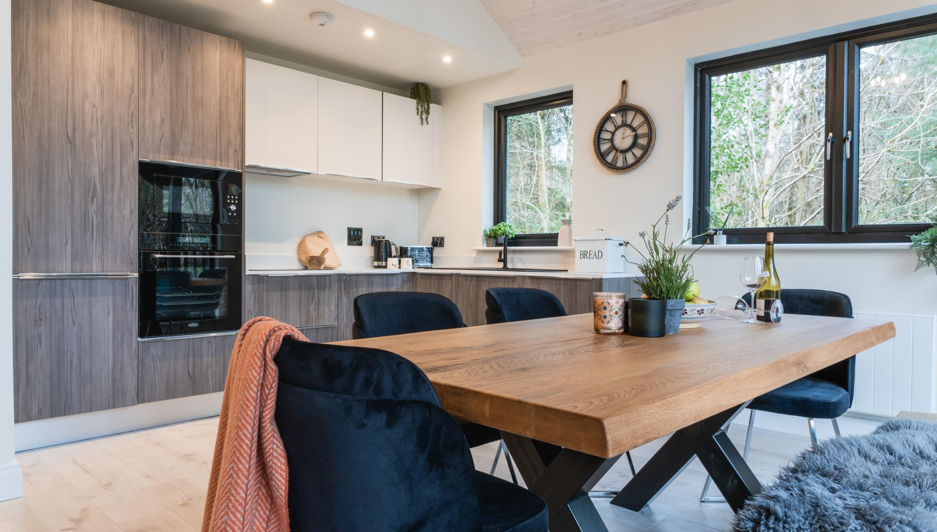

When setting up a glamping business in Ireland, planning permission is generally required, and how it's treated—residential, tourism, agricultural, or other—depends on the local authority’s zoning rules, land use designation, and intended business model. Here’s a breakdown of how to approach it in Ireland, with guidance that’s broadly applicable across Europe, taking Glamping in Ireland as an example:
Planning Category: Glamping is typically considered a form of tourism development in Ireland. Glamping developments are generally classified as commercial tourism accommodation, not residential.
Residential zoning is for private dwellings, so glamping usually doesn't fall under this.
Agricultural land can be used, but a change-of-use permission is required.
Drumhierny Hideaway
‘Commercial Tourism Use’ in Ireland
Recommended Reading
Setting up a Glamping Business, Teagasc, Ireland

Slide 4
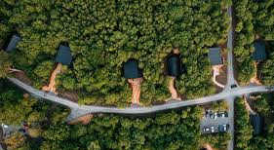
Case Study: Drumhierny Woodland, Leitrim, Ireland
Tourism Planning and ‘Commercial Tourism Use’
Drumhierny Woodland Hideaway, serves as a notable example of a glamping business that has effectively navigated both tourism and commercial planning frameworks. Established on a 100-acre estate, the retreat offers 16 architecturally designed, energy-efficient lodges nestled within private woodland areas, complemented by 5 km of trails and various wellness facilities.
Tourism Planning Use: 16 luxury eco-lodges in woodland with nature trails – planning approved as tourism accommodation.
Commercial Use Elements: Spa treatment rooms, yoga pavilion, indoor 14-meter swimming pool, coffee area, and events – additional permissions for ancillary commercial use. Their success was aided by a clear planning strategy, community engagement, and a strong sustainability narrative.
Website Drumhierny Woodland Hideaway
Luxury Glamping Getaway In Leitrim Gets Green Light For New Therapy Suite And An Outdoor Plunge Pool 2024

Slide 5
PHASE 1: Tourism Planning & Development Strategy 2024
Drumhierny Woodland Hideaway, serves as a notable example of a glamping business that has effectively navigated both tourism and commercial planning frameworks. Established on a 100-acre estate, the retreat offers 16 architecturally designed, energy-efficient lodges nestled within private woodland areas, complemented by 5 km of trails and various wellness facilities.
Commerical Tourism Planning Use: 16 luxury eco-lodges in woodland with nature trails – planning approved as tourism accommodation October 2024
Commercial Use Elements: Spa treatment rooms, yoga pavilion, indoor 14-meter swimming pool, coffee area, and events – additional permissions for ancillary commercial use. Their success was aided by a clear planning strategy, community engagement, and a strong sustainability narrative.
Website Drumhierny Woodland Hideaway
Luxury Glamping Getaway In Leitrim Gets Green Light For New Therapy Suite And An Outdoor Plunge Pool 2024

Slide 6
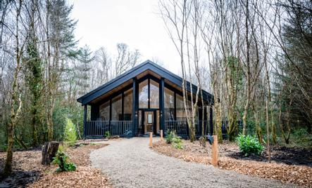
Case Study: Drumhierny Initial Tourism Planning Permissions
Protected Structure Status: Drumhierny Lodge is a protected structure under the Leitrim County Development Plan 2023–2029. This designation necessitated careful planning to ensure that any modifications respected the historical and architectural significance of the building.
Retention Permissions: Drumhierny also sought retention permission for several existing facilities, including:
The Cedaroo wellness centre building.
Two outdoor hot tubs and four outdoor seaweed baths.
A children's play area, ESB substation building, car park, and access lane.
Temporary retention of the reception building and coffee shop for a five-year period.
These permissions ensured compliance with planning regulations and allowed for the continued operation of these facilities.
Website Drumhierny Woodland Hideaway
Planning application details ref: 2360094 Leitrim County Council 2024

Slide 7
Consider Costs When Planning: Zoning & Land Use Check
Before purchasing or developing in Irland confirm that the land is zoned for tourism or recreational use. Avoid protected zones (Natura 2000, coastal protection, floodplain) unless tourism use is explicitly permitted.
Costs are typically involved for each stage: zoning, planning permission, site infrastructure, eco-design, and business development
Realistic price ranges for: Land (€10,000–€80,000), eco units (€6,000–€40,000), infrastructure (solar, septic, access), permits, reports, and marketing
A phased approach with cost-saving strategies (lease land, modular builds, recycled furnishings)
Land costs may be eligible for LEADER programme support in Ireland.
Tools to Use by Country
Ireland – www.myplan.ie
Netherlands – www.ruimtelijkeplannen.nl
Slovenia – Municipal zoning office www.gov.si
Italy – Contact your Comune and request the Piano Regolatore Generale.
Iceland – National Planning Office www.skipulagsstofnun.is

Slide 8
Estimated Costs for Drumhierny Woodland Hideaway
Phase 1: Core Glamping Infrastructure
(Initial development of lodges, pathways, access, and basic utilities)
Item | Description | Estimated Cost
Land acquisition/lease | 100-acre estate in Leitrim | €500,000 – €1 million (if purchased)
Eco-lodges x16 | High-spec, insulated wooden lodges with bathrooms | €1.2 – €2 million (€75k – €125k each)
Paths, trails, landscaping | 5km of trails, eco-design | €100,000 – €250,000
Water, septic, electrics | Off-grid or hybrid systems | €150,000 – €300,000
Reception & check-in lodge | Timber-frame or repurposed building | €50,000 – €100,000
Initial marketing & branding | Website, photography, digital launch | €20,000 – €40,000
Subtotal Estimate |  | €2 – €3.7 million

Slide 9
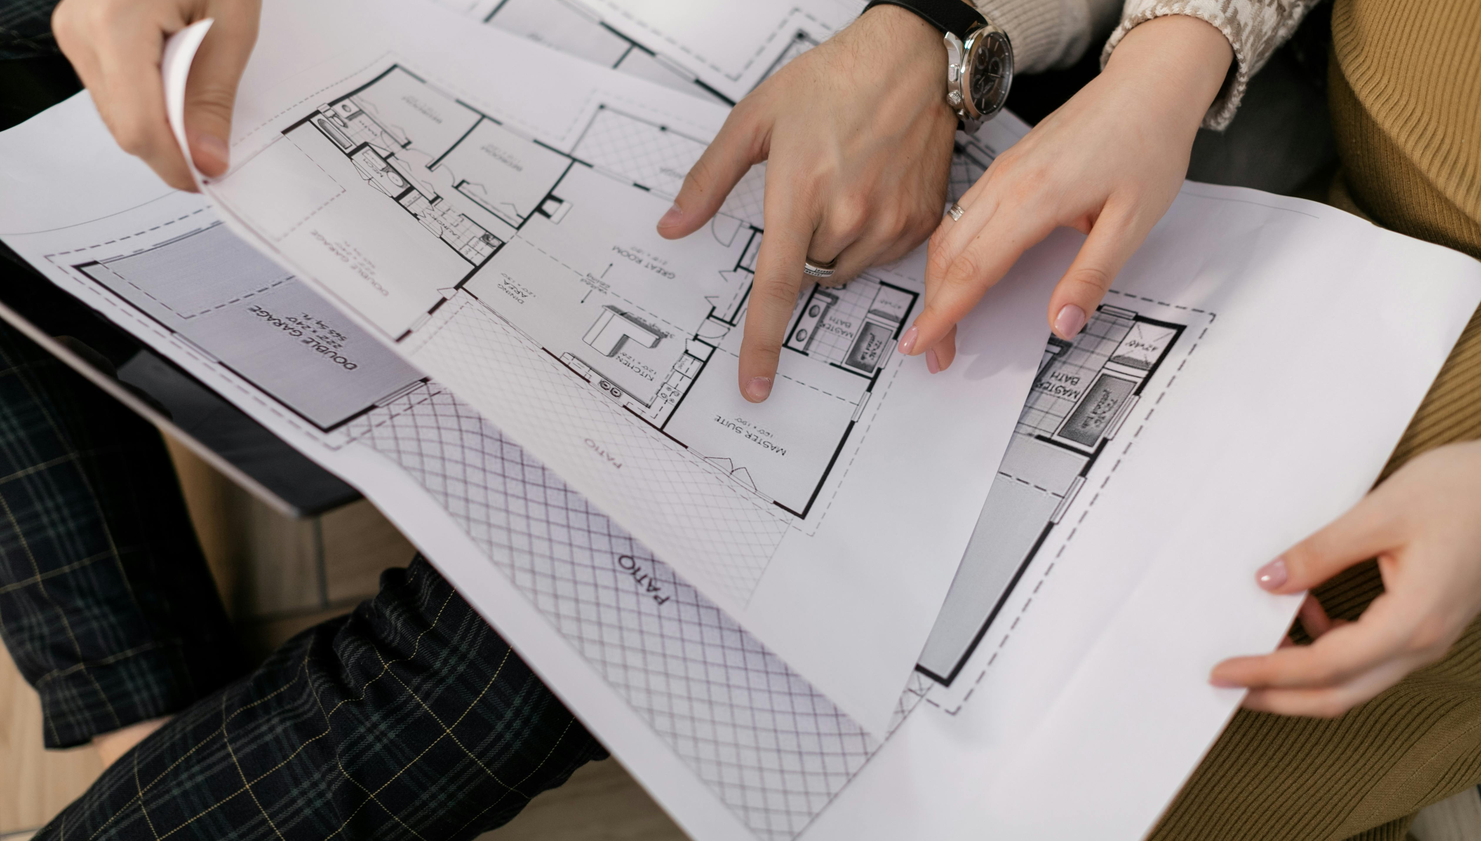
Drumhierny Woodland Hideaway was given the green light for a major expansion to its facilities including a new therapy suite and an outdoor plunge pool.
Site Selection: Rural land is often zoned agricultural or residential. You’ll need to show that your business supports local tourism and doesn’t negatively impact the environment.
Zoning: Check the local County Development Plan via your Local Authority. Tourism accommodation may be allowed in rural/agricultural zones under "rural enterprise" or "agri-tourism" objectives.
Planning Permission: Required for all permanent and most semi-permanent structures (glamping pods, treehouses, shepherd huts). Pre-planning consultations with the local council are free and recommended.
Regulatory Notes: If serving food or offering wellness services (e.g., hot tubs, forest bathing), additional licences from HSE (Health Service Executive) or Failte Ireland may apply.
🔗 Irish Planning Portal | Failte Ireland Standards
Ireland
Planning Application Considerations
Recommended Reading
Setting up a Glamping Business, Teagasc, Ireland

Slide 10
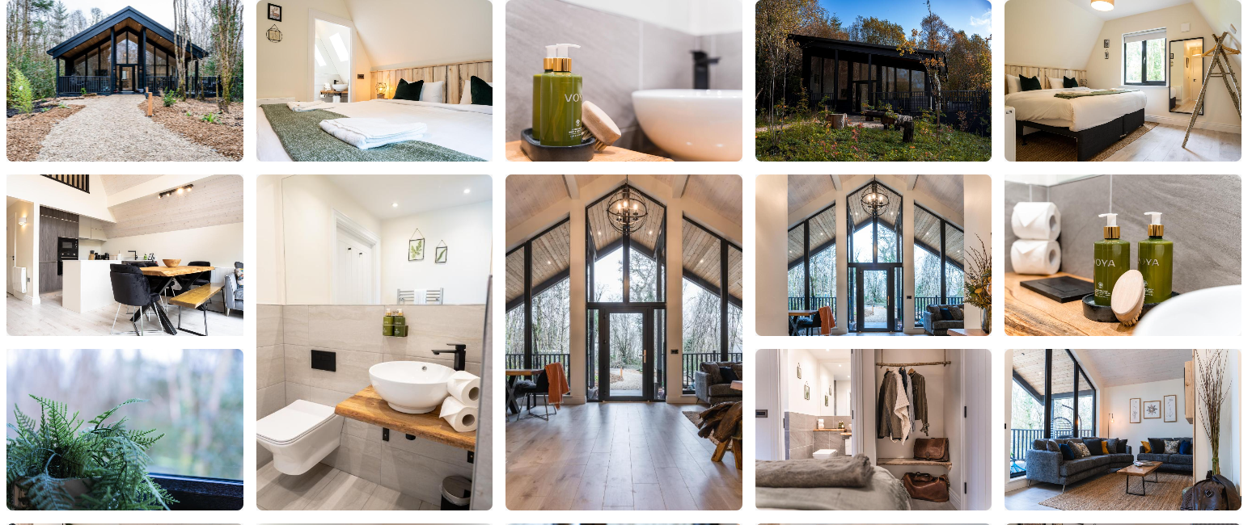

Slide 11
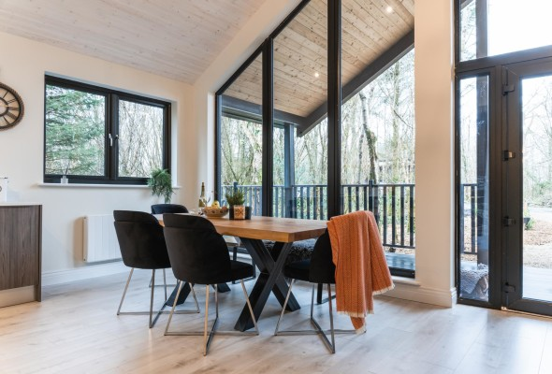
PHASE 2: Commercial Expansion 2025
The initial phase of Drumhierny’s tourism development focused on creating a sustainable tourism destination. The lodges were constructed with a strong emphasis on environmental sustainability, utilizing locally sourced materials and achieving high energy efficiency standards. The site's integration with the natural landscape and its proximity to attractions like the Shannon Blueway positioned it as an eco-friendly retreat. Welcome to Leitrim
Commercial Expansion: Recognising the potential for growth, Drumhierny sought to enhance its offerings by incorporating additional commercial facilities. In January 2025, a planning application was submitted to Leitrim County Council proposing significant upgrades (see next slide)
Website Drumhierny Woodland Hideaway
Recommended Reading
Framespace Re-inventing the Construction Industry
Leitrim Observer: Popular Leitrim sanctuary eyes expansion with new facilities
11

Slide 12
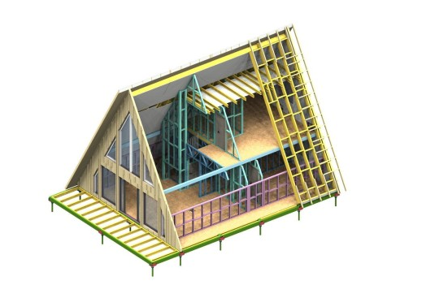
Case Study: Drumhierny Commercial Expansion Application
The Commercial Expansion Application included developments aimed at diversifying the site's offerings, appealing to a broader range of visitors and enhancing the overall guest experience.
Conversion of Drumhierny Lodge into a bar and restaurant, with a two-storey extension housing a kitchen and function room.
Addition of a single-storey glass Orangery with a rooftop terrace.
Restoration and repurposing of existing coach house buildings into a reception area, café, staff facilities, and offices.
Reconstruction of outbuildings to link the coach house with Drumhierny Lodge, providing toilets and storage facilities.
Construction of a glass lobby and first-floor connection to the northern grounds.
Website Drumhierny Woodland Hideaway
Drumhierny Planning Permission 26/01/2025

Slide 13
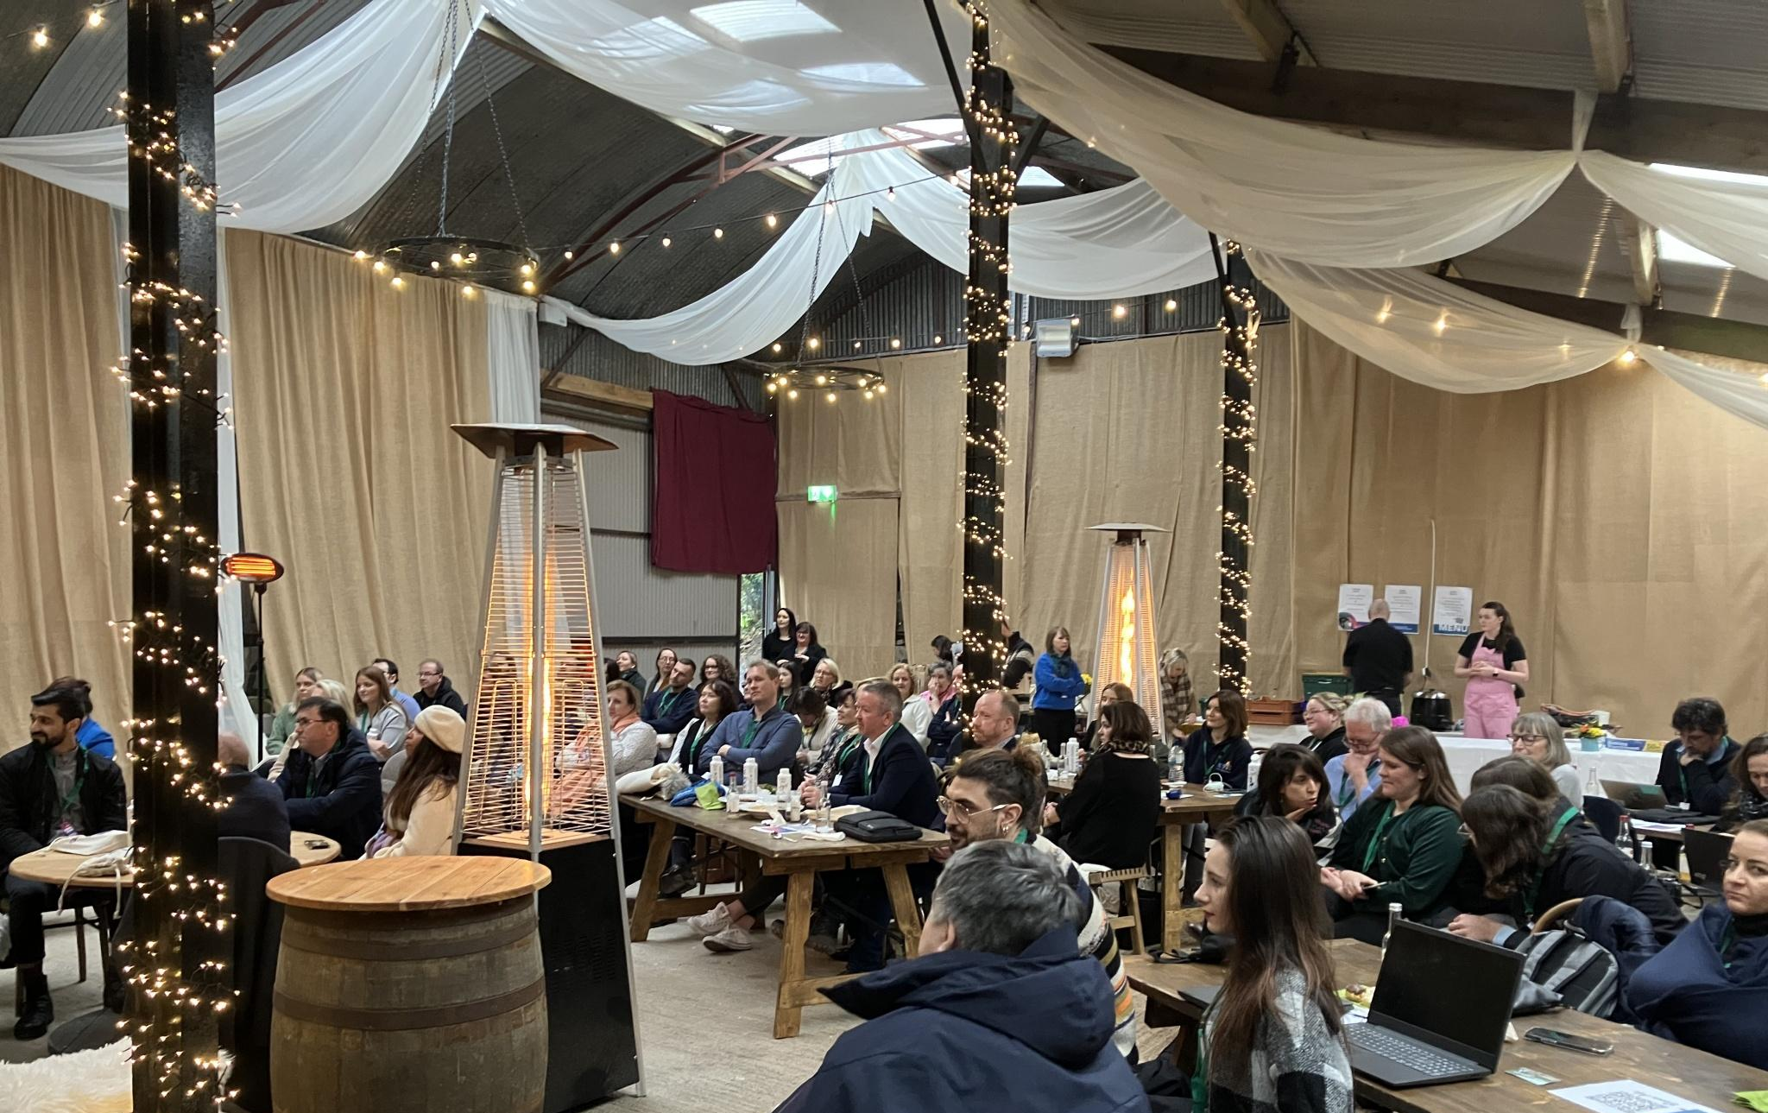
Planning Application 2025
Leitrim County Council greenlit a significant expansion at Drumhierny, including a new therapy suite, outdoor plunge pool, retention of existing wellness buildings (hot tubs, seaweed baths, sauna), conversion of a barn into an event space, coffee shop, car park, reception, and modifications to entrance walls—subject to 10 conditions.
The site now boasts a number of well-being facilities, including an indoor 14 metre swimming pool, outdoor hot tubs, a sauna, loungers and thermal pools set in the original walled garden of the estate and protected by historical walls and large oak trees.
Website Drumhierny Woodland Hideaway
Total Planning: Planning for a Log Cabin

Slide 14
Estimated Costs for Drumhierny Woodland Hideaway
Phase 2: Wellness & Experience Upgrades (Commercial Expansion)
(Based on 2025 planning application for spa, bar, Orangery, coach house restoration)
Item | Description | Estimated Cost
Restoration of Drumhierny Lodge | Bar/restaurant, kitchen, function room | €400,000 – €750,000
Orangery & rooftop terrace | Glass structure for dining/events | €150,000 – €300,000
Coach house renovations | Reception, café, staff hub, offices | €250,000 – €500,000
Glass lobby, linking infrastructure | Connecting walkways, structures | €80,000 – €150,000
Outdoor spa facilities | Seaweed baths, plunge pools, hot tubs | €100,000 – €200,000
Interior furnishings & decor | Natural materials, bespoke fit-outs | €100,000 – €200,000
Subtotal Estimate |  | €1.08 – €2.1 million

Slide 15
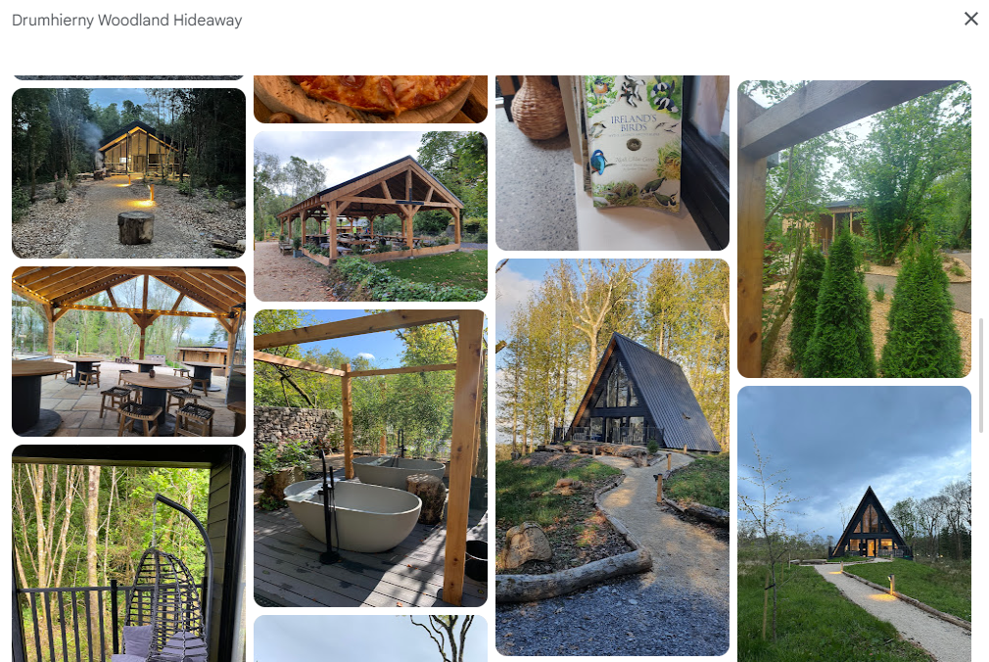

Slide 16
Estimated Financial Sustainability & Revenue Streams
Drumhierny’s model combines multiple income streams to recover capital expenditure and sustain long-term growth:
Revenue Source | Description | Estimated Yield
Lodge bookings | €190 – €300/night avg. (seasonal) × 16 units | €900,000 – €1.2M/year
Spa & wellness services | Treatments, yoga, nature therapy | €50,000 – €150,000/year
Food & beverage | Café, bar, Orangery events | €100,000 – €250,000/year
Private events | Small weddings, retreats, corporate | €80,000 – €200,000/year
Sustainability grants | SEAI/LEADER grants for energy, tourism | €50,000 – €150,000 one-off or partial

Slide 17


Case Study: Financial and Operational Takeaways
Strategy | Financial Benefit
Minimum 2-night stay | Fewer turnovers, higher yield
Diversified offerings | Multiple income streams, cross-selling
Staggered development | Lower upfront risk, scalable model
Temporary permissions | Test and adapt before large spend
Wellness + heritage focus | Access to niche grants, premium market
Rural location + employment | Community support, potential for incentives
EPIC STAYS is licensed
under CC BY-SA 4.0
Funded by the European Union. Views and opinions expressed are however those of the author(s) only and do not necessarily reflect those of the European Union or the European Education and Culture Executive Agency (EACEA). Neither the European Union nor EACEA can be held responsible for them.

Slide 18
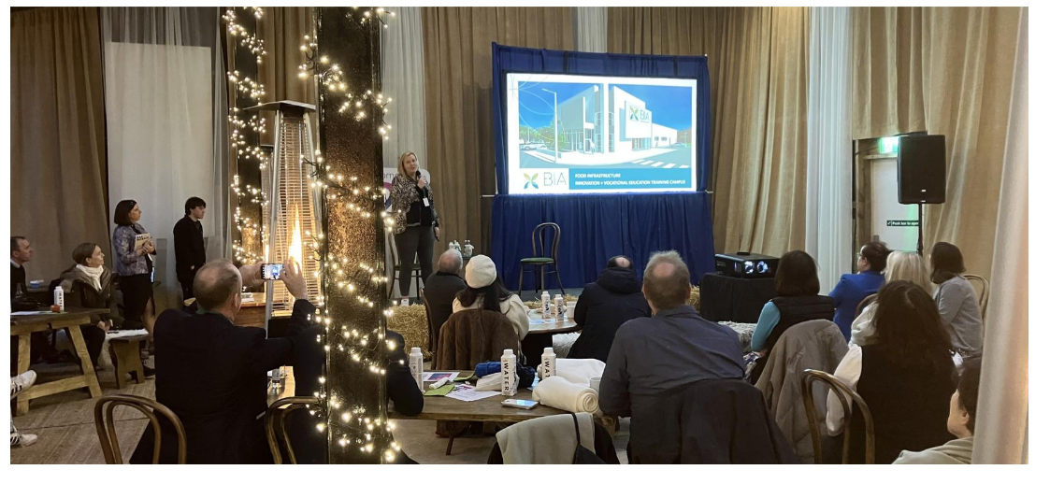
Case Study: Multiple Revenue Streams Include
Offering | Purpose | Revenue Role
Spa & Wellness | Outdoor hot tubs, seaweed baths, yoga | High-margin, add-on experience
Events & Retreats | Wellness retreats, small weddings, corporate escapes | Higher per-guest yield, group bookings
Nature Experiences | 5km of trails, foraging walks, forest therapy | Low-cost enrichment; encourages longer stays
Bar/Orangery Restaurant (proposed) | Guest dining, external visitors | Captures F&B spend, adds community draw
Sustainability Ethos | Locally sourced products, eco-focus | Attracts eco-conscious guests, enables grant access

Slide 19
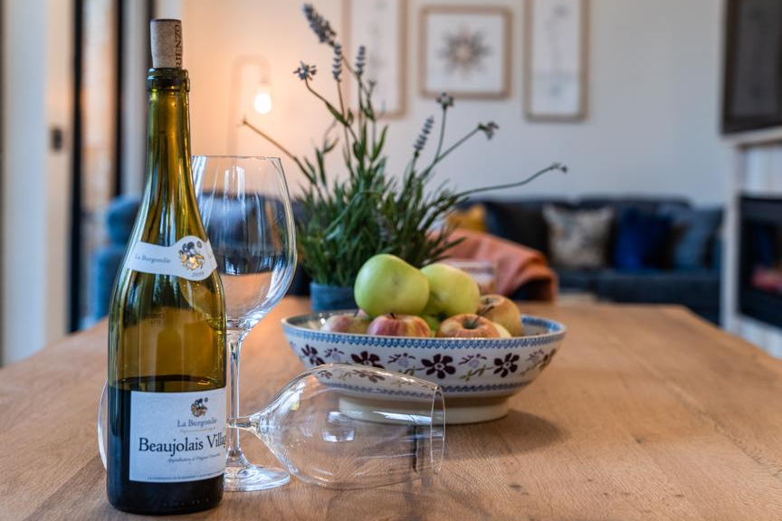
Case Study: Drumhierny Environmental & Local Community Commitment
Dedicated to Environmental Sustainability, Local Engagement and Ethics. Drumhierny Woodland Hideaway is, in essence, what Epic Stays is all about. It is owned by true country people, living locally, who are personally invested in securing the estate for future generations while collaborating with and developing working relationships to enrich the local community and environment.
As part of their long-term vision, they back up their commitment with a comprehensive plan that sees 4 phases to full realisation of the estate’s potential.
Learn how they are committed to environmental sustainability, have a dedicated Corporate Social Responsibility CSR Commitment and are highly involved in supporting their local community e.g., support local artists.
Website Drumhierny Woodland Hideaway
Drumhierny Planning Permission 26/01/2025

Slide 20
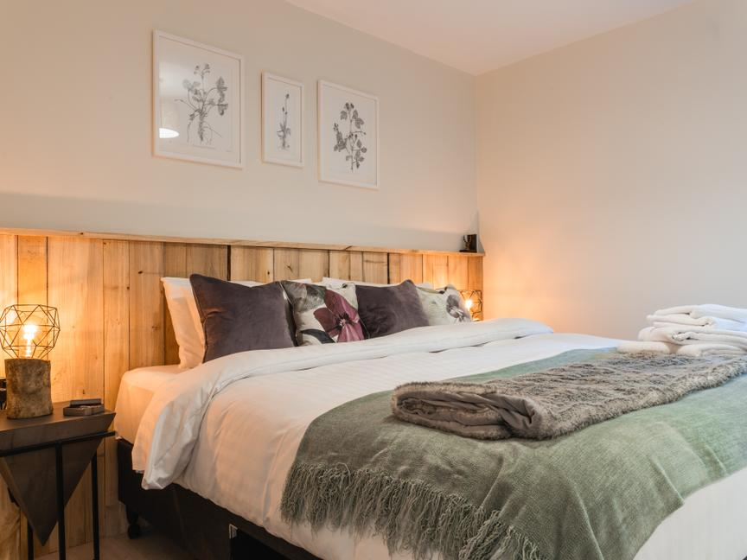
Case Study: Drumhierny Key Takeaways
Drumhierny Woodland Hideaway exemplifies how a glamping business can evolve by thoughtfully integrating tourism and commercial planning, all while maintaining a strong commitment to sustainability and heritage conservation.
Integrated Planning Approach: Successfully combining tourism and commercial elements requires a comprehensive planning strategy that addresses zoning, environmental impact, and community engagement.
Respect for Heritage: When dealing with protected structures, it's essential to balance development goals with preservation requirements.
Sustainability as a Core Value: Incorporating sustainable practices can differentiate your business and attract a niche market of environmentally conscious visitors.
Flexibility and Compliance: Seeking retention permissions and being adaptable to planning requirements ensures long-term operational viability.
Website Drumhierny Woodland Hideaway
Sustainability Policy

Slide 21
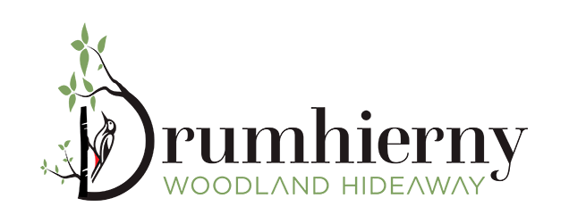
Case Study: Drumhierny Environmental & Local Community Commitment
They back up their future objectives with their Vision Statement and how they drive their daily operations guided by their Mission Statement.
Their sustainable tourism policy outlines measures to minimise environmental impact, such as:
Regular monitoring and reduction of electricity consumption.
Use of locally sourced materials and crafts in construction.
Promotion of eco-friendly practices among guests and staff.
This commitment to sustainability not only aligns with environmental goals but also enhances the site's appeal to eco-conscious travellers.
DRUMHIERNY WOODLAND HIDEAWAY – OUR PROMISE TO THE PLANET
Website Drumhierny Woodland Hideaway
Sustainability Policy

Slide 22
Case Study: Drumhierny Other Best Practices to Consider
1. Staggered Infrastructure Development
Drumhierny began with core lodges and trails
Applied later for planning permission for commercial use expansion
This staged model allows revenue from early bookings to support later capital investments
2. Temporary Planning Retention
Applied for temporary retention (5 years) of pop-up café and reception
Smart move to test service demand before committing to permanent build
Ensures compliance while remaining flexible
3. Protected Structure Use
Drumhierny Lodge is a protected building; they leveraged it as a heritage feature
Turned planning constraint into a brand asset (“stay in history, surrounded by nature”)
4. Brand Positioning and Digital Investment
Strong, polished website and sustainability messaging
Emphasis on high-end nature experiences rather than camping or budget glamping
Drives higher guest expectations, premium pricing, and media coverage

Slide 23
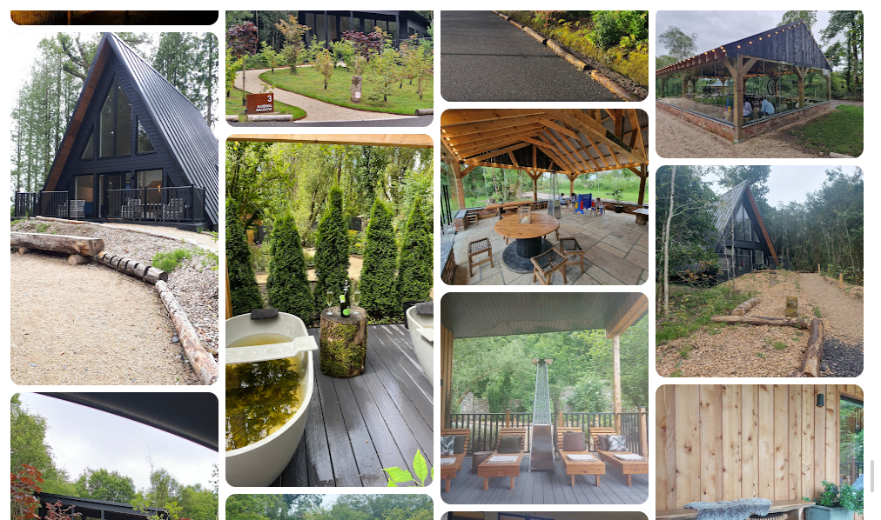
Case Study: Drumhierny Other Best Practices to Consider
5. Seasonal Staffing + Local Hiring
Hospitality, groundskeeping, wellness therapists
Offers local employment and may make them eligible for rural tourism incentives or LEADER grants
EPIC STAYS is licensed
under CC BY-SA 4.0
Funded by the European Union. Views and opinions expressed are however those of the author(s) only and do not necessarily reflect those of the European Union or the European Education and Culture Executive Agency (EACEA). Neither the European Union nor EACEA can be held responsible for them.

Slide 24
