Slide 1
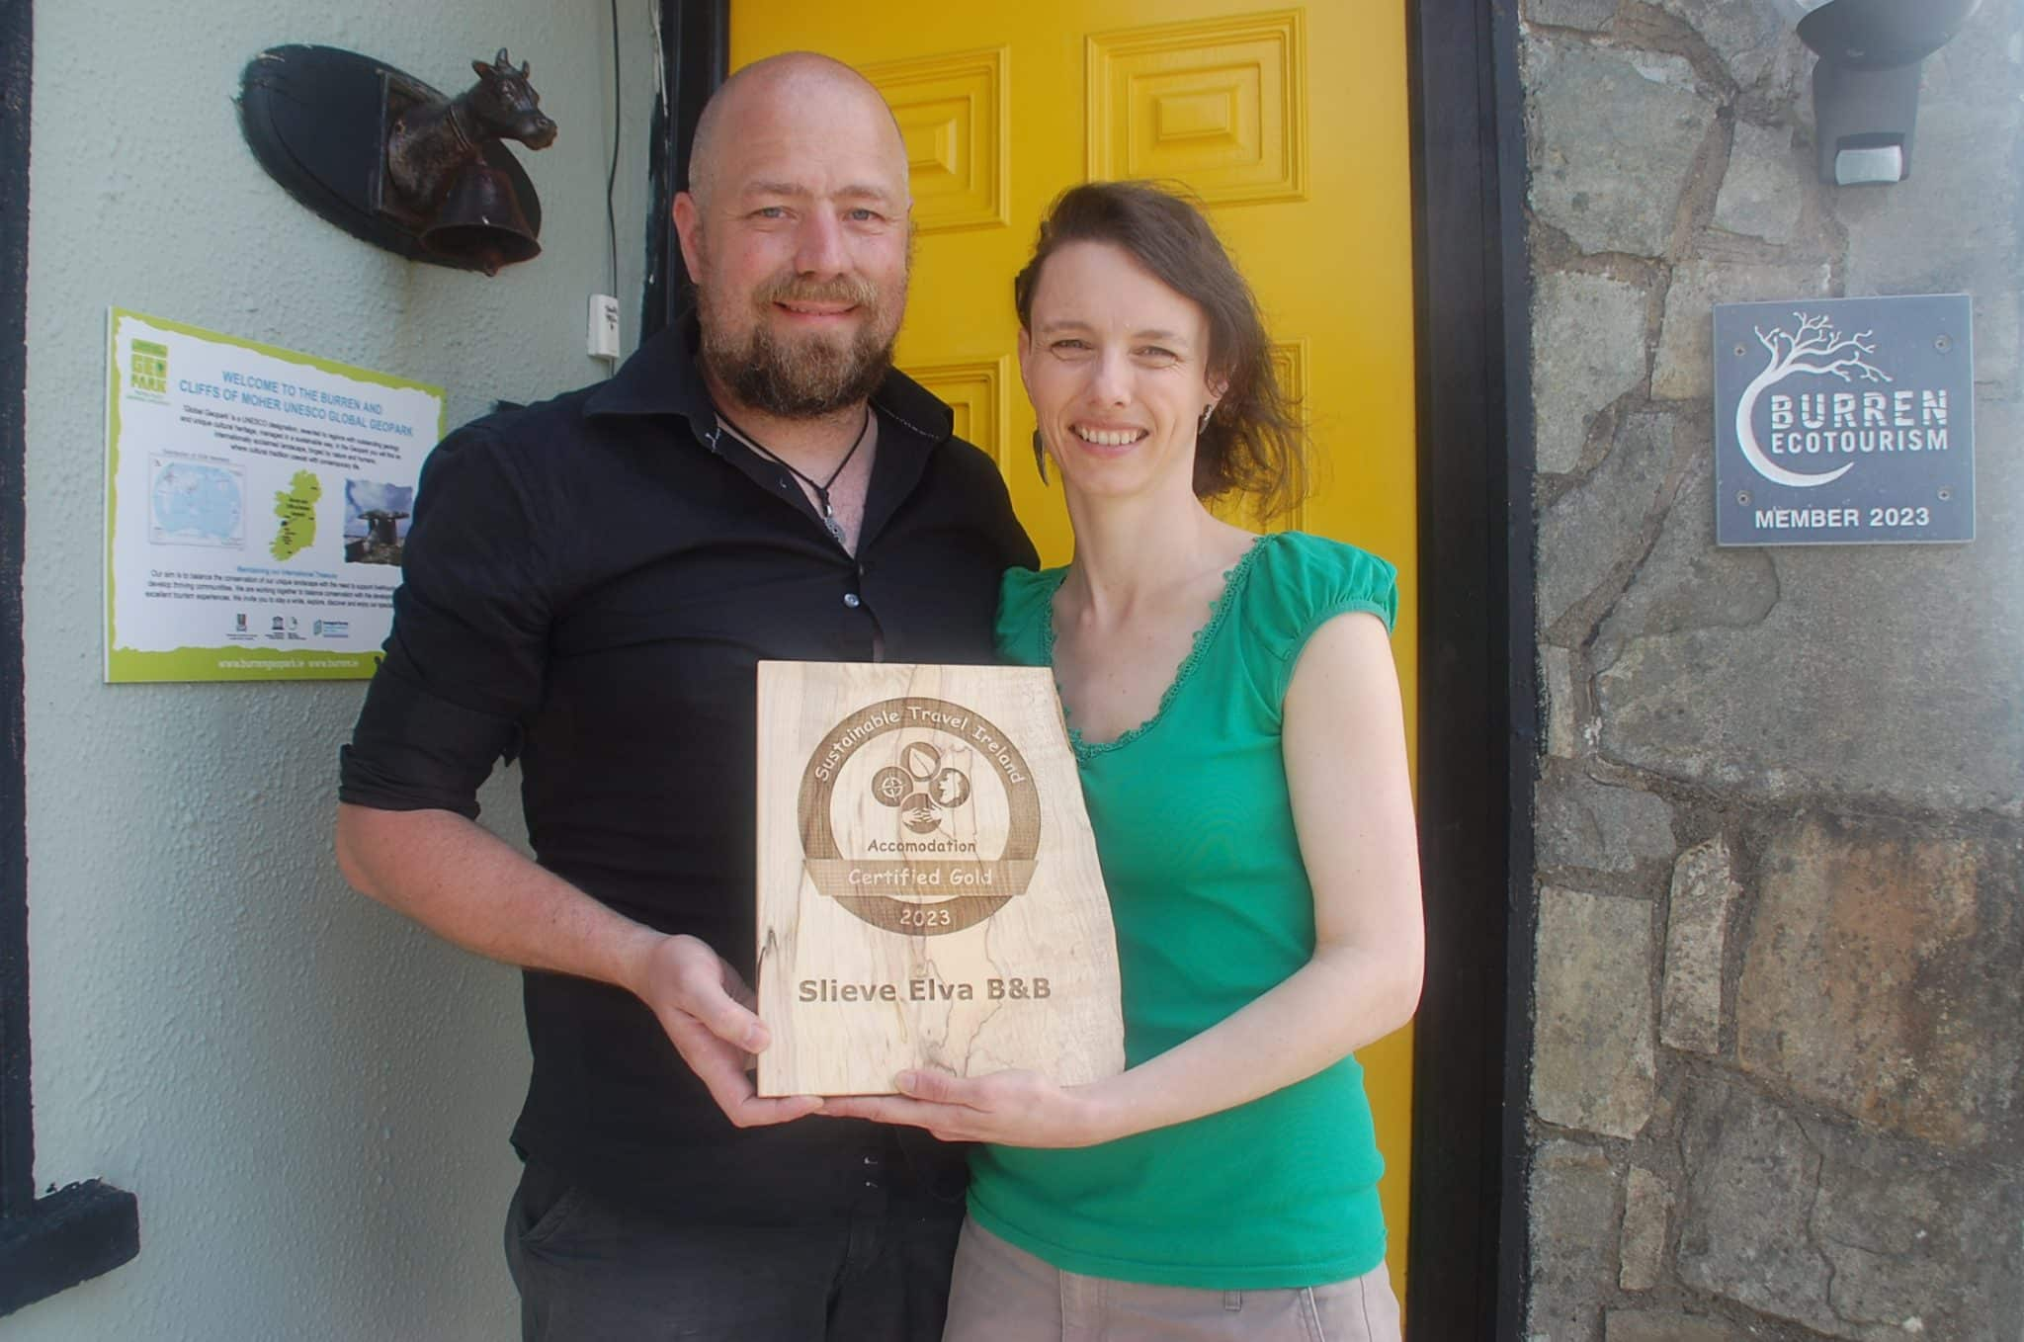
Case Study
www.sustainabletourismnetwork.ie
Slieve Elva B&B, in the Burren, Co Clare, Ireland
Financial Viability Green Model

Slide 2
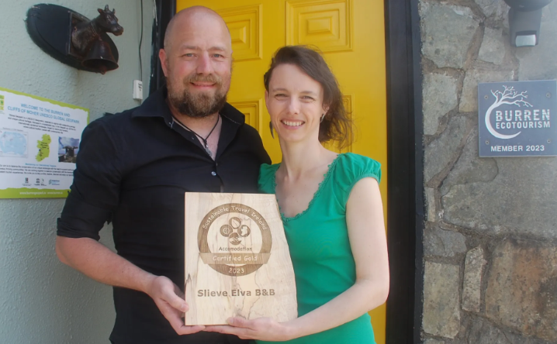
How One Small B&B Made Huge Improvements in Sustainability and Saved €8,000
Small Actions = Big Monetary Savings!
Even a tiny, cash-poor business can make such improvements and savings in such a short amount of time.
In the case of one Irish B&B (Slieve Elva in Co. Clare) that undertook sustainability upgrades, they managed to:
Cut energy use by 65%, saving about €5,000 on bills annually.
Reduced waste going to landfill by 71.4% and saved €1000.
They also radically reduced their carbon footprint.
“Everything started with proper, frequent monitoring and collecting all data of weekly usage in 2020. This gave us a very clear insight on all areas where changes and savings could be made from tackling low-hanging fruit.”
CASE STUDY
Upfront Investments vs. Long-Term Savings
How One Small B&B Made Huge Improvements in Sustainability and Saved €8,000

Slide 3
The small actions save a lot of € € € :
Installing thermostatic valves: The cost was around €600; they now save 25-30% on the heating costs (around €550 annually).
Changing all lighting to LEDs: cost approximately €250, leading to savings of roughly €360.
Solar PV + battery (+ hot‑water unit) installed (€12,000 less €3,000 grant), now covers 60–65% of electricity—pays back in 4 years vs 8 years originally.
EV charger (€1,500 with €600 grant), saves €500 yr on trips
Greenhouse saves €1,600 by supporting onsite food & garden systems. Water harvesting saves €400
Landfill waste ↓71.4%, recycling ↓63.5%, saving €150/yr—via bulk toiletry refills, guest recycling, composting, reuse/upcycling.
Water-saving: low-flow showers/toilets; “one-song” showers; cistern tweaks save €160/yr See all actions here.
CASE STUDY
Slieve Elva B&B, in the Burren, Co Clare, Ireland
What Are the 9 Startup Costs for an Eco Lodge Business?

Slide 4

Case Study
Irish B&B (Slieve Elva in Co. Clare) not only saved on energy but also reduced waste to landfill by 71%, saving another €1,000.
Those savings mean you have less expense pressure to pass onto the guest via higher prices.

Slide 5
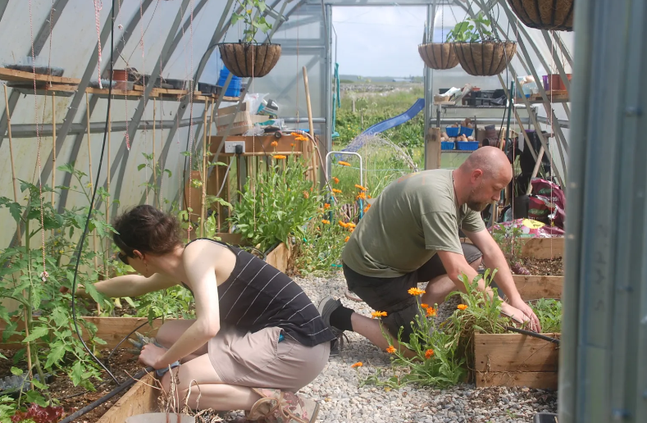


Slieve Elva B&B became the first B&B in Ireland to earn First Gold-Level Sustainable Certification
Certification brought structure and verified progress. It boosted the B&B’s credibility, widened its marketing reach, attracted eco-conscious guests, garnered media attention, and built stronger guest trust, which in turn increased visibility and bookings.
It also aligned with the local community’s values, strengthening local ties and identity. All the financial investments made are expected to pay off within four years. Slieve Elva began small by swapping in LED lights, tracking energy usage, and promoting guest awareness. These low-cost actions quickly cut energy use and bills. As a result, this freed up funds for bigger upgrades like solar panels, a biogas heating system, and an EV charger.
The result? A regenerative, community-rooted business that became Ireland’s first B&B to achieve gold-level sustainability certification.
CASE STUDY
Eco-Certifications and Market Access
EPIC STAYS is licensed
under CC BY-SA 4.0
Funded by the European Union. Views and opinions expressed are however those of the author(s) only and do not necessarily reflect those of the European Union or the European Education and Culture Executive Agency (EACEA). Neither the European Union nor EACEA can be held responsible for them.

