Slide 1
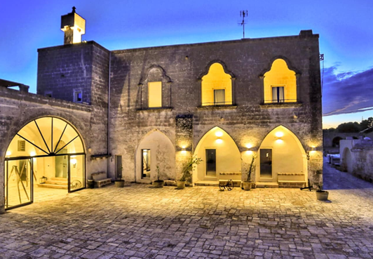
Case Study
https://nordiskvillage.com/locations/puglia/
Nordisk Village, Manduria, Puglia, Italy
Eco Friendly Wine Estate

Slide 2
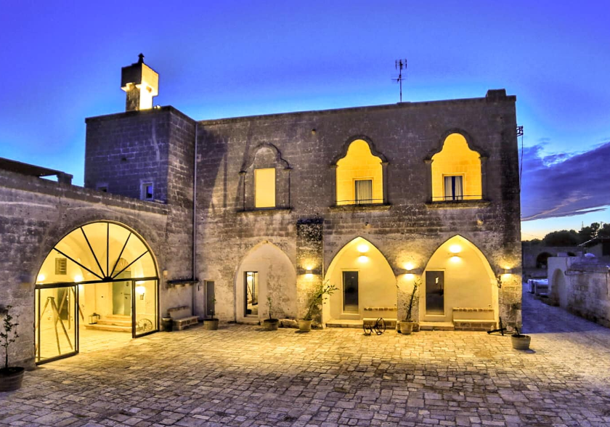
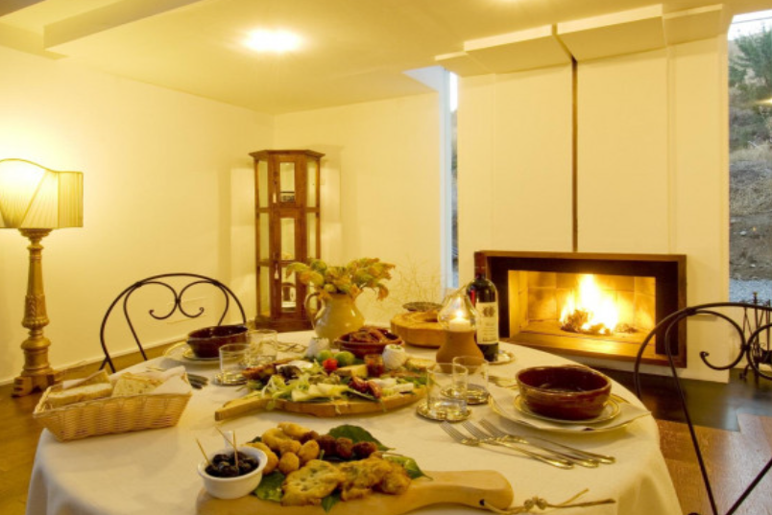


Nordisk Village Puglia – Manduria, Puglia is a Scandinavian-style glamping resort. Developed a sustainable glamping site within the historic Masseria Cuturi wine estate, featuring eco-friendly tents and communal facilities completely surrounded by the fortified walls of the farm, all leading down to the stunning beaches of Manduria. The target is to make every stay 100% emission-free through green energy, etc.
Features & Activities: Six cotton tents accommodating up to four guests each. Shared masonry bathroom, mini-bar, swimming pool, and relaxation room. Activities include wine tasting, cycling, and cultural tours.
See reviews on booking.com “Structure nothing short of fantastic, tents surrounded by greenery make the stay truly spectacular. The tent is super comfortable, equipped with all the comforts to make a 4-star hotel envy” and
Italy
Case Study
EPIC STAYS is licensed
under CC BY-SA 4.0
Funded by the European Union. Views and opinions expressed are however those of the author(s) only and do not necessarily reflect those of the European Union or the European Education and Culture Executive Agency (EACEA). Neither the European Union nor EACEA can be held responsible for them.

Slide 3
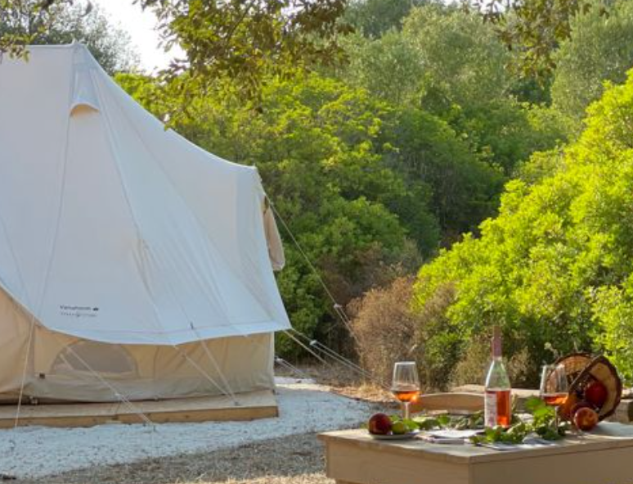
“A wonderful stay in a structure where you can breathe the air of genuineness and authenticity. A fantastic experience to relax in the middle of nature ❤️
Two special notes to the welcoming, helpful and knowledgeable staff about the history of the farm and the delicious breakfast, with quality ingredients.”

