Slide 1
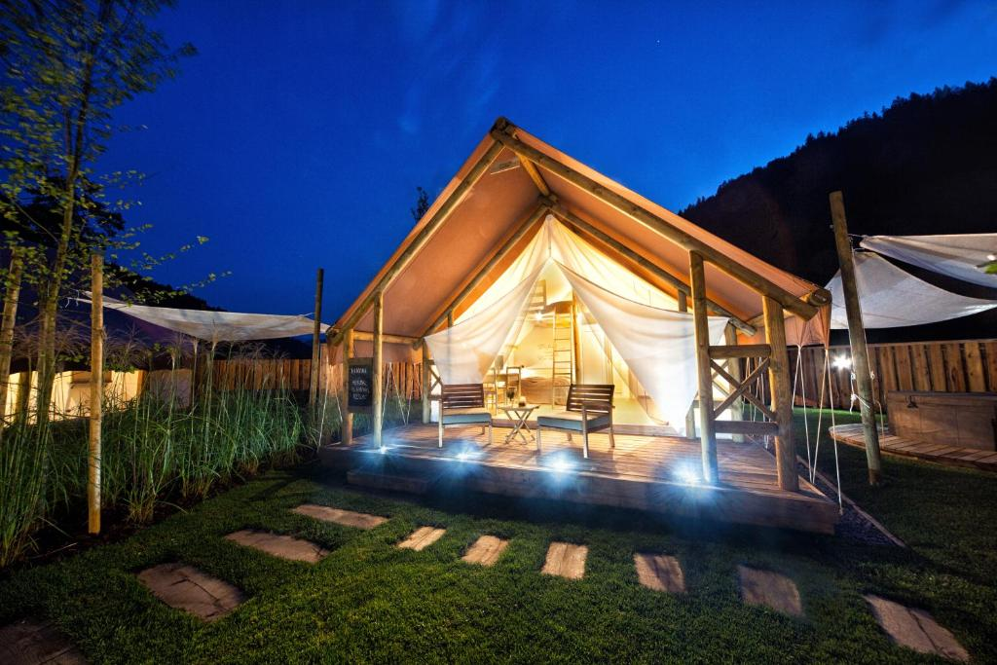
Case Study
BOOKING.COM
Herbal Glamping Resort Ljubno, Slovenia
A Sustainable Alternative Glamping Accommodation

Slide 2
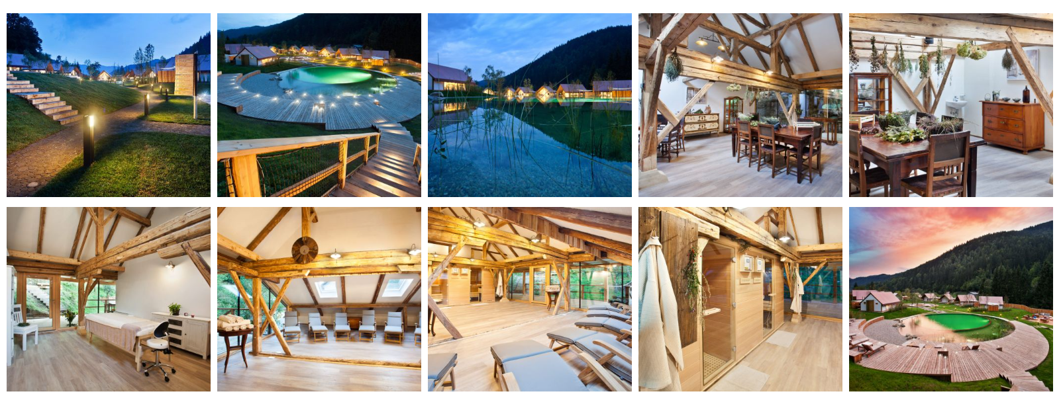
Case Study: Herbal Glamping Resort Ljubno
A Sustainable Alternative Glamping Accommodation
Located in the serene Upper Savinja Valley near Ljubno ob Savinji, Herbal Glamping Resort Ljubno is part of the Charming Slovenia brand. This resort seamlessly blends luxury with nature, offering guests an immersive experience centered around herbal wellness and ecological harmony. Source

Slide 3
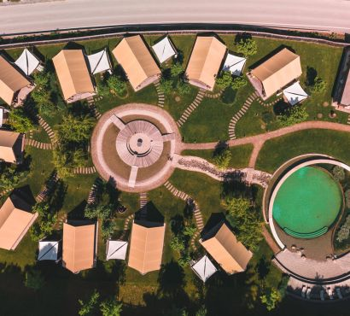
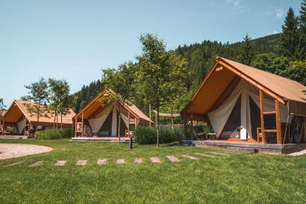


Case Study: Herbal Glamping Resort
Accommodation: The resort boasts 10 luxurious glamping tents, each equipped with modern amenities, private jacuzzis, and eco-friendly designs that minimize environmental impact.avtokampi.si
Herbal Integration: A central theme of the resort is its focus on herbs. Guests can explore an on-site herbal garden, participate in workshops, and enjoy herbal-infused spa treatments.
The entire village is intertwined with its herb and vegetable gardens. The main building houses the restaurant, where you can watch the top chef at work. All dishes are made with organic ingredients, and herbs and spices are freshly picked daily from their herb garden.
Sustainable Practices: The resort emphasizes sustainability through natural swimming pools without chemicals, energy-efficient facilities, and the use of local materials in construction.
Slovenia
Case Study
EPIC STAYS is licensed
under CC BY-SA 4.0
Funded by the European Union. Views and opinions expressed are however those of the author(s) only and do not necessarily reflect those of the European Union or the European Education and Culture Executive Agency (EACEA). Neither the European Union nor EACEA can be held responsible for them.

