Slide 1
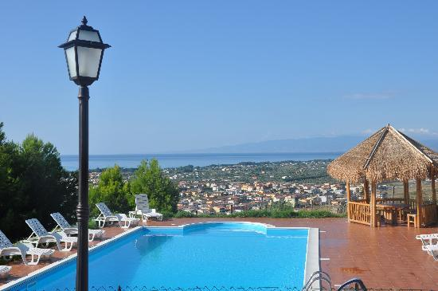

Accommodation Type:
Acqua di Friso accommodation Calabria holiday to the sea: Eco-apartments, self-catering and rooms in farm holiday Calabria, swimming pool, gourmet restaurant.
The agritourism of 18 hectares offers a beautiful view of the Gulf of Squillace in the Ionian Sea and a summer pool. t has private beach access through a gate in the farm. You can be free to go with the car in 10 minutes. It is a unique place, a SIC (protected area) with rare water lilies, traces of endangered turtles and turrets to view the flight of birds.
Case Study
Agricampeggio Acqua di Friso, Italy
Website: https://www.acquadifriso.it/en/
1

Slide 2
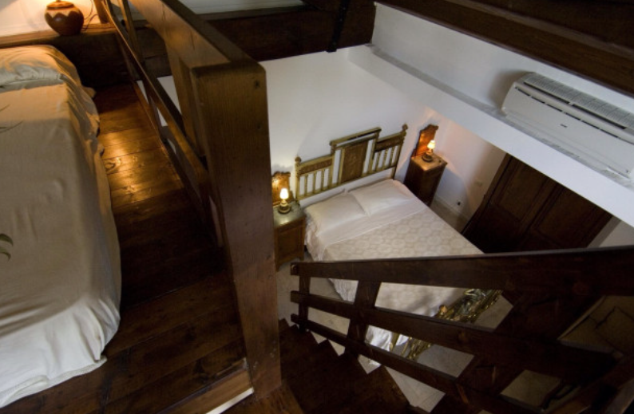
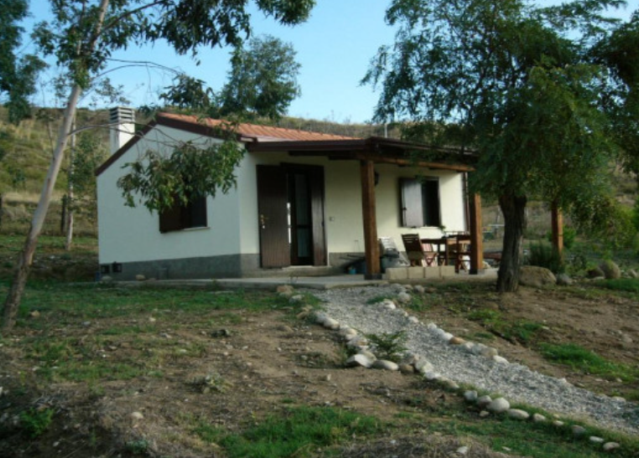


Agricampeggio Acqua di Friso
Eco-Glamping agri camping and glamping in Calabria near the sea.
Sustainability: Situated within an organic farm spanning 18 hectares of pine, olive, and eucalyptus trees. Offers eco-friendly accommodations, including glamping tents and campsite pitches, promoting low-impact tourism. Features a private sandy beach accessible via a short drive, emphasising a connection with nature.
Amenities and Services: Provides a swimming pool, playground, and a restaurant serving homemade dishes prepared with organic ingredients from the farm. It also hosts workshops and activities related to agriculture and sustainability, enhancing the guest experience.
Community Engagement: Collaborates with local producers and artisans, supporting the regional economy. Encourages guests to explore nearby natural attractions, such as the Sila National Park, promoting environmental awareness.
Italy
Case Study
EPIC STAYS is licensed
under CC BY-SA 4.0
Funded by the European Union. Views and opinions expressed are however those of the author(s) only and do not necessarily reflect those of the European Union or the European Education and Culture Executive Agency (EACEA). Neither the European Union nor EACEA can be held responsible for them.

Slide 3
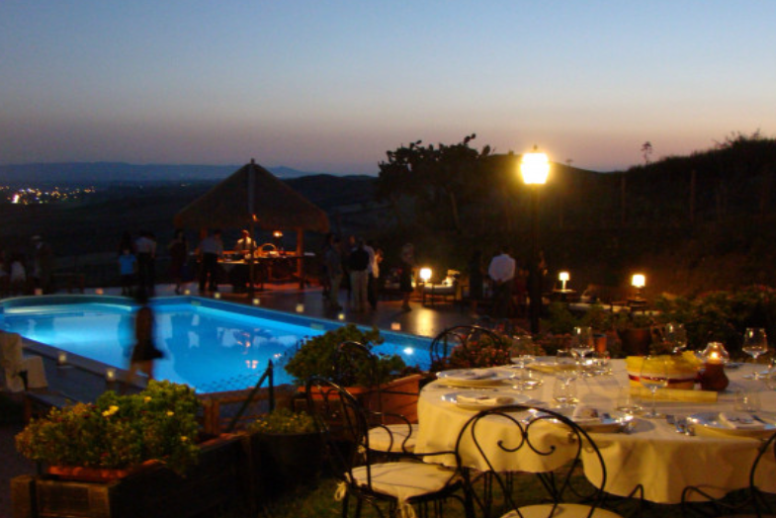
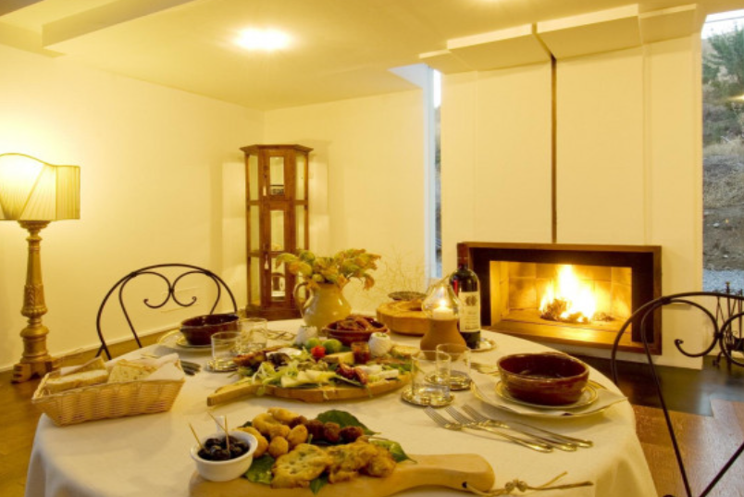
Agricampeggio Acqua di Friso
Recognition and Reviews: Highly rated on platforms like Pitchup.com for its serene environment and commitment to sustainability. Praised by guests for its authentic experiences and eco-conscious approach.
Key Outcomes: High occupancy rates in peak season. Great reviews and satisfaction from guests. Local partnerships formed by collaborating with local businesses and artisans.
Success Factors
Integrate Sustainability: Emphasise eco-friendly practices in operations and accommodations.
Leverage Local Resources: Collaborate with local communities to offer authentic, immersive experiences.
Promote Environmental Education: Engage guests with activities that highlight environmental conservation and sustainability.
Italy
Case Study

