Slide 1
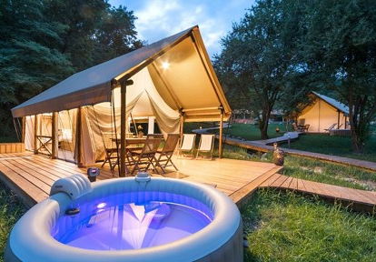


Case Study
Chateau Ramšak
Chateau Ramšak, Wine Glamping Resort, Slovenia
This project was co-funded by EU cohesion funds – it was the final recipient of an ERDF-supported financial instrument
EPIC STAYS is licensed
under CC BY-SA 4.0
Funded by the European Union. Views and opinions expressed are however those of the author(s) only and do not necessarily reflect those of the European Union or the European Education and Culture Executive Agency (EACEA). Neither the European Union nor EACEA can be held responsible for them.

Slide 2
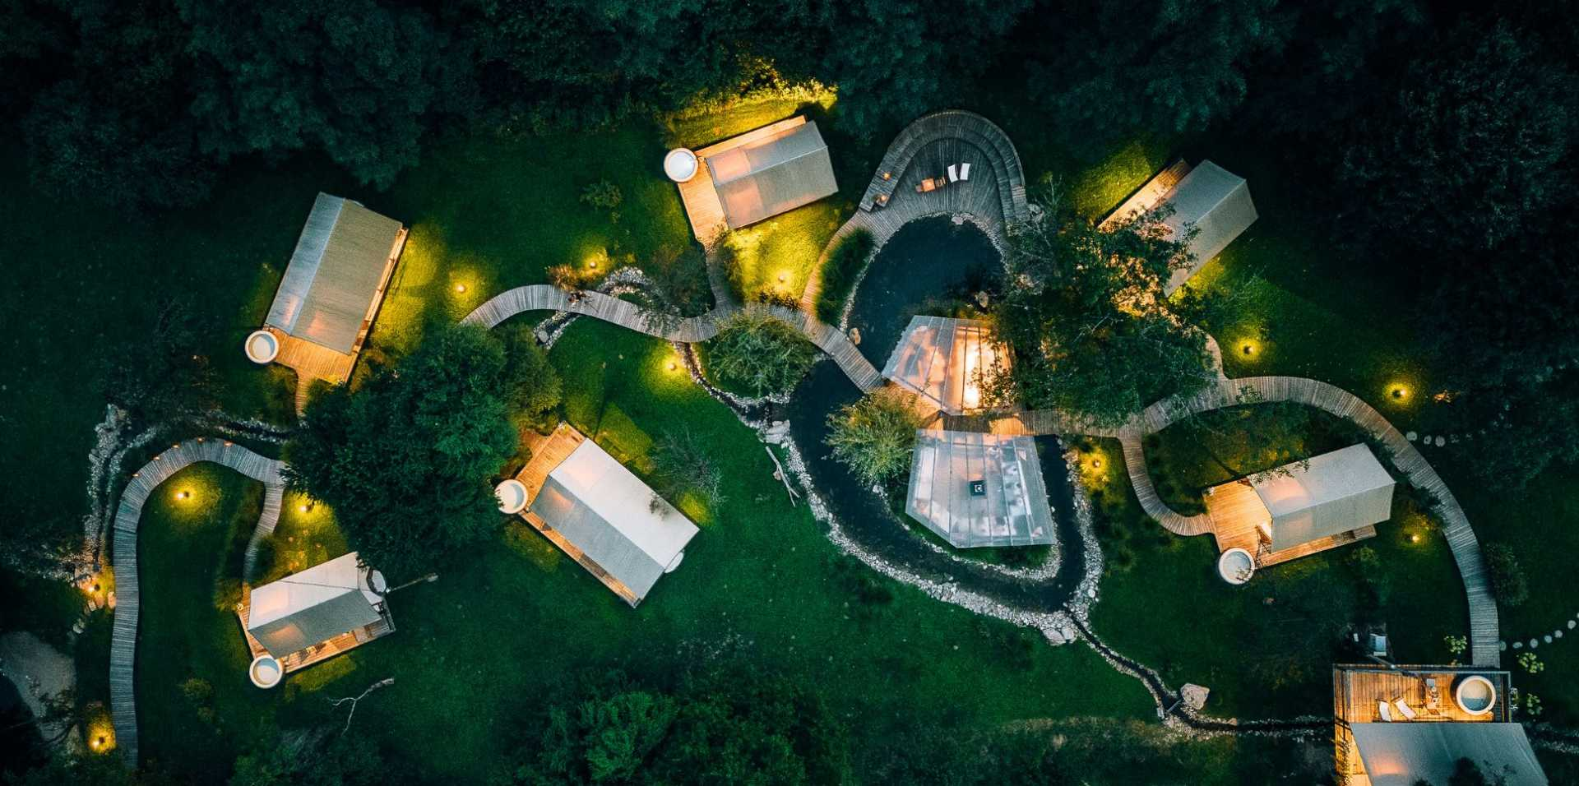

Slide 3
Success Stories and Case Studies
Chateau Ramšak, Wine Glamping Resort, Slovenia
Chateau Ramšak in Slovenia’s Styria region is a high-end glamping resort set in a vineyard. It features treehouses and luxury safari tents with private hot tubs and has won multiple awards. Notably, this project was co-funded by EU cohesion funds – it was the final recipient of an ERDF-supported financial instrument.
Funding Model: The owners combined an ERDF-backed loan (through a Slovenian bank) with their own capital. Under the EU's 2014–2020 Cohesion policy, the resort received €192,500 from the European Regional Development Fund (ERDF)—€163,625 directly contributed by the EU—to support the development of innovative and sustainable tourism infrastructure. The EU funding likely covered around 50% of the investment in the form of a low-interest loan or grant.
This allowed them to invest in quality – each treehouse has bespoke furnishings, and there’s infrastructure like a natural pond and winery on site. With the funding, they initially built six units. https://www.chateauramsak.com/

Slide 4
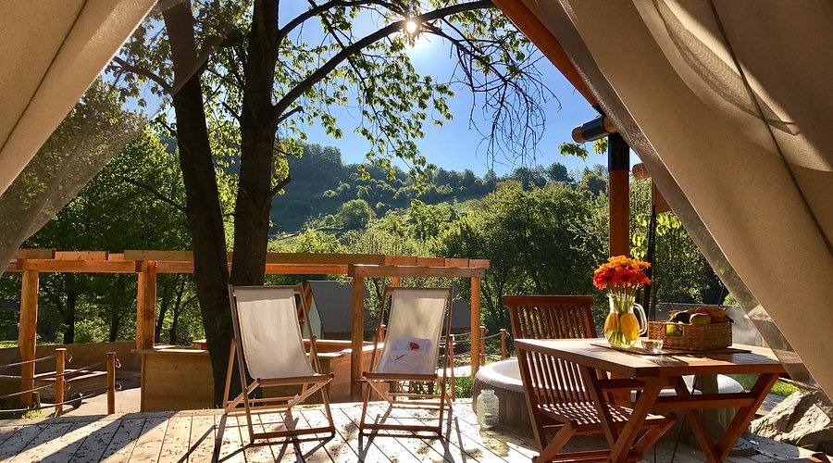
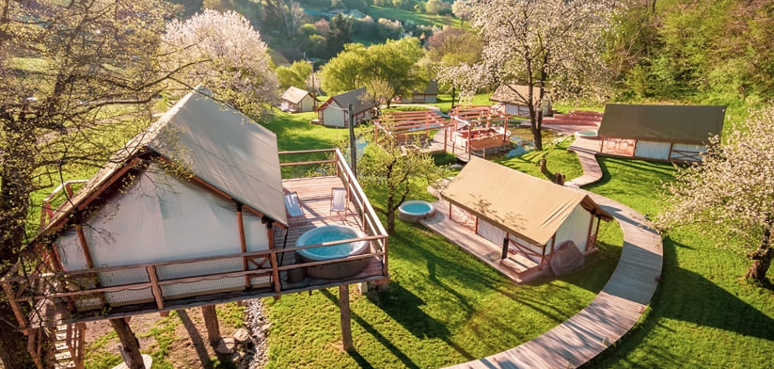
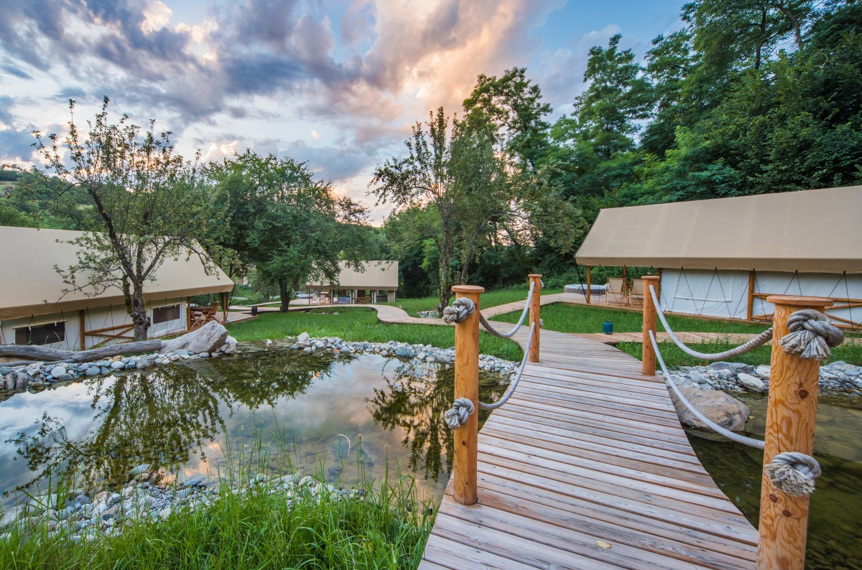


Slide 5
Success Stories and Case Studies
Success: By aligning with Slovenia’s push for innovative tourism (wine tourism + glamping), they accessed funds that require showing regional impact (job creation, attracting higher-value tourists). They now operate seasonally with very high occupancy and rates (over €300/night for treehouse), drawing visitors globally. They’ve scaled carefully – reinvesting profits to add amenities (they added a honeymoon treehouse recently).
Scaling & Tips: They leveraged the region’s strength (wine and nature) – a lesson that tying your business to local culture/strengths can strengthen funding applications and market appeal. They advise new glamping operators to invest in quality (“People will pay for luxury in nature”) and to utilize available support – the owners networked with the Slovenian Tourism Board and participated in promotional events through national initiatives, which helped put them on the map. This case demonstrates how Slovenia’s enterprise funds and EU programs can catalyse a world-class glamping business, but one must align the project with strategic themes to win that support.

Slide 6
