Slide 1
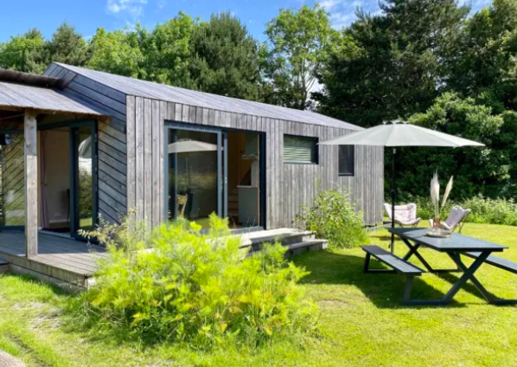


Case Study
https://www.weergors.nl/
Camping ’t Weergors, Holland
Camping Site
Our charming, medium-sized family campsite is located in the heart of the former South Holland island of Voorne-Putten, near the Haringvliet inlet and the North Sea beach. The 19th-century farmhouse remains the heart of the campsite.
EPIC STAYS is licensed
under CC BY-SA 4.0
Funded by the European Union. Views and opinions expressed are however those of the author(s) only and do not necessarily reflect those of the European Union or the European Education and Culture Executive Agency (EACEA). Neither the European Union nor EACEA can be held responsible for them.

Slide 2
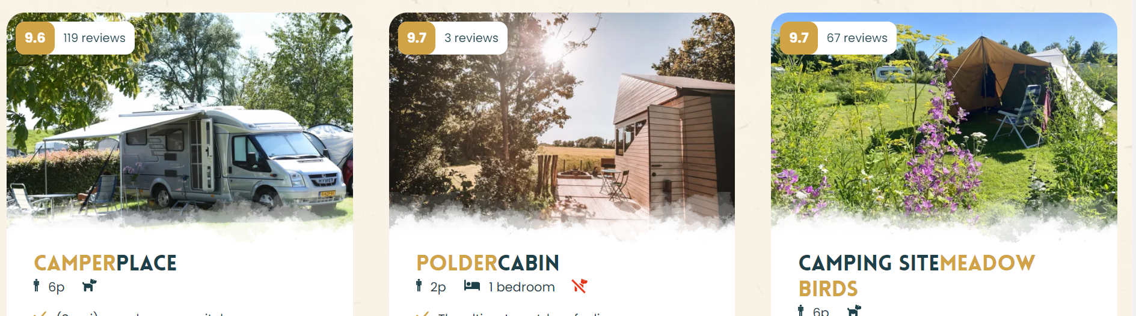
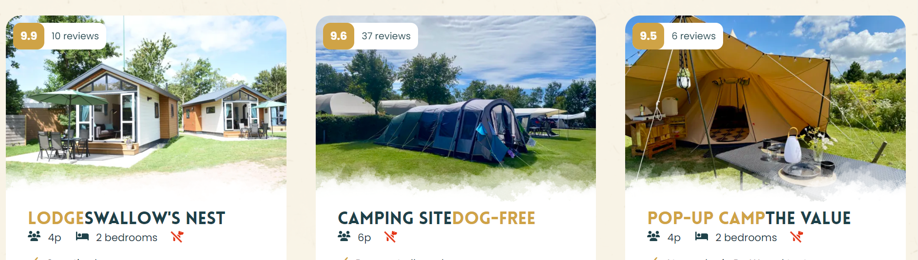

Slide 3
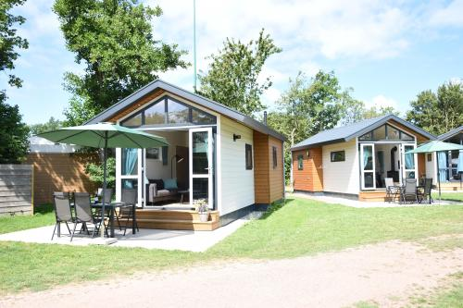
Case Study: Camping ’t Weergors
EU Rural Development (EAFRD/LEADER/PSR): Small-scale, community-led projects can qualify. Such projects often rely on mixed funding sources.
Camping ’t Weergors (Voorne-Putten, ZH).
A family campsite turned “landschapscamping” is testing an off-grid hut using LEADER (EU rural) funding.
As one report notes,
“Dankzij een subsidie van LEADER Zuid-Hollandse Eilanden kan de familiecamping een innovatieve oplossing testen: … inclusief off-grid toiletten, vuurplaats en shelter/kookplaats”.
In other words, the LEADER grant let them build a self-contained lodging (toilet, kitchen, sleeping shelter) in the woods.

Slide 4
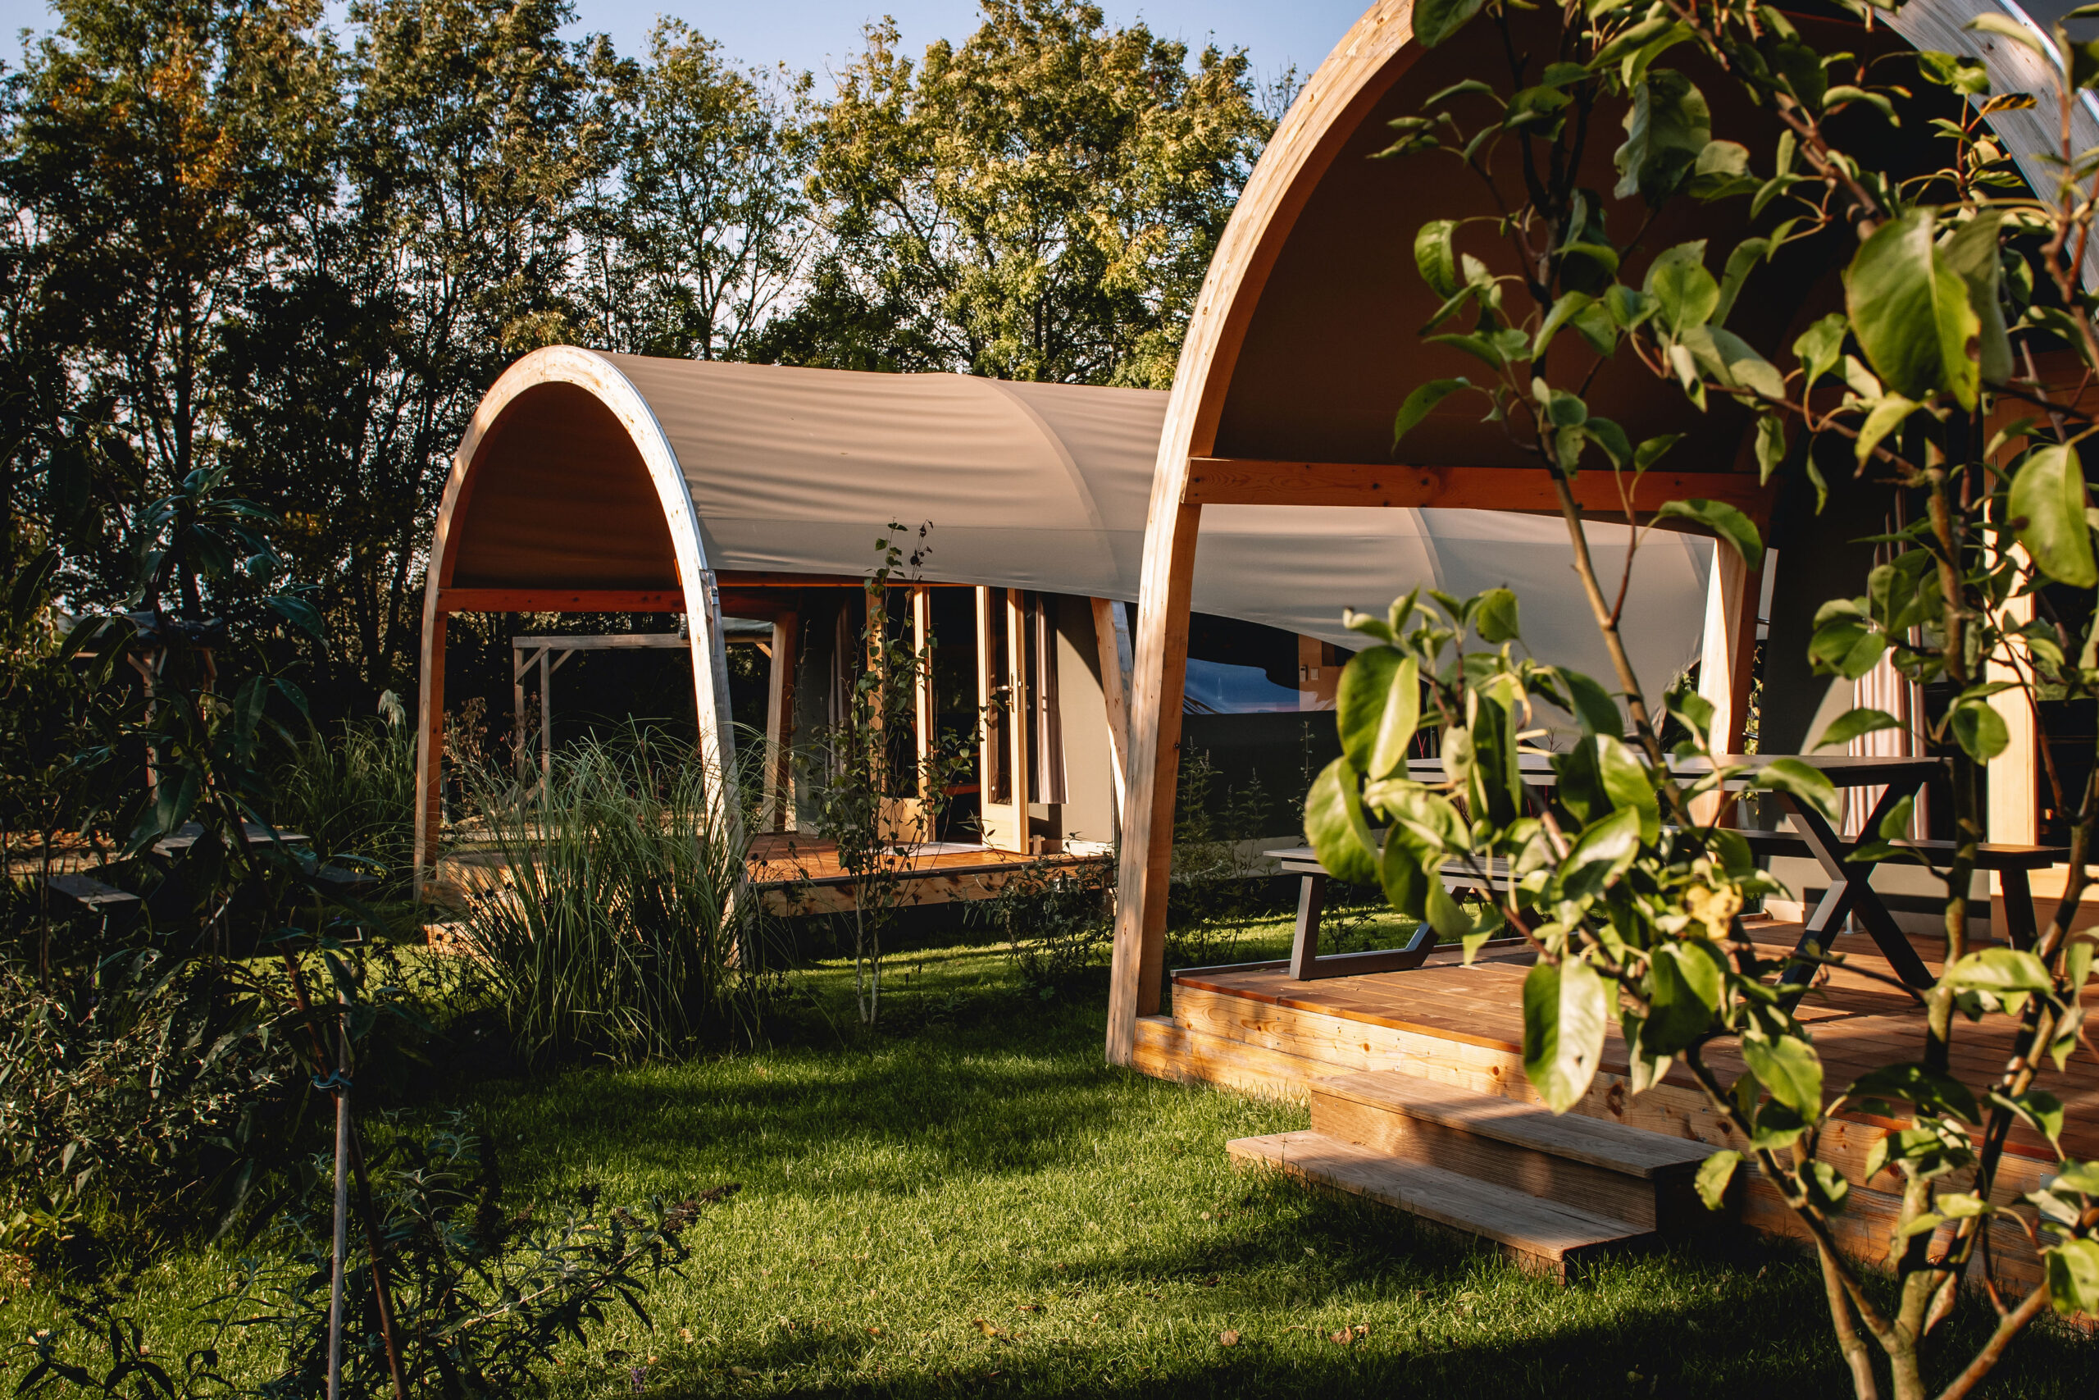
Case Study: Camping ’t Weergors
What they did: This pilot helps them learn what works for guests and can be applied elsewhere.
(Tip: Regional LAGs often approve such small-scale eco-tourism pilots.)
The grant enabled the building of a nature-integrated shelter with composting toilets and an outdoor kitchen, allowing the family to test how “sustainable tourism” works in practice. Source
Many agri-entrepreneurs or village cooperatives similarly use PSR or LEADER funds (often up to €20k–€100k) to add glamping units, trail huts or eco-B&B’s. Photos from Camping’t Weergors.
EPIC STAYS is licensed
under CC BY-SA 4.0
Funded by the European Union. Views and opinions expressed are however those of the author(s) only and do not necessarily reflect those of the European Union or the European Education and Culture Executive Agency (EACEA). Neither the European Union nor EACEA can be held responsible for them.

