Slide 1
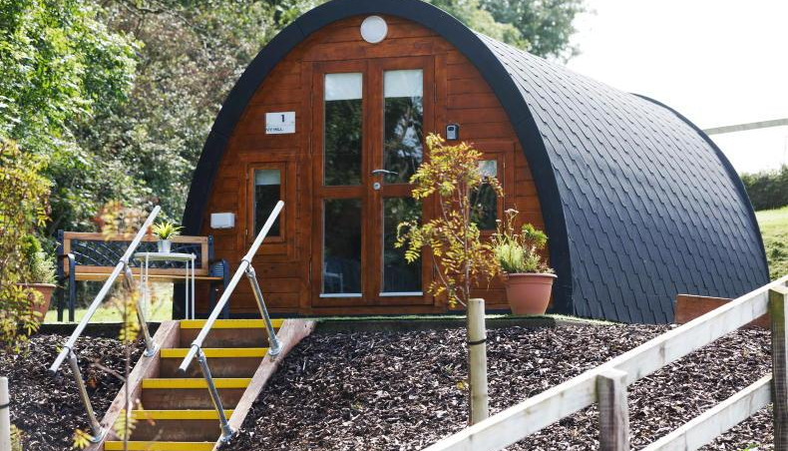


Ivy Hill Glamping is a real example of a farmer diversifying successfully to an alternative tourism accommodation.
Alan, a beef farmer in County Clare, installed one glamping pod on unused farmland in 2021 and gradually built popularity.
He started small – just one unit – mainly self-financed and using farm revenue.
The pod features comfy beds, a kitchenette and even a TV, showing that meeting guest comfort needs was key.
Photo Credit: Ivy Hill Glamping
Case Study
Information Sources
Top Pod or Not to Pod
Website: Ivy Hill Glamping
Ivy Hill Glamping, County Clare, Ireland
EPIC STAYS is licensed
under CC BY-SA 4.0
Funded by the European Union. Views and opinions expressed are however those of the author(s) only and do not necessarily reflect those of the European Union or the European Education and Culture Executive Agency (EACEA). Neither the European Union nor EACEA can be held responsible for them.

Slide 2
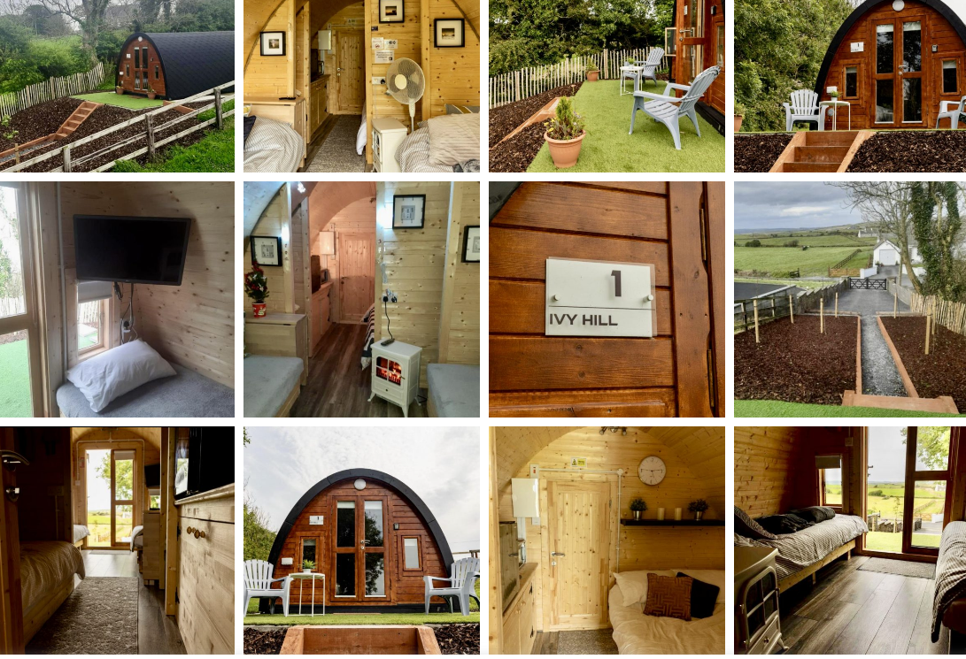

Slide 3
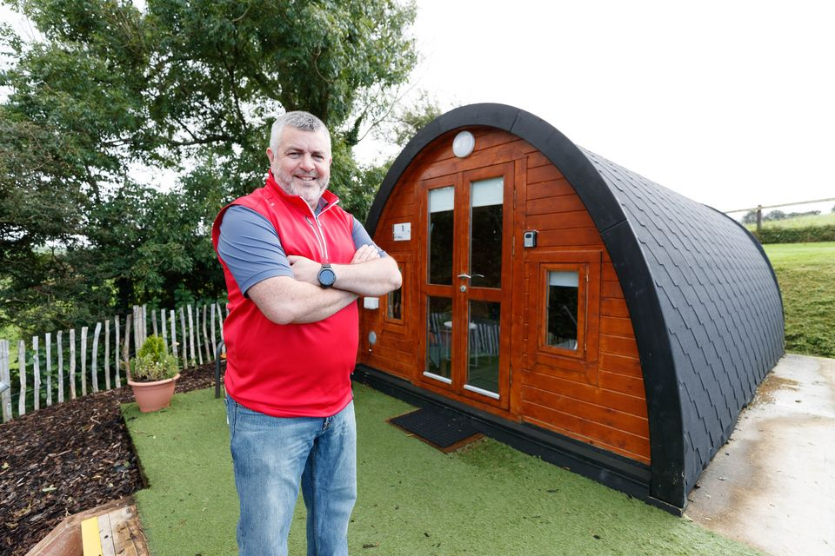



CASE STUDY Ivy Hill Glamping
Ivy Hill Glamping in Co. Clare began with one pod and scaled with LEO support. Alan Vaughan, a dry-stock farmer, successfully diversified his farm by introducing glamping accommodations.
He established Ivy Hill Glamping, which has attracted both domestic and international visitors, with at least half of the bookings coming from foreign guests.
This venture has provided an additional income stream and enhanced the value of his farm, demonstrating the potential benefits of agritourism for farmers in suitable locations.
Note: LEO grants prioritise manufacturing or export-oriented businesses, but innovative tourism projects may qualify, especially if they show job creation and potential to attract overseas visitors (making it an “export” in a sense).

Slide 4
In the beginning, business was slow, but positive reviews and word-of-mouth led to a surge in bookings.
Funding & Growth: Alan likely used personal funds for the first pod (approx €15k–€20k cost). As bookings grew, he reinvested earnings to add amenities and plan for additional pods.
He also leveraged support from agencies: he engaged with Fáilte Ireland’s quality assurance and the Irish Self-Catering Federation for training. Importantly, local supports, such as the Local Enterprise Office and LEADER, were mentioned as potential grant sources – although the case doesn’t specify whether he took a grant, these supports are accessible. Alan’s story highlights “start small, prove demand”. Now, with consistent occupancy (even if mostly one-night stays by road trippers), he’s considering adding more pods.
Tip: He chose a weather-resilient, purpose-built unit and secured insurance easily by having a solid structure. Future entrepreneurs can learn that gradually scaling (1 pod to start) can be a smart, lower-risk approach.
Getting off the ground!
Blended Financing & Business Support

Slide 5
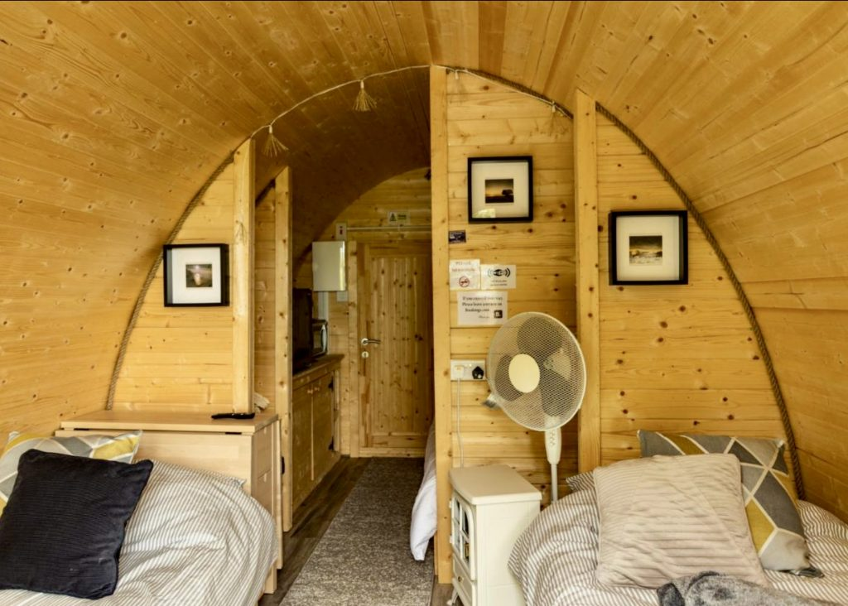
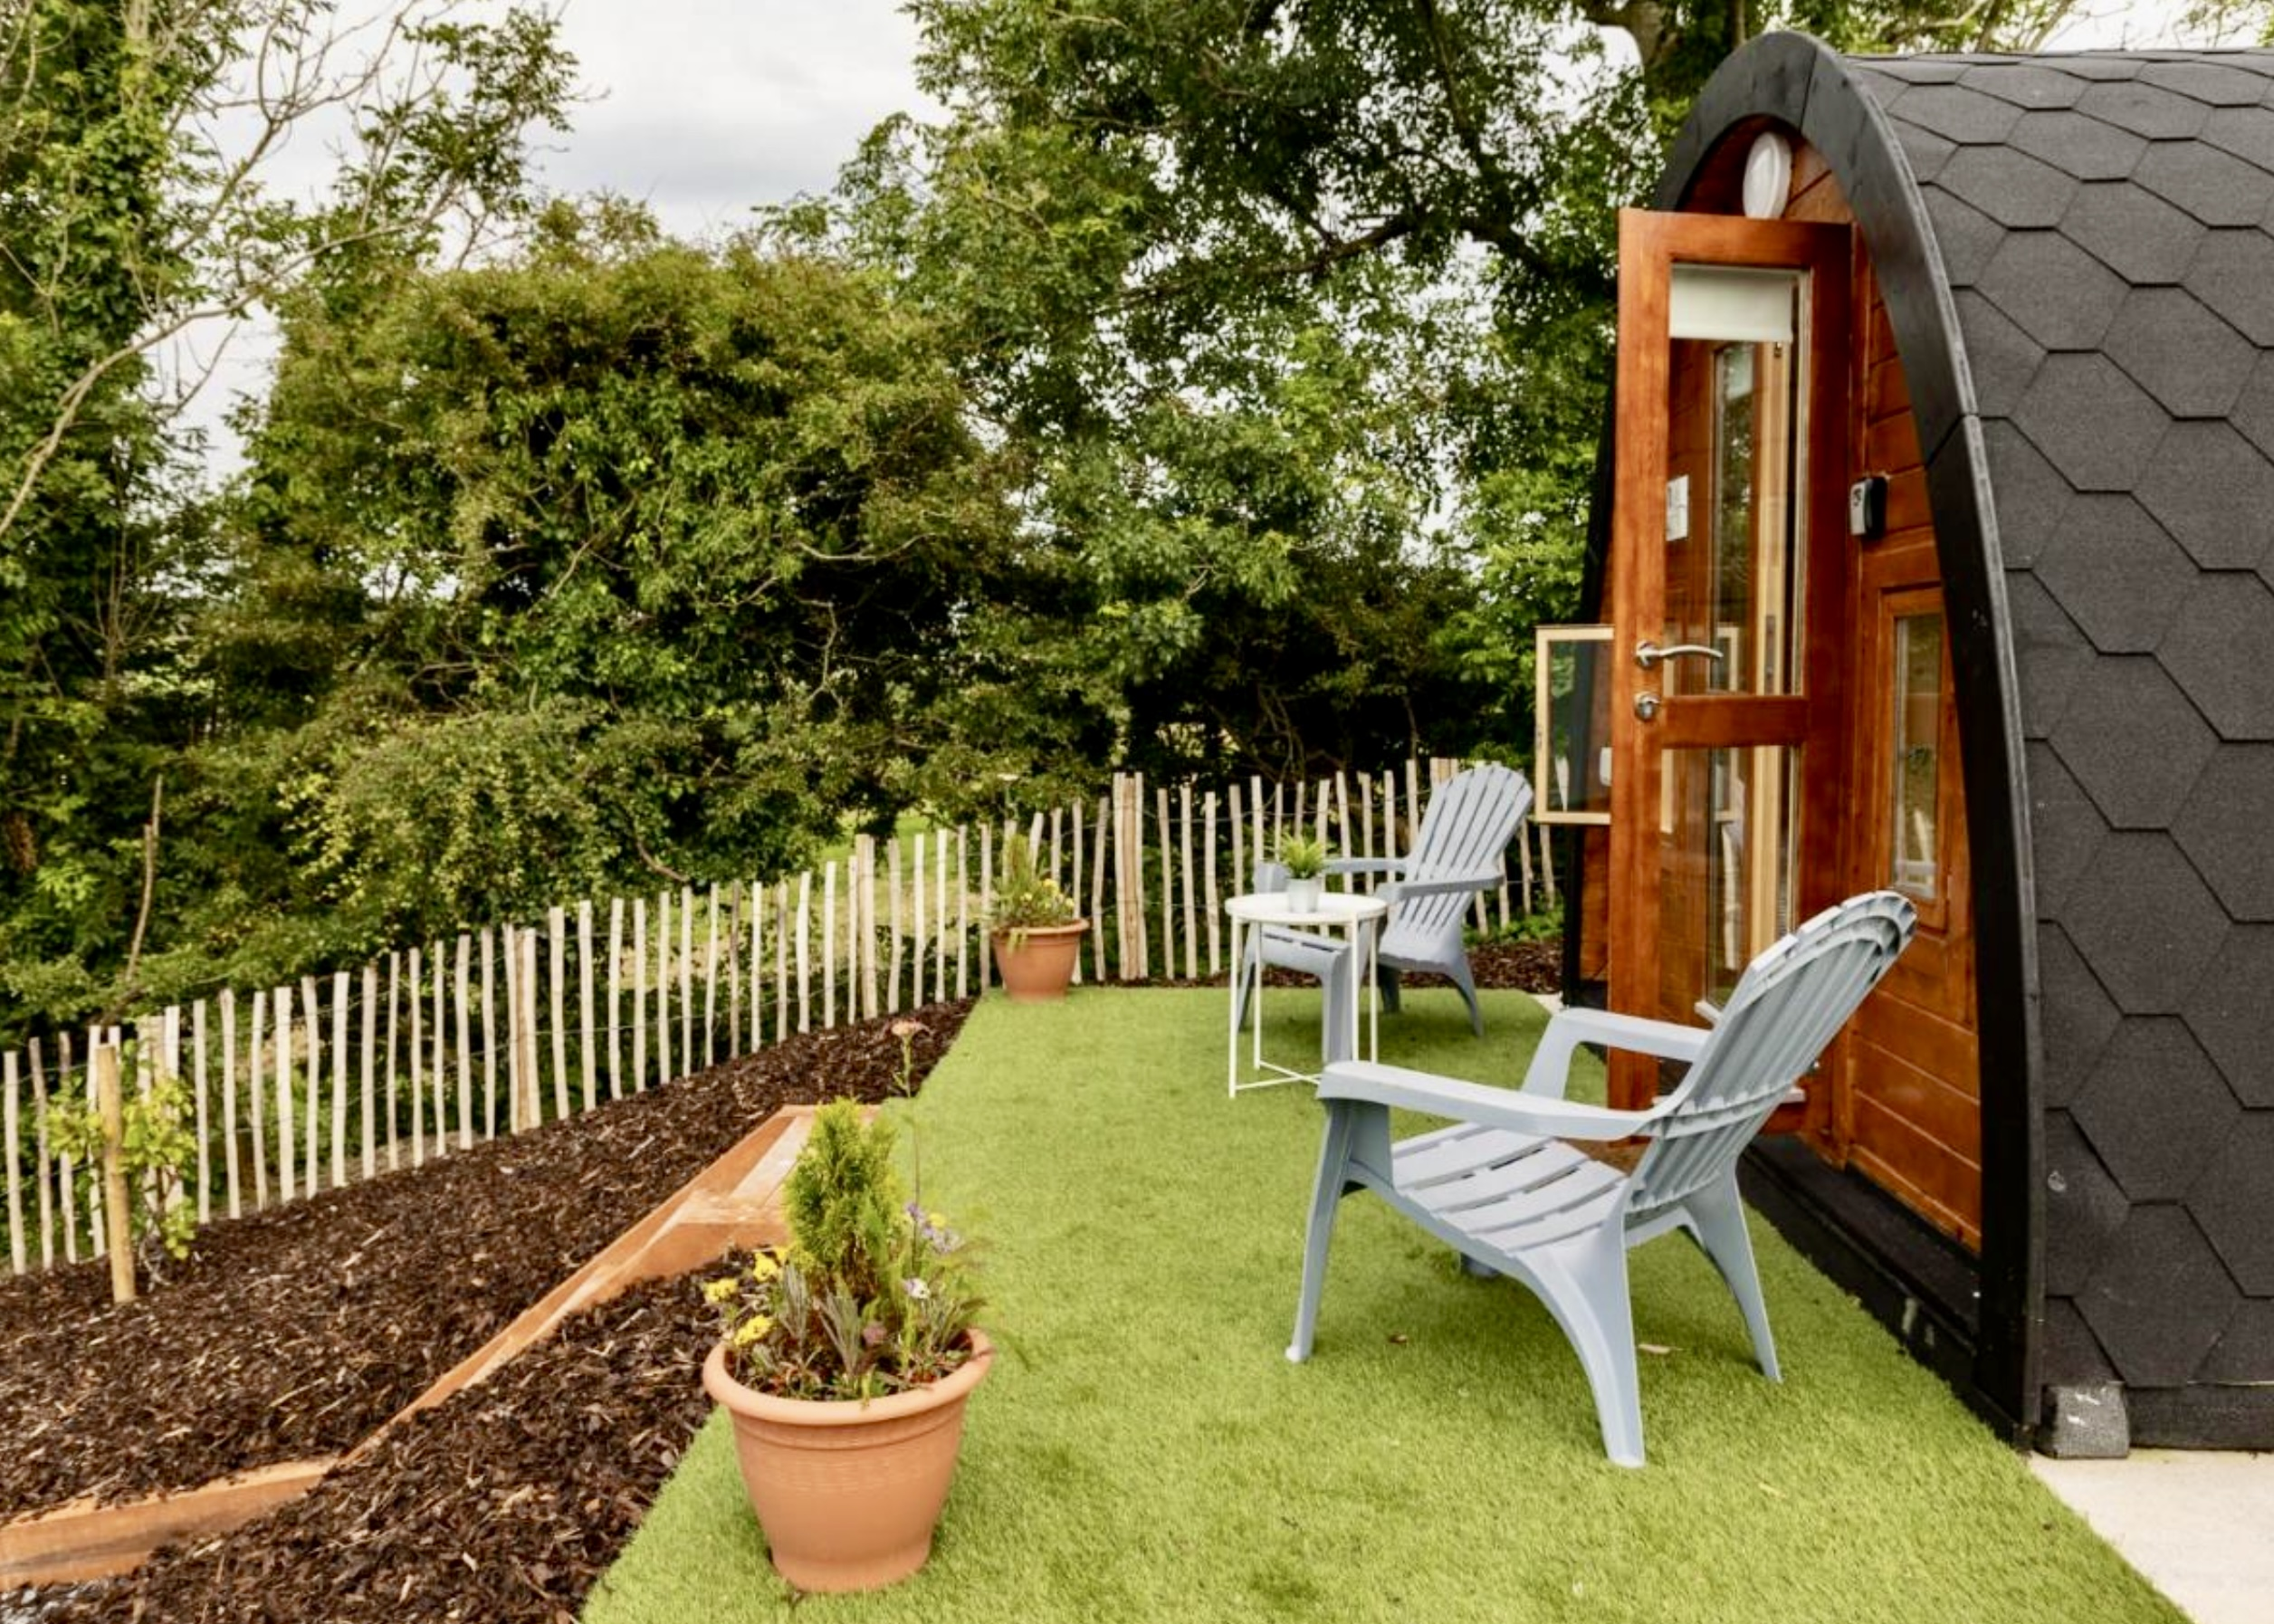
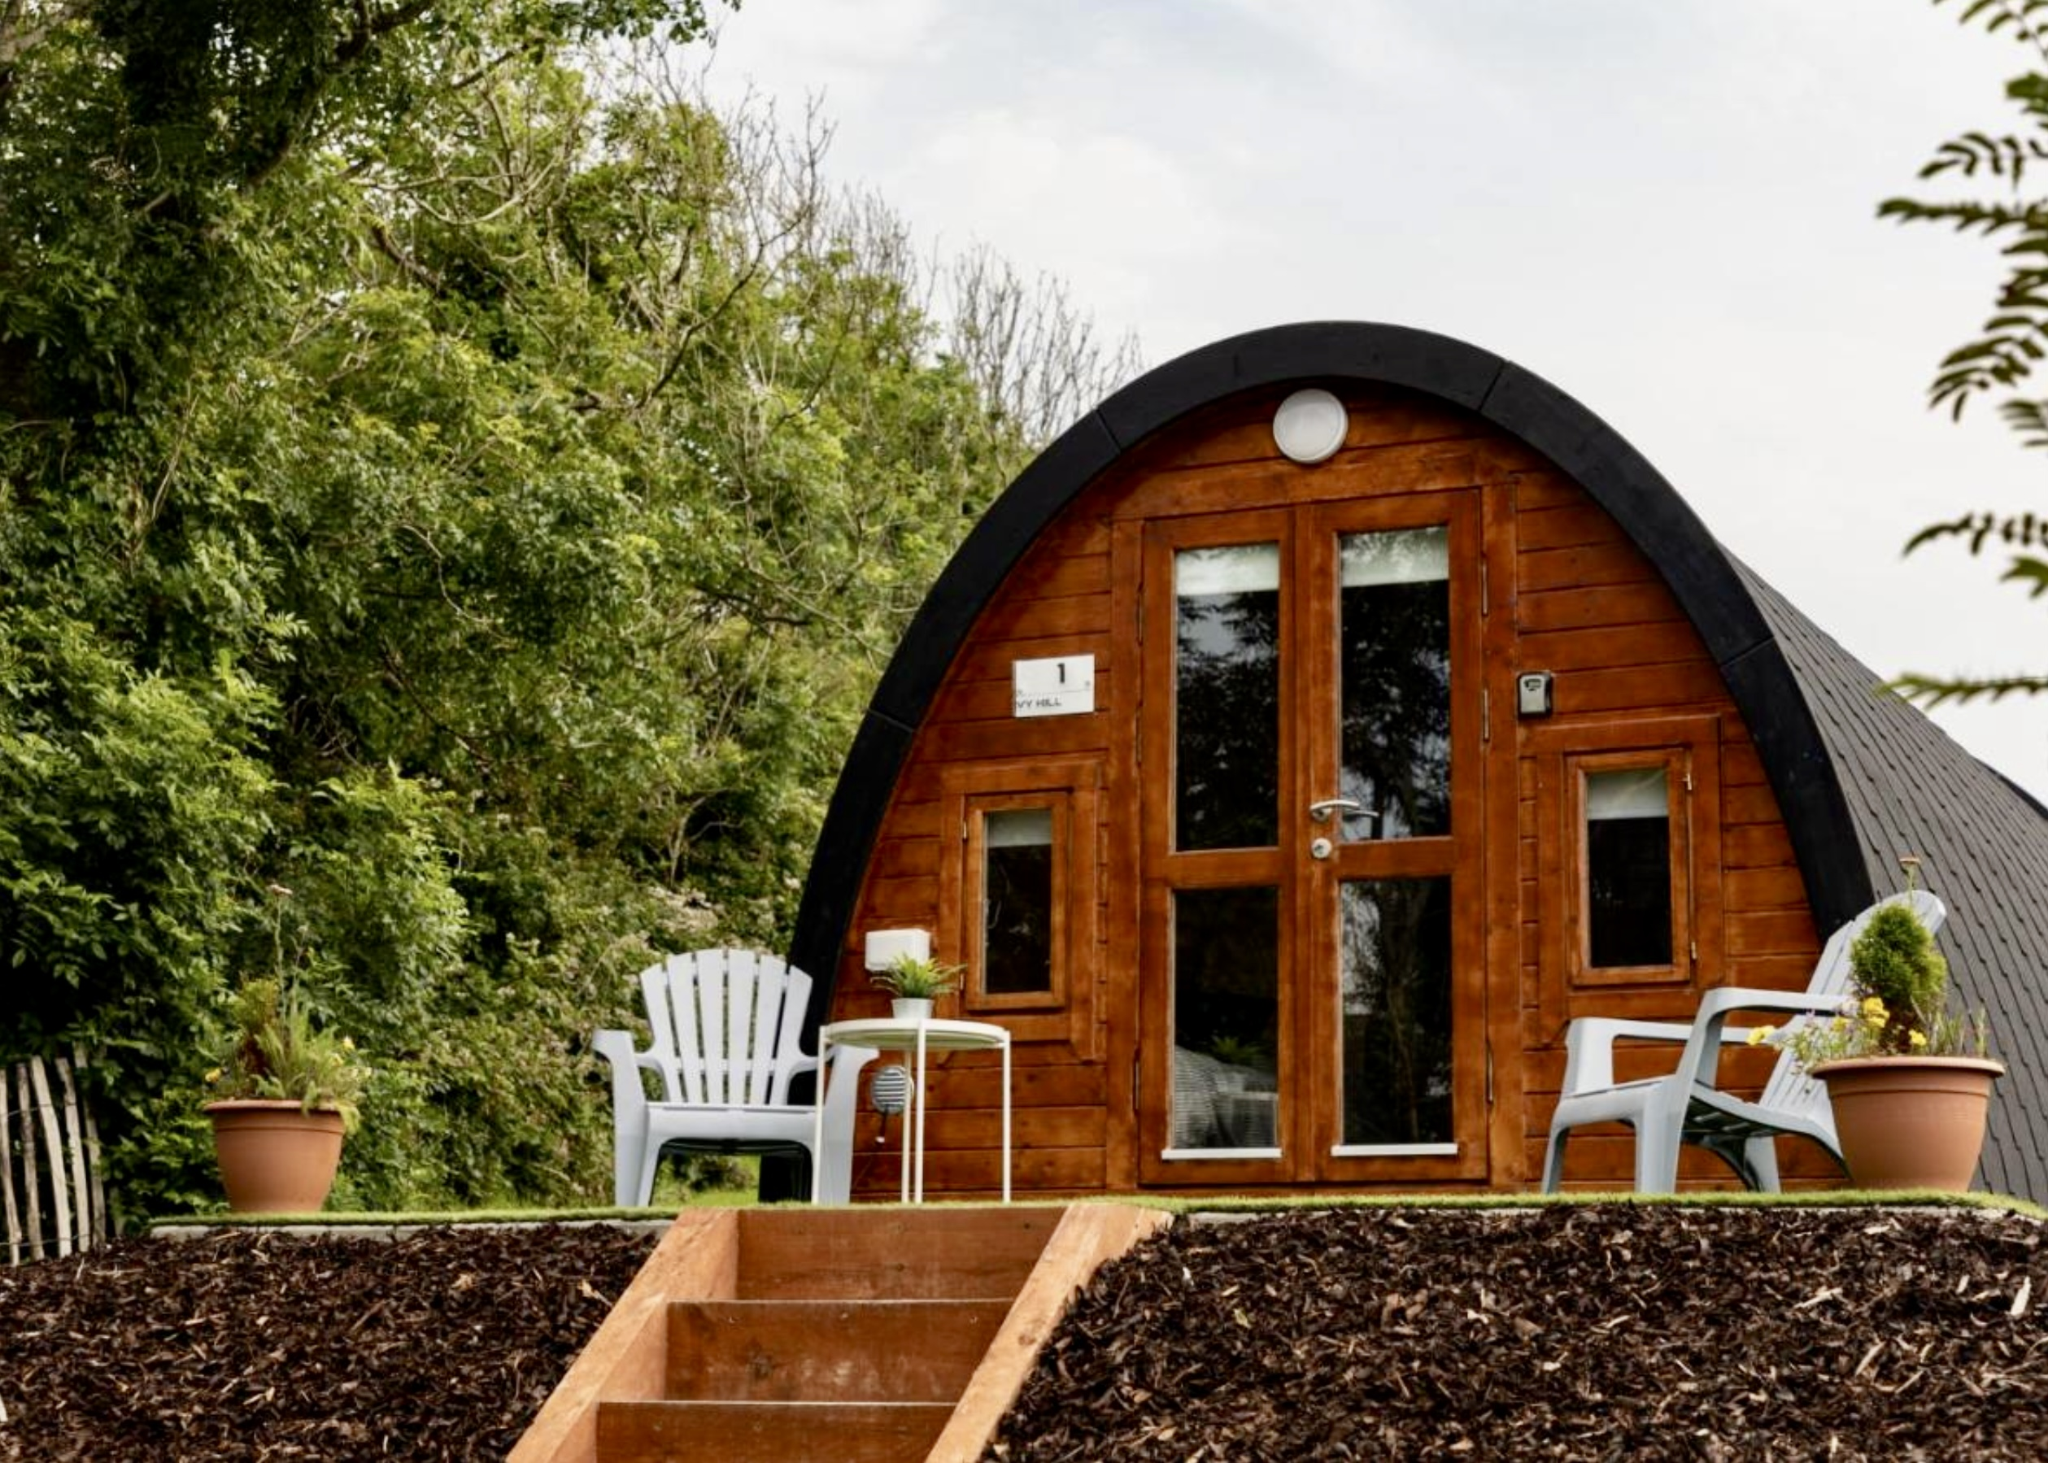
CASE STUDY Ivy Hill Glamping
For instance, the Glamping Pod One Bed 4m X 8m from Loghouse, priced at €13,630.00, offers a ready-made solution for accommodating guests.
‘Why opening one glamping pod on his farm was the best thing this Clare farmer has ever done’ Irish Independent
For those considering a similar venture, starting with a single glamping pod can be a manageable way to test the market.
For those considering a similar venture, starting with a single glamping pod can be a manageable way to test the market.
Additionally, equipping the pod with amenities like the Rhino-Pods Cubit—a compact, portable outdoor kitchen with a sink and self-powered tap—can enhance the guest experience.

