Slide 1
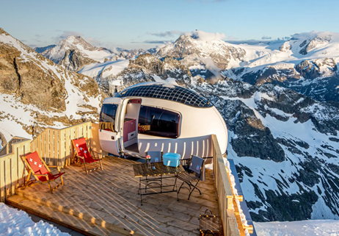


Case Study
Ecocapsule
Ecocapsule – Slovakia (Crowdfunding with Indiegogo)
Off-grid
Mobile Home
EPIC STAYS is licensed
under CC BY-SA 4.0
Funded by the European Union. Views and opinions expressed are however those of the author(s) only and do not necessarily reflect those of the European Union or the European Education and Culture Executive Agency (EACEA). Neither the European Union nor EACEA can be held responsible for them.

Slide 2
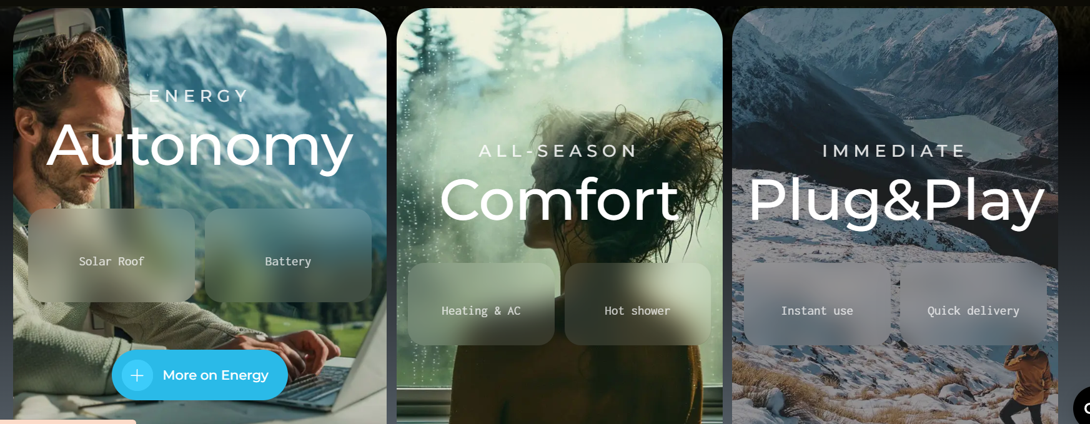
https://ecocapsule.com/

Slide 3
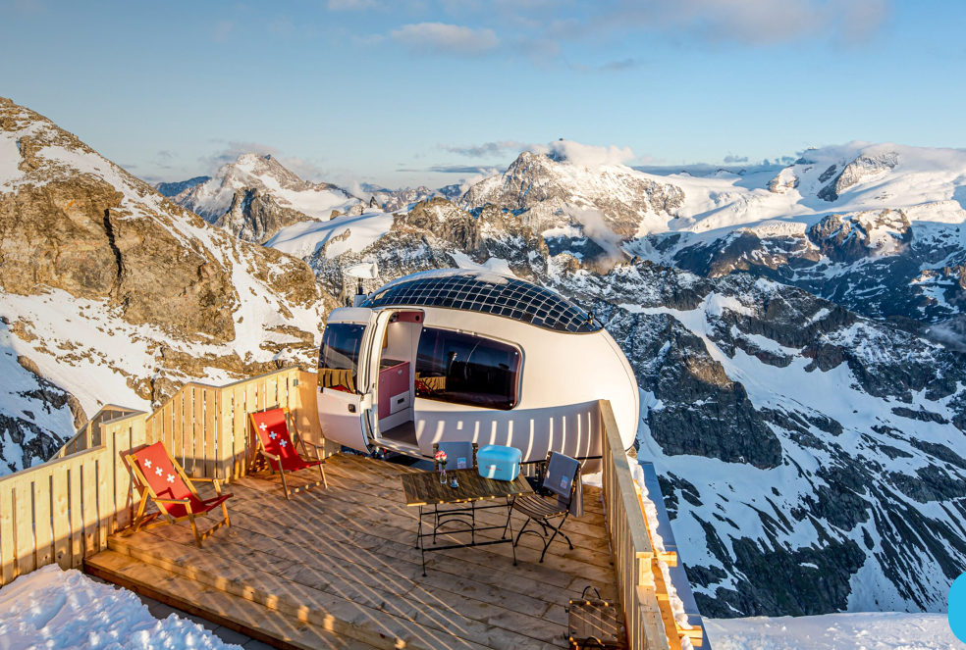
Case Study: Ecocapsule – Slovakia (Crowdfunding with Indiegogo)
Ecocapsule is a smart, self-sustainable micro-home powered by solar and wind energy. It’s shaped like an egg and built with cutting-edge sustainable technologies. Designed for off-grid eco-tourism, tiny living and as a remote accommodation (glamping, research stations)
What they did: Promoted as a sustainable pod for glamping, wilderness retreats, or eco-hostels. Its futuristic design captured media attention, highlighting its green energy appeal and providing a strong brand story and visuals, and requested support from a community of eco-tourism advocates willing to support innovation.
Website https://ecocapsule.com/
The goal was to raise €50,000 — they raised over €200,000 from eco-conscious backers globally.

Slide 4
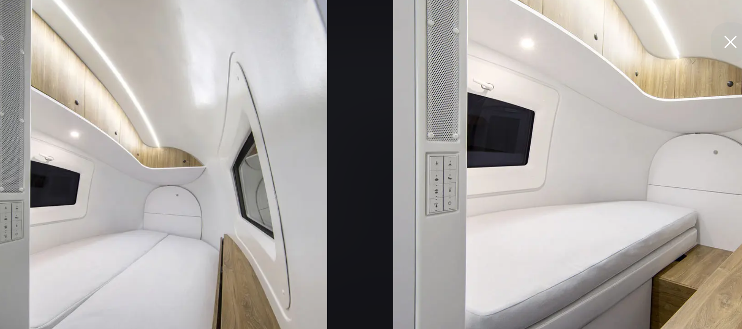
https://ecocapsule.com/

Slide 5
Case Study: Ecocapsule – Slovakia (Crowdfunding with Indiegogo)
Outcome: Up and running and installed in places like mountain retreats and vineyards. Used for nature-based tourism, glamping pods are often located in national parks and remote areas. Installed in eco-resorts like Iceland, Spain and other countries.
Used for event spaces, conferences and eco-festivals. Deployed as emergency housing for disaster responses.
EPIC STAYS is licensed
under CC BY-SA 4.0
Funded by the European Union. Views and opinions expressed are however those of the author(s) only and do not necessarily reflect those of the European Union or the European Education and Culture Executive Agency (EACEA). Neither the European Union nor EACEA can be held responsible for them.

