Slide 1
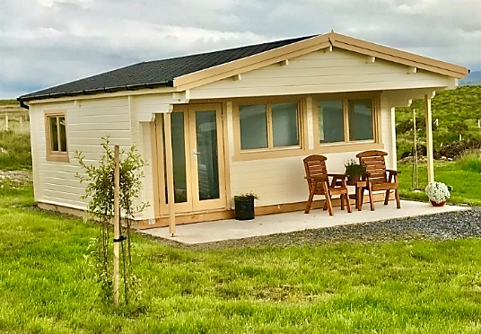


Case Study
Ardara Farm, Ireland
Ardara Farm, Ireland Farm Diversification Project Made Possible with LEADER Funding
EPIC STAYS is licensed
under CC BY-SA 4.0
Funded by the European Union. Views and opinions expressed are however those of the author(s) only and do not necessarily reflect those of the European Union or the European Education and Culture Executive Agency (EACEA). Neither the European Union nor EACEA can be held responsible for them.

Slide 2
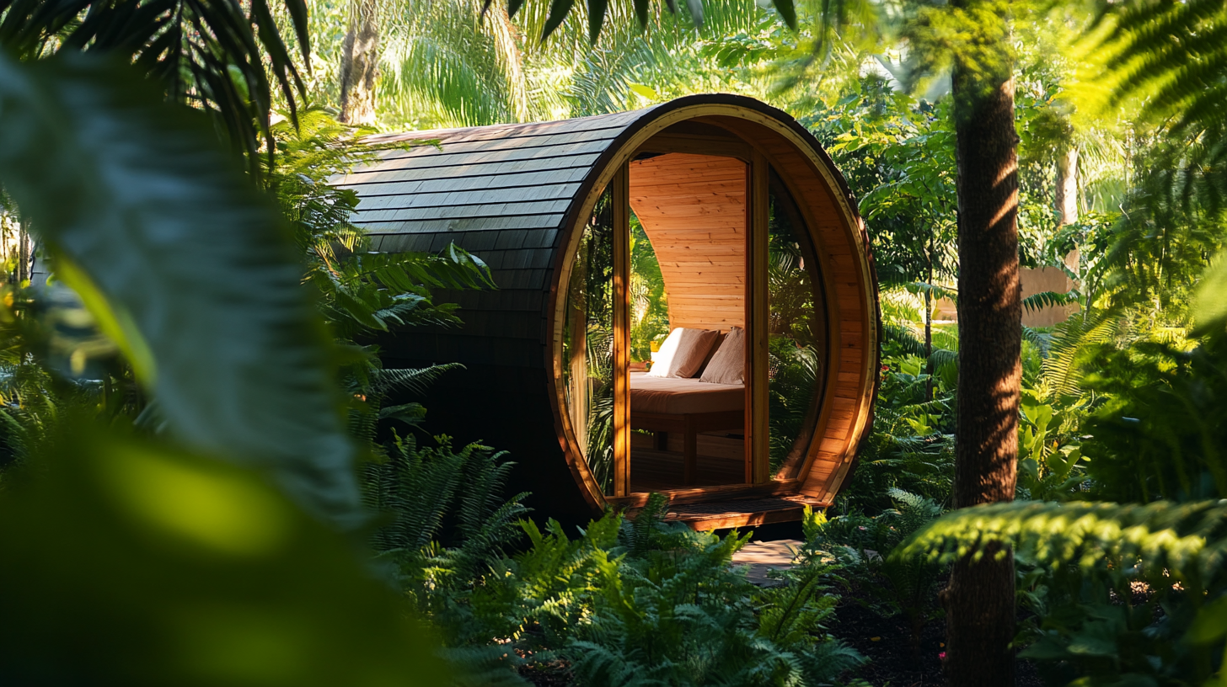
Donegal Local Development CLG (DLDC) , as Implementing Partner to the Donegal LCDC, supports businesses in a range of ways through the LEADER Programme.
LEADER in Ireland can help in many ways, including assisting in putting plans around your ideas, providing funding for studies and enabling capital funding for projects.
An example is when Francis and Deirdre Connolly realised their vision and developed a Glamping Site on their farm in Ardara, Co. Donegal, Ireland.
When they approached DLDC in 2018, they were directed to the LEADER Team which implements the Programme on behalf of the Donegal Local Community Development Committee (LCDC). They worked closely with Rural Development Manager Frank Kelly and LEADER Project Officer Laura Martin to submit an application for the development of “Owenea River Rest”. In January 2019, Francis and Deirdre were awarded €97,744.71 towards the development of the project.
Francis and Deirdre Connolly
Farm Accommodation, Ardara, Donegal

Slide 3
Meeting LEADER Objectives & Priorities
Owenea River Rest Tourism project was approved for LEADER funding as a new rural tourism business. It achieved LEADER objectives and priorities, assisting in diversifying the Rural Economy and, in turn, generating economic activity while helping to sustain and create employment in rural areas.
He added that “this project is a very good example of how LEADER funding can improve and benefit a local area like Ardara by attracting more people to visit, and which in turn will have a positive knock-on effect in the local area.
The project was funded under the theme of Economic Development, Enterprise Development, and Job Creation, specifically under the sub-theme of Rural Tourism. As a Farm Diversification Project, Francis was able to avail of a voluntary labour contribution as a farmer, which is of great benefit to projects like this one.
Note: LEADER is a rural development programme co-funded by the EU which operates a locally-led, bottom-up, approach to meeting the needs of local communities and businesses. The programme supports private enterprises and community groups in rural areas. LEADER forms part of Ireland’s multi-annual Rural Development Programme, which is co-financed by the EU and is part of the Common Agriculture Policy (CAP).

Slide 4
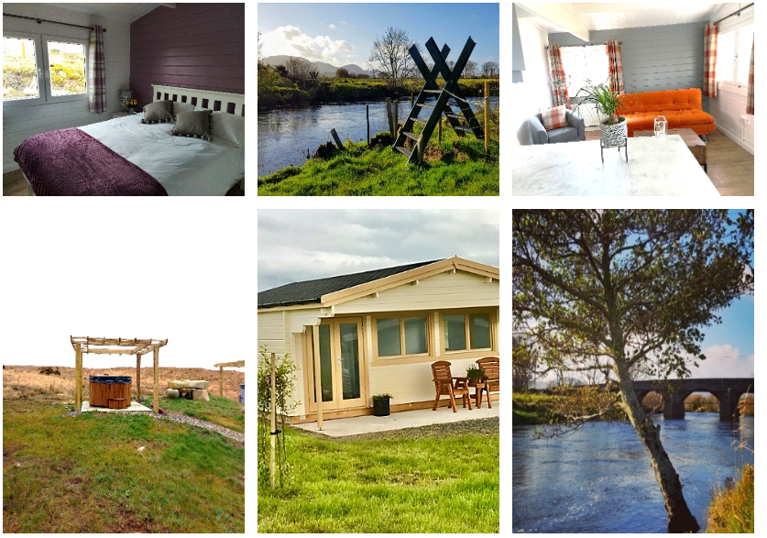

Slide 5
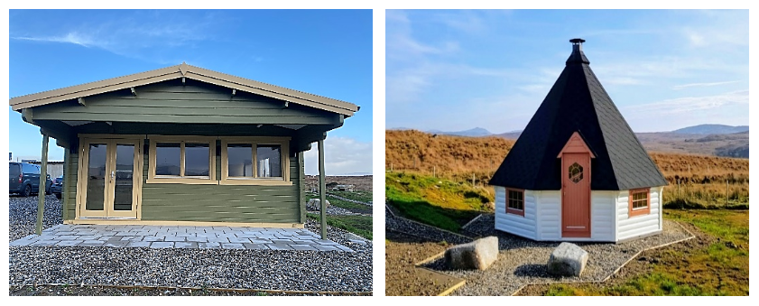
Approved Holiday Park with Four Accommodations
The 2-acre site has now successfully been converted into a Holiday Park with four individually designed luxury self-contained cabins (Moonrise Lodge, Mountain View, Sunset Haven and River Rest) complete with bathrooms, kitchens and living areas.
One of the cabins is also wheelchair accessible. This site also has three spaces for Campervans and it will also house a kids play area, barbeque facilities and car parking.
The Glamping Site is based in Tullycleave a very popular tourist location, close to Ardara and Portnoo and offers so much history, heritage, adventure and scenery, you’ll never fit it all in one visit! The 2-acre site allows visitors to have plenty of space/privacy, and also has access to a wide variety of attractions locally.

