Slide 1
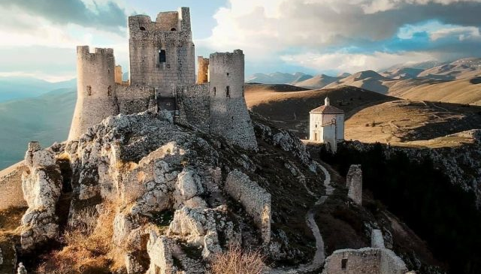

Accommodation Type:
Community Initiative:
The Calascio Community Cooperative, Società Cooperativa SCC, was founded with the aim of meeting the needs of the local community, improving the social and economic quality of life through the development of economic activities aimed at producing goods and services, restoring environmental and monumental assets, and creating employment opportunities.
Visit Calascio and Rocca Calascio. Immerse yourself in the authentic soul of these villages, discovering the history, breathtaking views, and flavors they have to offer...
Case Study
“The Vivi Calascio cooperative” (Co-operative), Spain
Website: https://www.vivicalascio.com/
1

Slide 2
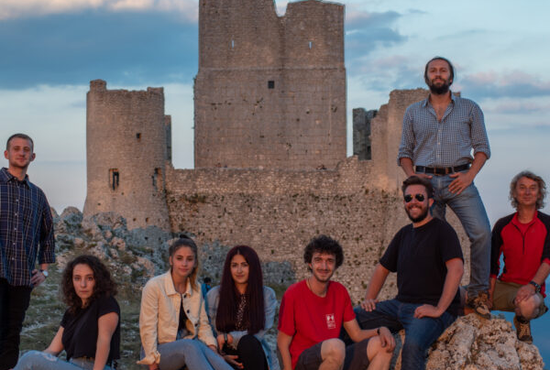
Case Study: “The Vivi Calascio cooperative” (Co-operative)
“The Vivi Calascio cooperative” is a specific example of a cooperativa di comunità. It’s based in Calascio, Abruzzo, and was created by 120 locals to revitalise their village by promoting tourism, pooling resources and grants for lodges, tours, restoring buildings, and offering tourism services that help both residents and visitors.
What they did: They were at risk of depopulation, despite having great historical, cultural, and landscape potential. The local socio-economic function of the community cooperative is tangible in the territory and has proven to be the real solution.
Website https://www.vivicalascio.com/

Slide 3
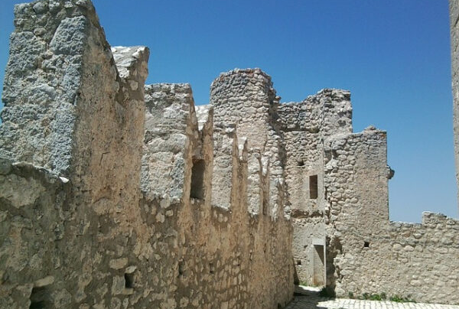


Case Study: “The Vivi Calascio cooperative” (Co-operative)
Outcome: Today, they get more than 30,000 annual visitors, manage important tourist flows, and offer professional, quality services that they are constantly improving.
Tip: If using personal or community money, treat it professionally – write a simple business plan and budget to show supporters. This builds confidence and also prepares you for approaching formal funders later.
EPIC STAYS is licensed
under CC BY-SA 4.0
Funded by the European Union. Views and opinions expressed are however those of the author(s) only and do not necessarily reflect those of the European Union or the European Education and Culture Executive Agency (EACEA). Neither the European Union nor EACEA can be held responsible for them.

