Slide 1
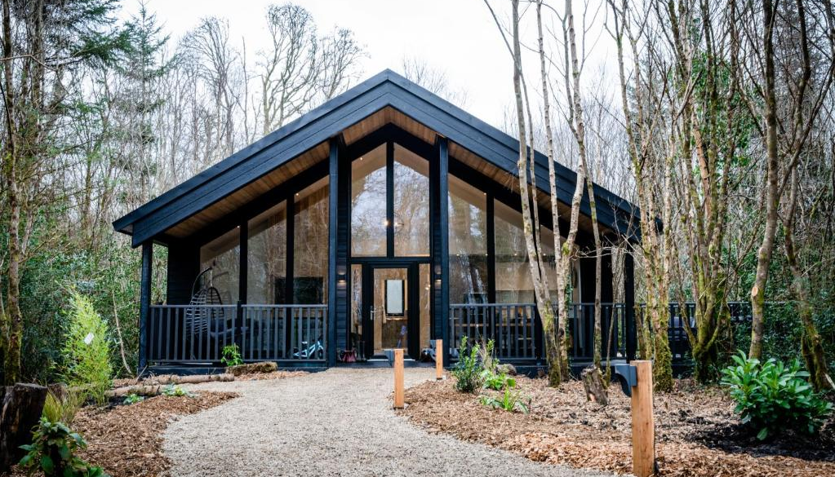

Hideaway Sanctuary
Discover your new sanctuary at Drumhierny Woodland Hideaway, a 100-acre estate, just waiting to be explored.
This exclusive Hideaway offers 16 stylish, luxurious, sustainable lodges nestled within their own private area of the woodland with 5km of tracks & trails throughout the Estate leading you to hidden fairy forts and on all sorts of adventures.
Case Study
Drumhierny Hideaway (Wellbeing Sanctuary), Ireland
Website https://www.drumhiernyhideaway.ie/en/
1

Slide 2
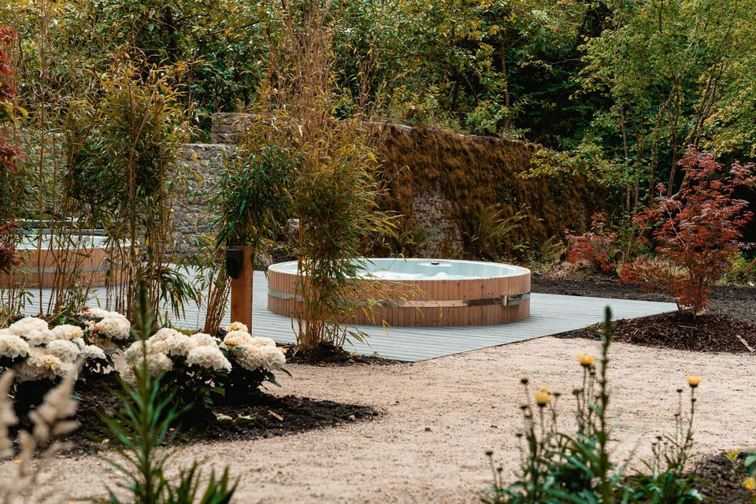
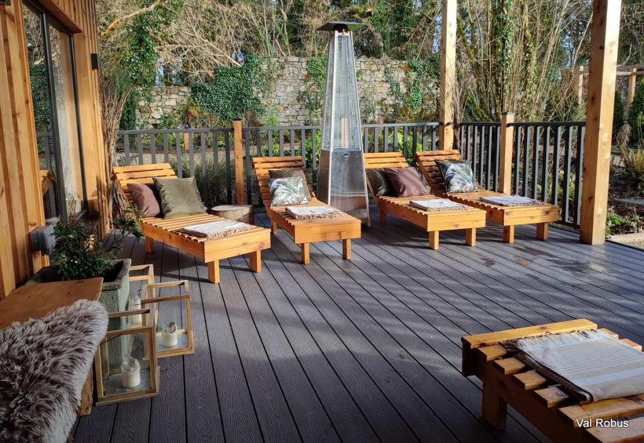
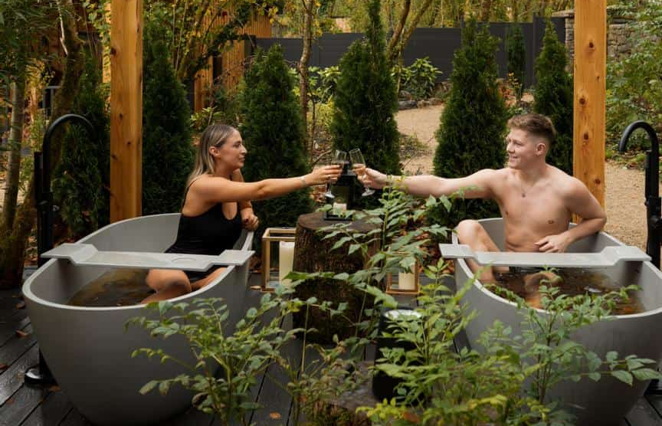


CASE STUDY: Drumhierny Hideaway (Wellbeing Sanctuary), Ireland
Photo Irish Independent
Photo Magnum Lady
Photo Leitrim Tourism
The Drumhierny Outdoor Wellbeing Sanctuary is a true haven of tranquillity, protected by historical walls and large oak trees that have been stewards of the estate for centuries. Guests enjoy the Sheemore Treatment Haven, which offers various treatments and Reiki. Seaweed woodland baths are filled with natural, hand-harvested local seaweed. Wooden-clad outdoor hot tubs with an oak tree canopy provide shelter. Sauna with outdoor cold plunge and rainforest shower, and relaxation area with outdoor fires and loungers. https://www.drumhiernyhideaway.ie/en/wellbeing/
EPIC STAYS is licensed
under CC BY-SA 4.0
Funded by the European Union. Views and opinions expressed are however those of the author(s) only and do not necessarily reflect those of the European Union or the European Education and Culture Executive Agency (EACEA). Neither the European Union nor EACEA can be held responsible for them.

Slide 3
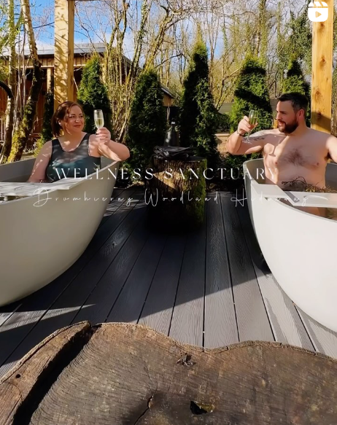
CASE STUDY: Drumhierny Hideaway (Wellbeing Sanctuary), Ireland
Fire & Ice Experience: Indulge in the ultimate relaxation with our exclusive Fire & Ice Package. Immerse yourself in a serene oasis where soothing heat and refreshing coolness blend harmoniously. Step into our luxurious sauna, letting the gentle warmth melt away tension & stress. Then, surrender to the blissful embrace of our rejuvenating hot tubs, providing the perfect respite for your body and mind. The journey doesn't end there - brace yourself for a revitalising plunge into our invigorating cold pool, leaving you feeling refreshed and invigorated. Finally, embrace nature in our outdoor showers, where cascading waters offer a delightful sensory experience.
The perfect union of Fire & Ice!
https://www.instagram.com/p/C4nWZgprQSW/?hl=en

Slide 4
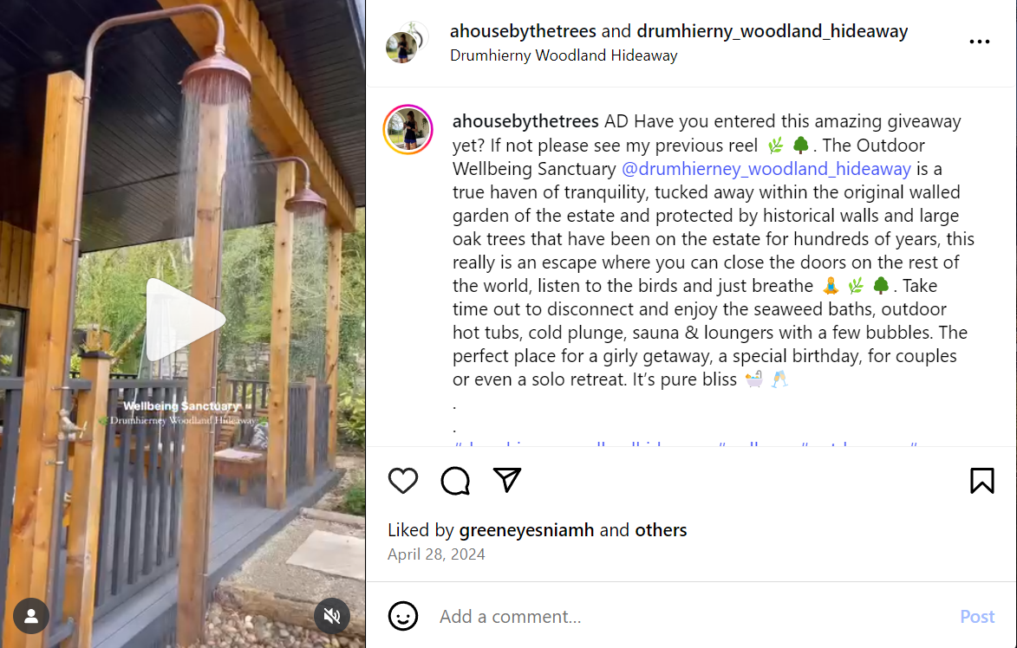
CASE STUDY: Drumhierny Hideaway (Wellbeing Sanctuary), Ireland
https://www.instagram.com/p/C6UOJoBP6V9/?hl=en

