Slide 1
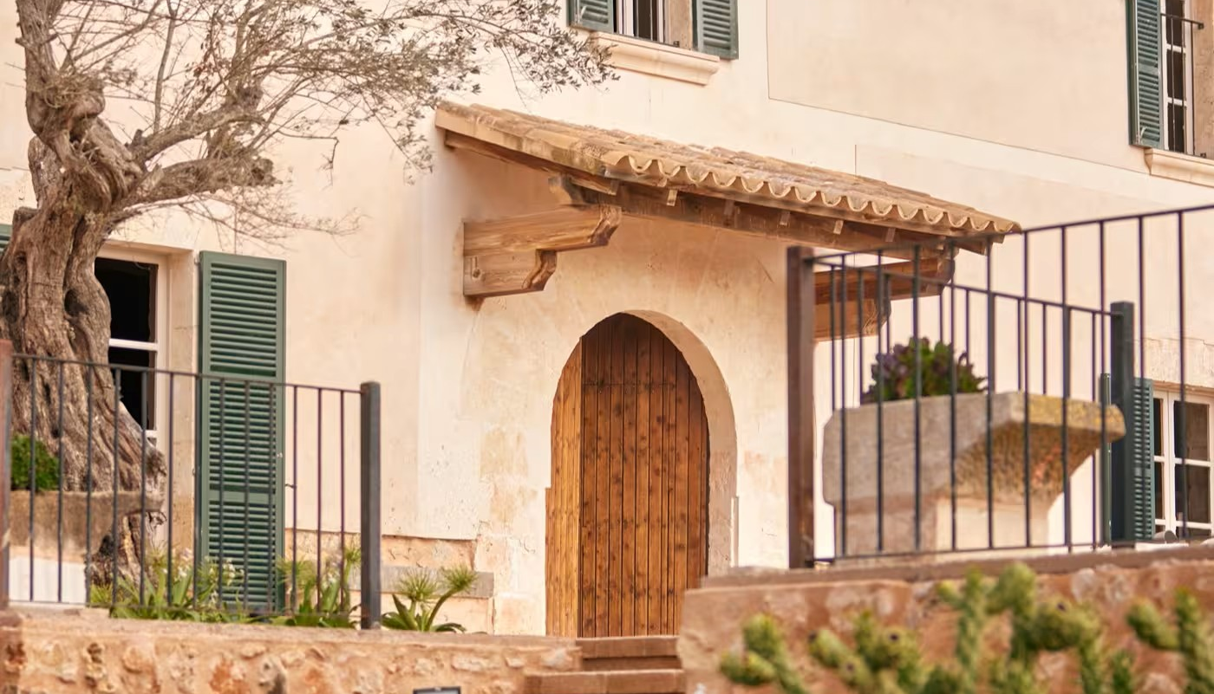

Photo Credit: Midgard Base Camp
The Beauty Of Simplicity
An agrotourism hotel full of history in the heart of nature
Son Sabater is a rambling restored 16th-century farmhouse with more than 20 hectares of holm oaks and carob trees, now converted into a superior 4-star agrotourism hotel. Located in the traditional town of Sa Pobla, very near Pollença and with views of the Serra de Tramuntana mountains
Case Study
Son Sabater (Eco-logic and Sustainable Country House), Sa Pobla, Spain
Website https://www.zafirohotels.com/en/son-sabater-by-zafiro/
1

Slide 2
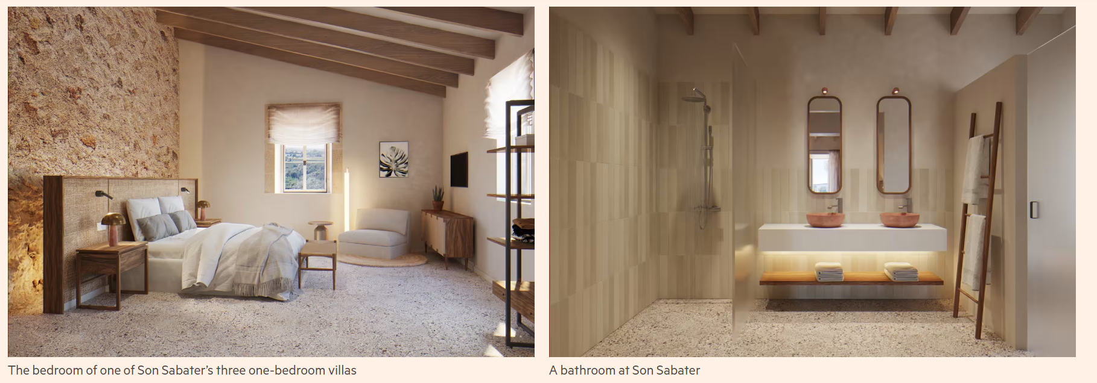


Case Study: Son Sabater (Eco-logic and Sustainable Country House), Sa Pobla, Spain
Images Financial Times
Son Sabater, has 15 rooms, including spacious suites and private villas with a terrace and garden, all of the accommodation reflects the character of the Plomer family and traditional Mediterranean style. High ceilings, exposed wooden beams and traditional Mallorcan stone walls. Spaces full of light, where the little details make all the difference.
EPIC STAYS is licensed
under CC BY-SA 4.0
Funded by the European Union. Views and opinions expressed are however those of the author(s) only and do not necessarily reflect those of the European Union or the European Education and Culture Executive Agency (EACEA). Neither the European Union nor EACEA can be held responsible for them.

Slide 3
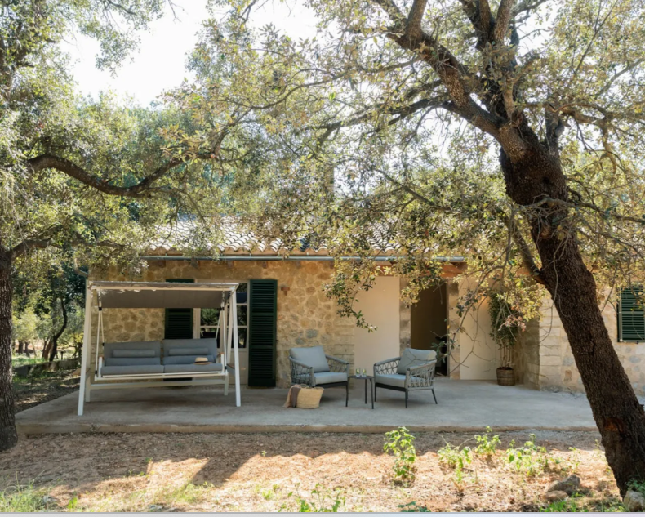
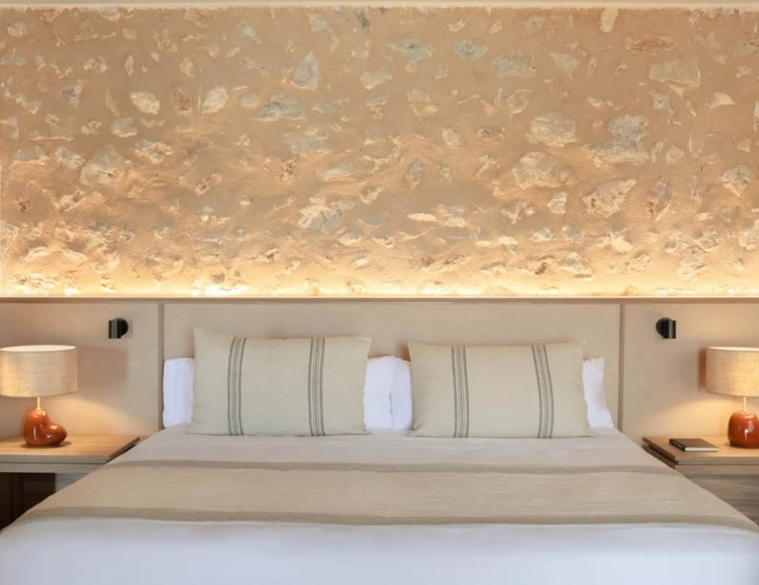
Case Study: Son Sabater (Eco-logic and Sustainable Country House), Sa Pobla, Spain
The Suites: Your oasis in in the heart of Mallorca
Waking at dawn to the sound of birds, on natural cotton sheets and with the aroma of holm oaks. The 15 rooms at Son Sabater by Zafiro, including spacious suites and private villas with a terrace and garden, are a reflection of the traditions of the island. Accompanied by a contemporary style applied by the interior designer of the Zafiro Palace Collection.
Our largest and most spacious Junior Suite. Ideal for disconnecting from stress and the city. A room full of rustic charm and extraordinary details, reflected in the natural materials such as stone and wood used in the decoration. A perfect refuge for enjoying a few days of peace and quiet in the countryside, far from the hustle and bustle.
https://www.zafirohotels.com/en/son-sabater-by-zafiro/suites/

