Slide 1
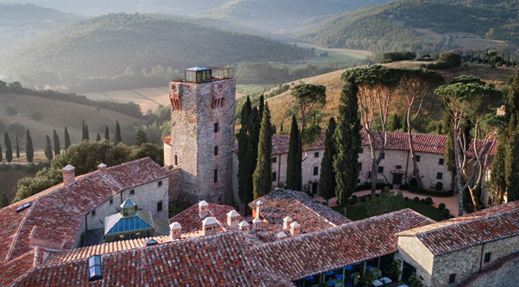

Photo Credit: Vogue.com
Accommodation Type:
Luxury Boutique Hotel
Start-Up Focus:
Restoration of a 1,000-year-old castle into an exclusive retreat blending historical authenticity with modern luxury.
Case Study
Castello Di Reschio, Umbria, Italy
Source https://www.vogue.com/article/castello-di- reschio-italian-hotel
Website: https://www.youtube.com/watch?v=G4wp
Y8UTQsM
1

Slide 2

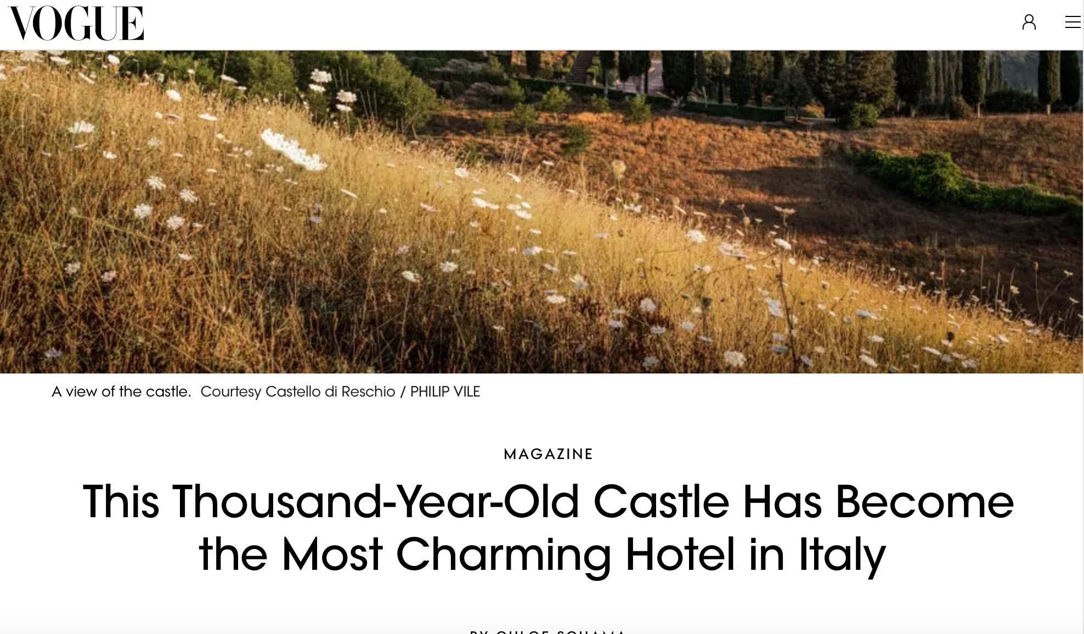
Case Study
Ecological Impact:
Emphasis on sustainable practices, including organic farming, renewable energy use, and preservation of local biodiversity.
Castello Di Reschio, Umbria, Italy
Click to Visit
Source https://www.vogue.com/article/castello-di- reschio-italian-hotel
Website: https://www.youtube.com/watch?v=G4wp
Y8UTQsM
2

Slide 3
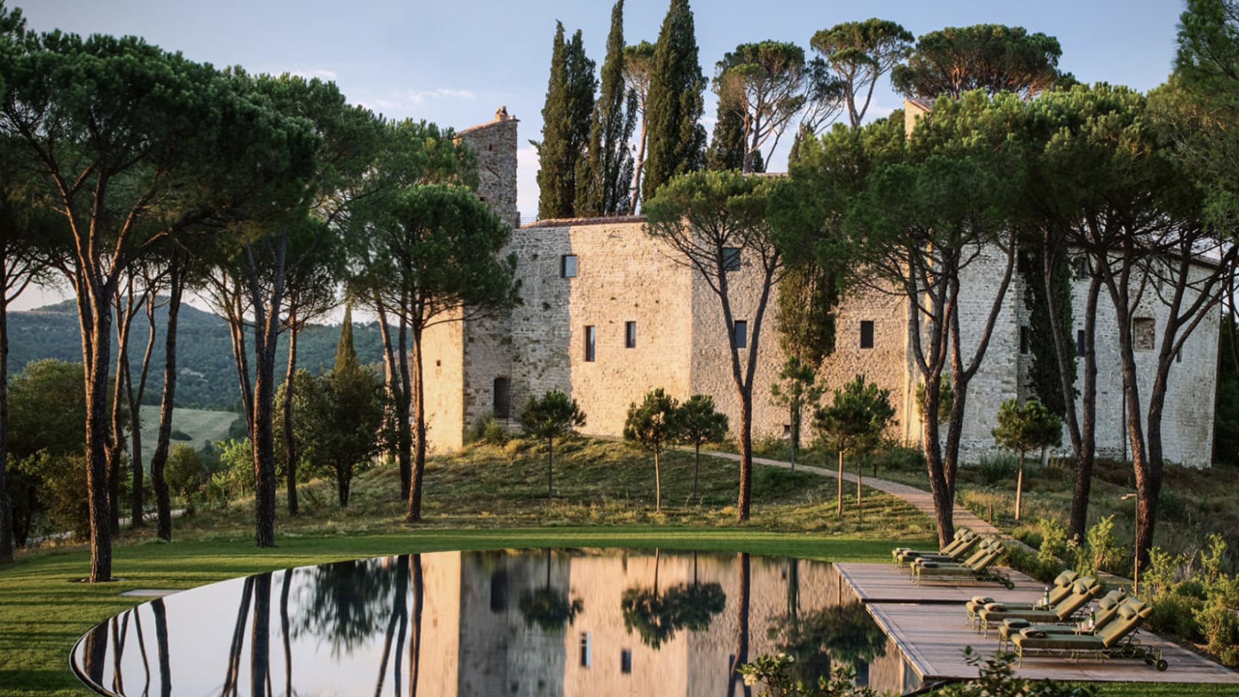
Click to Watch Video
Castello di Reschio
This video 1 is an interview with Count
Benedikt Bolza, the architect and visionary
behind the restoration of Castello di Reschio in Umbria, Italy.
In the video, Count Bolza discusses his family's journey in transforming a thousand-year-old castle into a luxurious hotel.
He elaborates on the meticulous restoration process, emphasizing the importance of preserving the castle's historical integrity while integrating modern comforts. The interview highlights his commitment to sustainability, the use of local artisans, and the challenges faced in adapting the ancient structure for contemporary hospitality.
Interview with Benedikt Bolza
Link: https://www.youtube.com/watch?v=l31LZpVNOyc
3

Slide 4
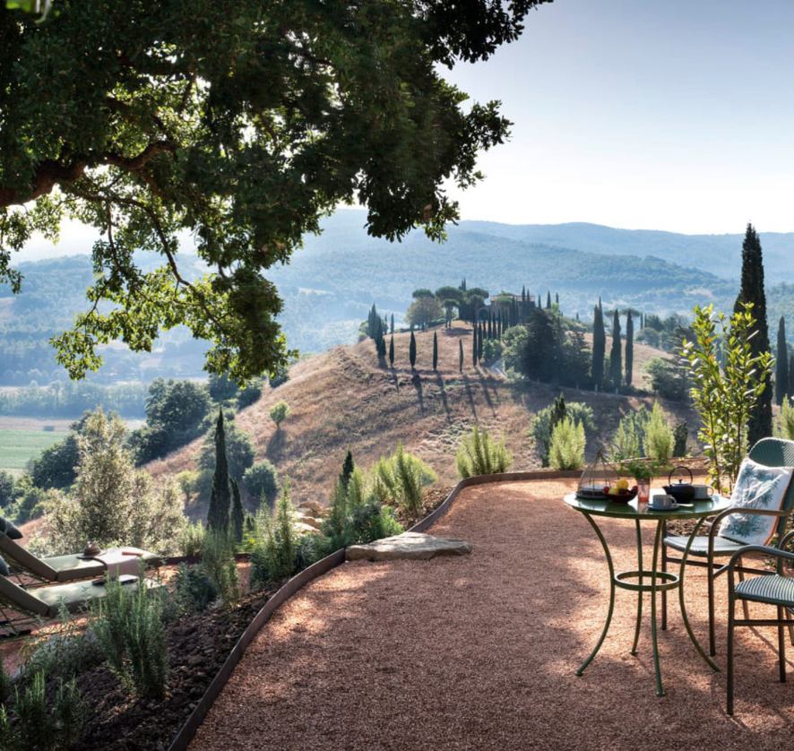


Alternative & Unique Accommodation:
Photo Credit: Cstel Reschio, Philip Vile
Castello di Reschio is a collection of luxurious, design-driven accommodations housed within a meticulously restored thousand-year-old castle estate in the heart of Umbria, Italy. Led by architect Count Benedikt Bolza, the project exemplifies how historical architecture can be transformed into exclusive, high-end hospitality while preserving authenticity.
The estate combines restored farmhouses, ancient stables, and the castle itself—each space retaining its original character while offering understated elegance, artisanal detail, and modern comfort. Guests experience an immersive connection to the region’s cultural and architectural heritage, surrounded by olive groves, forests, and rolling hills.
Castel Reschio, Umbria, Italy
EPIC STAYS is licensed
under CC BY-SA 4.0
Funded by the European Union. Views and opinions expressed are however those of the author(s) only and do not necessarily reflect those of the European Union or the European Education and Culture Executive Agency (EACEA). Neither the European Union nor EACEA can be held responsible for them.
4

Slide 5
Alternative & Accommodation - Financial Journey: :
Photo Credit: Cstel Reschio, Philip Vile
The restoration and transformation of Castello di Reschio were made possible through a long-term private family investment model, combining generational stewardship with a vision for sustainable luxury.
While not reliant on public grants, the project demonstrates how deep respect for craftsmanship, environmental sensitivity, and architectural heritage can create lasting value and a successful tourism venture rooted in place. It serves as a benchmark for integrating heritage conservation with modern hospitality in rural Europe.
Castel Reschio, Umbria, Italy
5

Slide 6
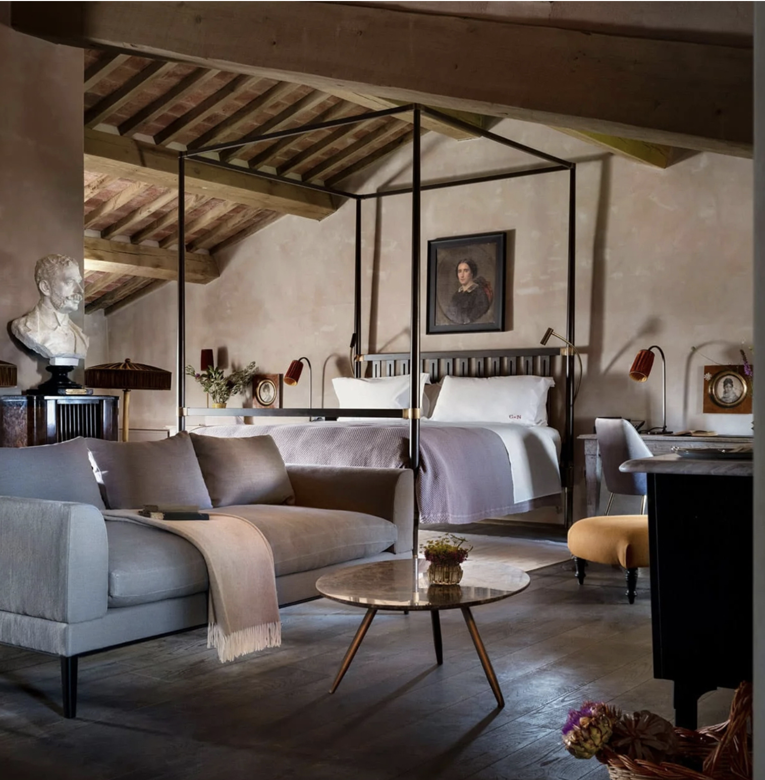
Key Takeaways
Castello di Reschio illustrates how heritage preservation and high-end design can coexist to create a timeless, immersive experience that resonates with luxury travelers seeking authenticity and tranquility. By blending centuries-old architecture with refined aesthetics, it shows how alternative accommodations can redefine luxury through storytelling, craftsmanship, and sustainable development.
Respect Heritage Without Compromising Luxury: Reschio proves that preserving historical identity does not mean sacrificing comfort. By restoring ancient buildings with artisanal techniques and minimal modern intrusion, it offers guests a rare experience of elegance rooted in place and time.
Photo Credit: Châteaux dans Les Arbes
6

Slide 7
Key Takeaways
Design Is a Storytelling Tool:
Every restored element at Reschio - from original stone walls to custom-made furniture - narrates a story. Thoughtful design choices deepen the guest experience and create emotional value, which is a competitive advantage in the premium tourism market.
Long-Term Vision Pays Off:
Reschio’s transformation was made possible through patient, family-led investment and careful stewardship of the land. It demonstrates the value of long-term thinking in tourism development, where quality, authenticity, and sustainability lead to a lasting brand.
Luxury and Nature Can Coexist:
By situating the restored structures within a biodiverse and protected estate, Reschio offers wellness, privacy, and nature immersion without disrupting the local ecosystem—responding to the growing demand for secluded, sustainable retreats.
7

