Slide 1
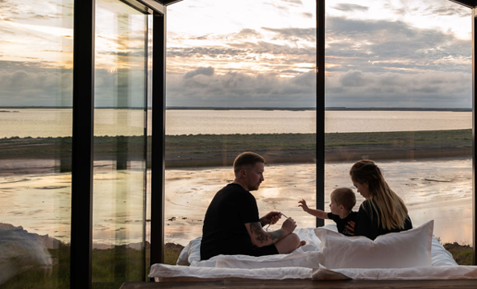

Photo Credit: Panorama Glass Lodge
Accommodation Type:
Scandinavian glass cabin igloo in Viking style
Concept:
Panorama Glass Lodge is a cluster of 23 m² micro-cabins whose walls and roofs are fully glazed over the bed. Each unit sits on screw-pile footings in remote South and West Iceland farmland, paired with a private geothermal hot-tub and minimalist Viking-inspired décor. The design turns the sky itself—aurora in winter, midnight sun in summer—into the room’s main feature while leaving a light footprint on the land.
Case Study
Panorama Glass Lodge, Iceland
Website: https://panoramaglasslodge.com/
1

Slide 2

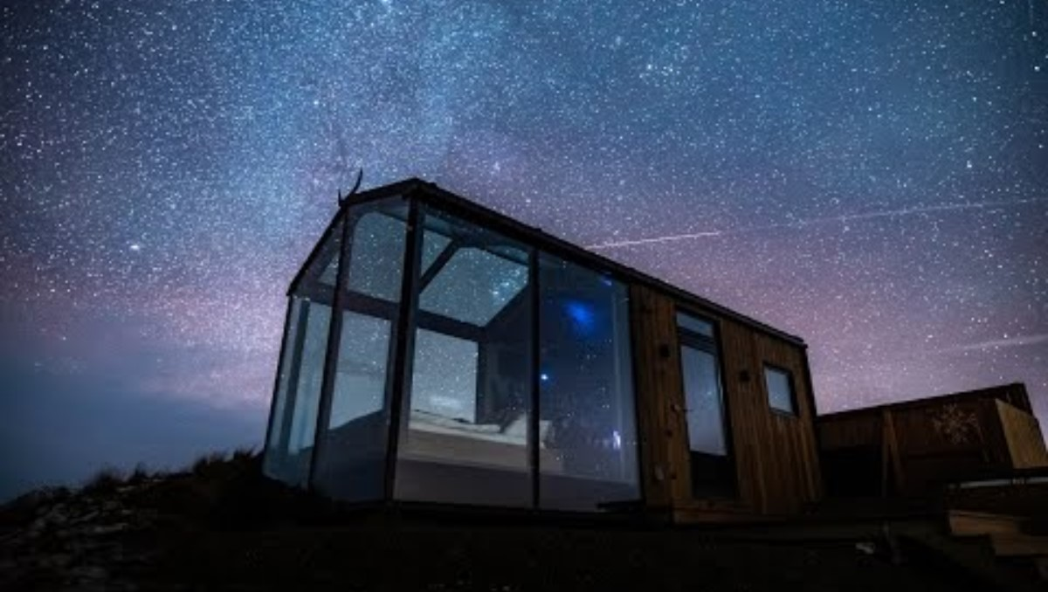
Case Study
Value Proposition:
Guests get a once-in-a-lifetime, camera-ready view of Iceland’s night- and day-skies without sacrificing spa-level comfort. By opening new booking dates only twice a year, the lodge creates scarcity that keeps occupancy above 90 % and supports premium rates (€430–950). The result is a highly sharable, ultra-private nature experience that commands both social-media buzz and repeat-free pricing power.
Panorama Glass Lodge, Iceland
Website: https://panoramaglasslodge.com/

