Slide 1
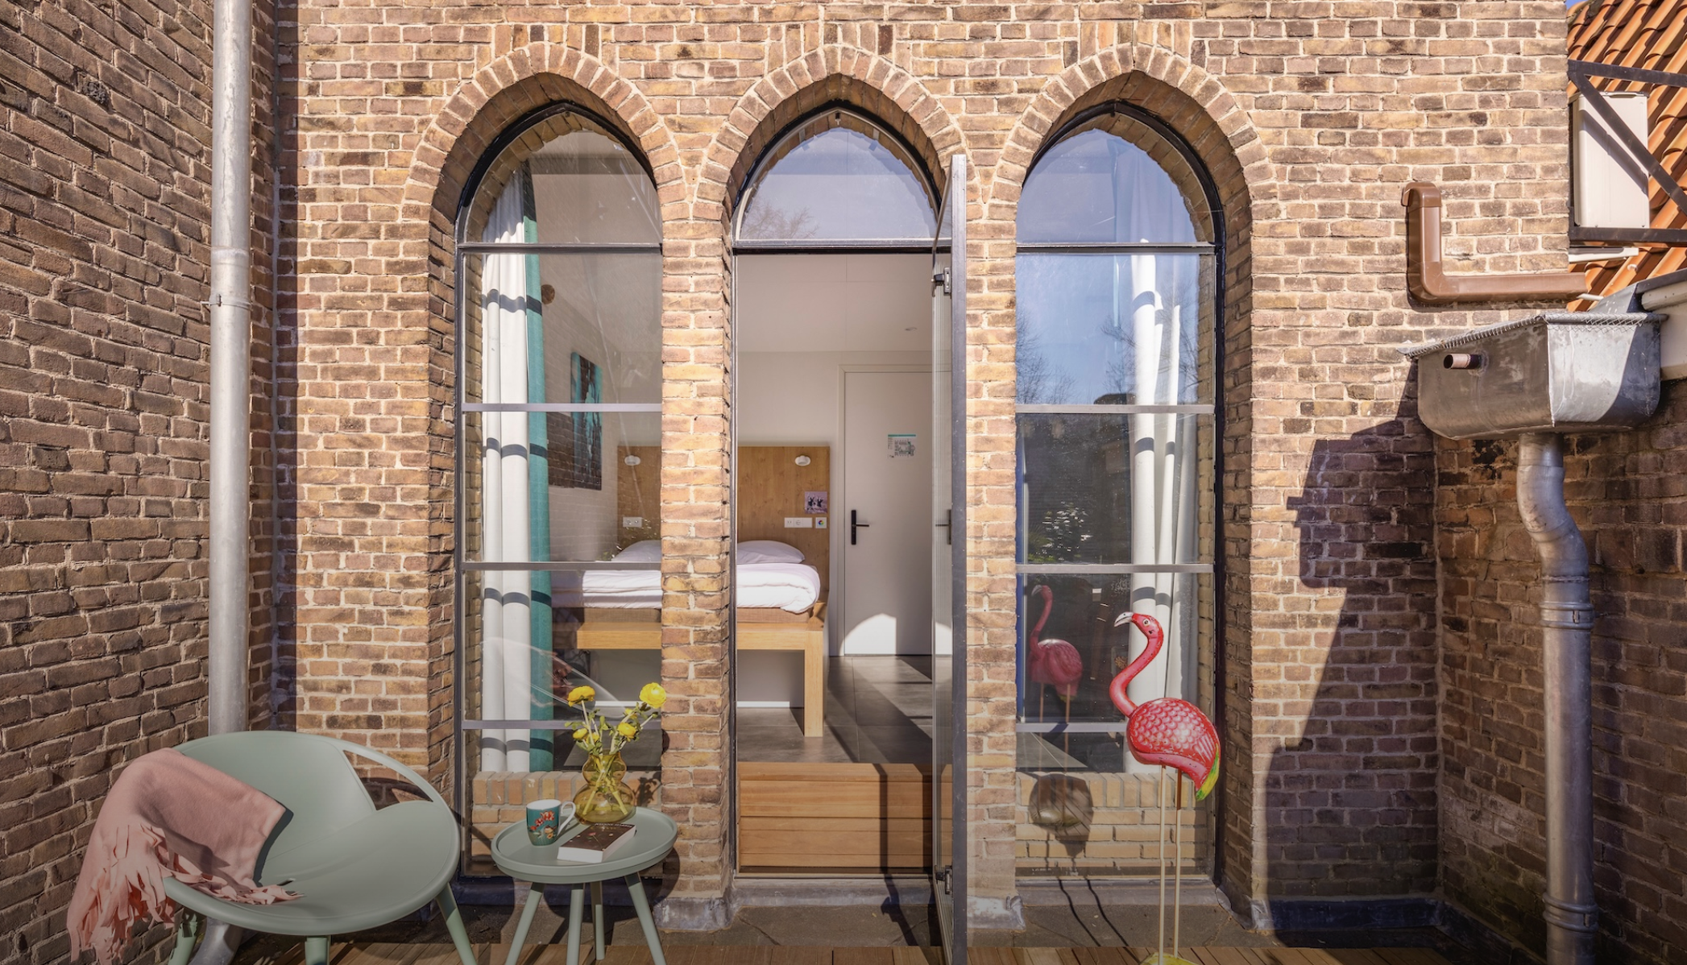


Accommodation Type:
Hotel & Hostel
Link with cultural events: An old church repurposed in a hotel with a focus on art, culture and local events (https://wearebunk.com/amsterdam/culture/)
Photo Credit: Bunk Amsterdam
Case Study
Information Sources: Hotel, Hostel, Restaurant
Website:https://wearebunk.com/amsterdam/
Bunk Amsterdam (Hotel & Hostel), Netherlands
EPIC STAYS is licensed
under CC BY-SA 4.0
Funded by the European Union. Views and opinions expressed are however those of the author(s) only and do not necessarily reflect those of the European Union or the European Education and Culture Executive Agency (EACEA). Neither the European Union nor EACEA can be held responsible for them.

Slide 2
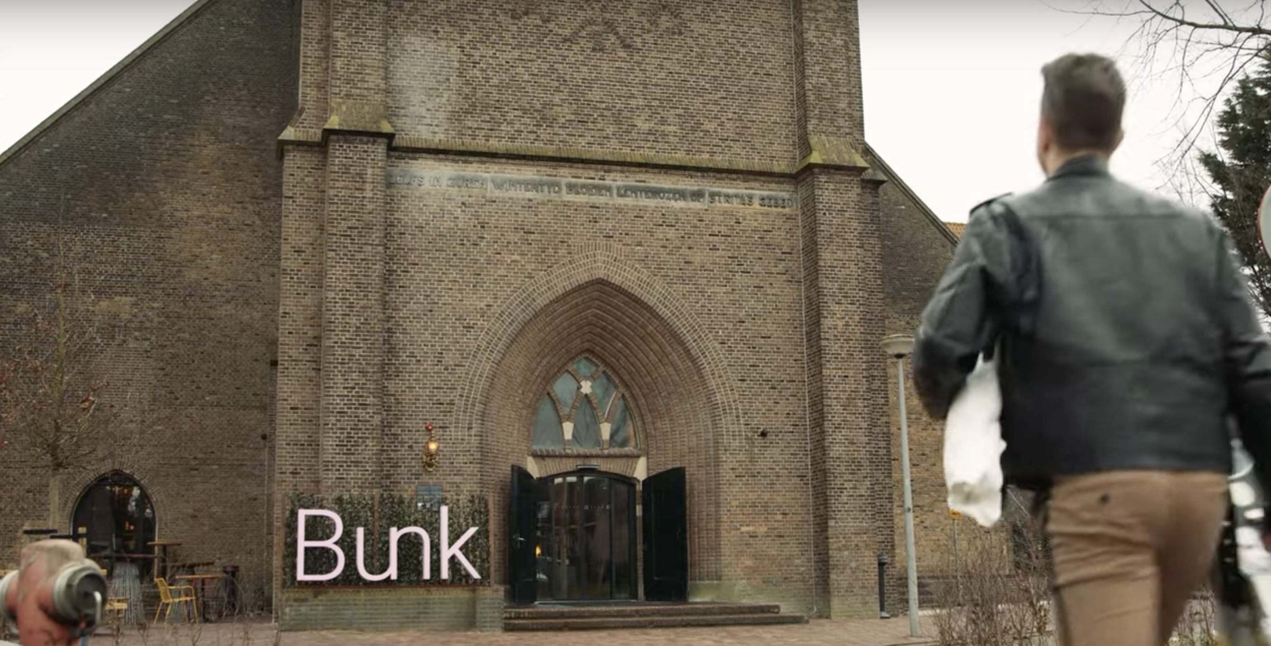
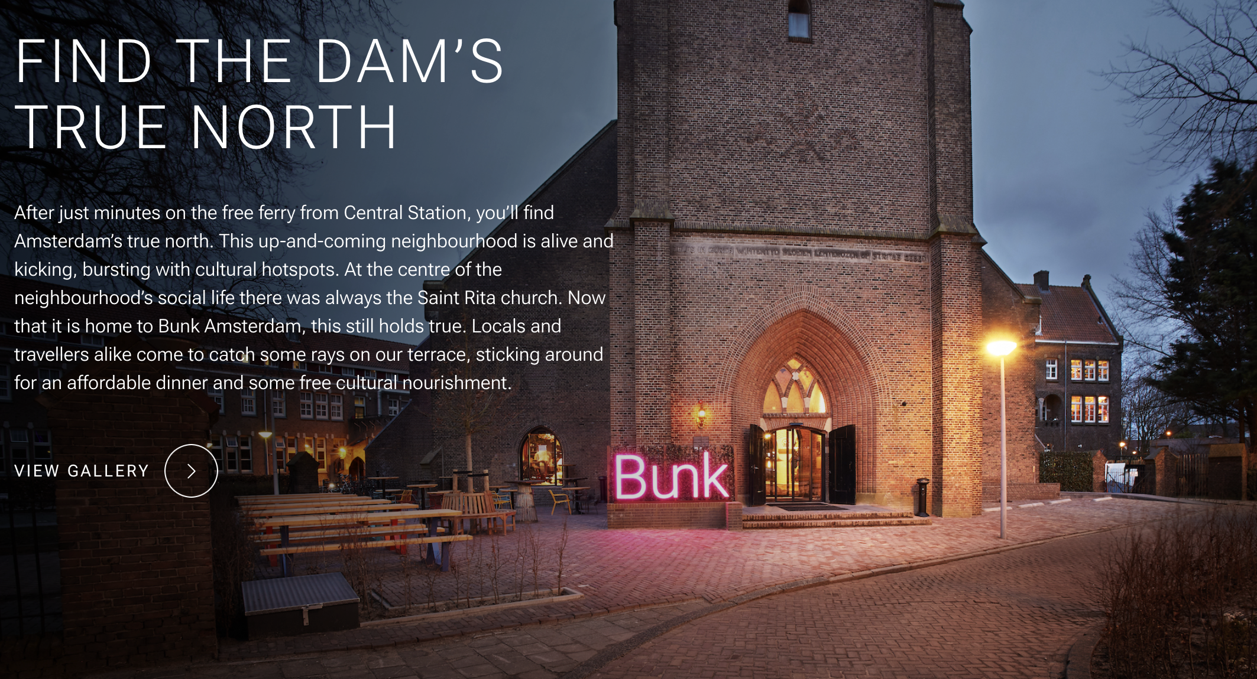
Click to See Videos
Link: https://www.youtube.com/watch?v=M2tUFbwW3-8
Click to Watch Video
Name: Bunk Amsterdam
Video Untold Stories Amsterdam: presents the Bunk Hotel in Amsterdam with a fresh and vibrant approach reflecting the hotel spirit.
Idea and Concept: Bunk Hotel Amsterdam, housed in a repurposed 1921 church in Amsterdam-Noord, seamlessly blends heritage architecture with modern design. It offers a unique stay experience featuring cozy rooms and pods, a vibrant restaurant, and communal spaces. Bunk is renowned for its cultural programming, hosting events like art exhibitions, live music, and workshops, fostering community engagement and supporting local artists.
Experience Bunk: Untold Stories

Slide 3
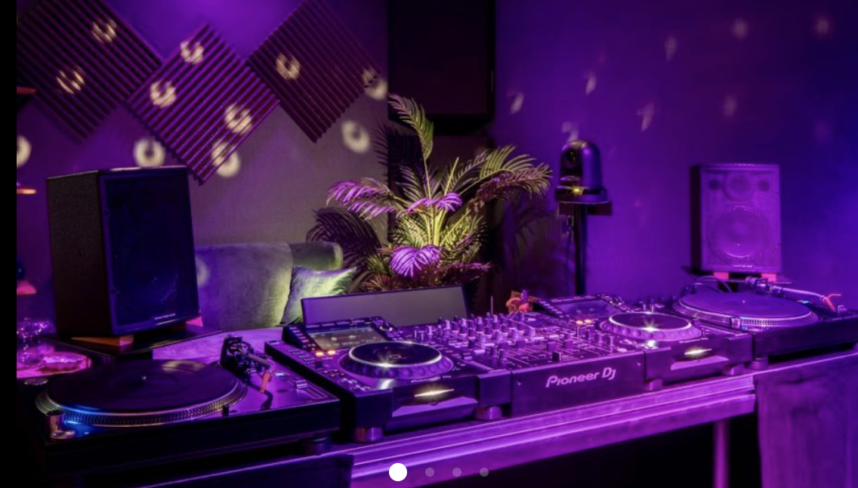
Amsterdam’s Cultural Pulse: Bunk Hotel’s integration of regular cultural events demonstrates how alternative accommodations can foster genuine community connections. By offering live performances and exhibitions, it transcends typical lodging, enriching guest experiences and embedding the property within the local creative ecosystem.
The Secret Music Studio: Providing a dedicated music studio highlights Bunk’s innovative approach to guest engagement. This facility supports creativity and cultural production, positioning the hotel as an incubator for local artists while enhancing its identity as a cultural hub beyond traditional hospitality.
Cast a Podcast: Bunk’s podcast recording space exemplifies how hospitality venues can empower guests to contribute to cultural storytelling. By facilitating media creation, the hotel encourages meaningful interaction with the community and adds layers of experience that deepen visitor connection and loyalty.
Photo Credit: Bunk Amsterdam
Bunk Amsterdam
Link with the city & its culture
3

Slide 4
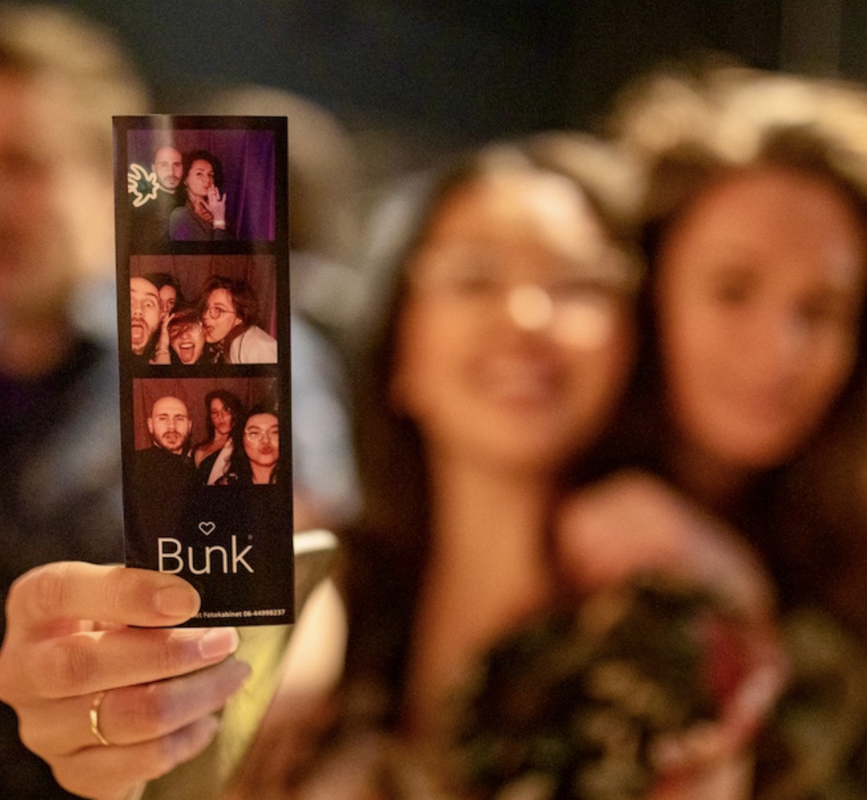
Key Takeaways
Culture as core experience: By integrating local art, music, and events into the guest experience, you cultural programming can transform your accommodation into a vibrant social space that reflect and support its urban or rural surroundings.
Space for creative production: By offering facilities like a secret music studio and podcast room, you can empower both guests and locals to create, reinforcing hospitality’s potential role as a platform for cultural expression.
Accessibility builds community: Through affordable stays, free cultural events, and inclusive design, hospitality spaces can welcome diverse audiences while serving as active participants in neighborhood life and social cohesion.
Photo Credit: Bunk Amsterdam

